Slide 1

HuskyLEAD
Planning an Event
From Start to Finish
Maryann Wilcox
Coordinator of Student Activities
Registered Student Organizations

Slide 2
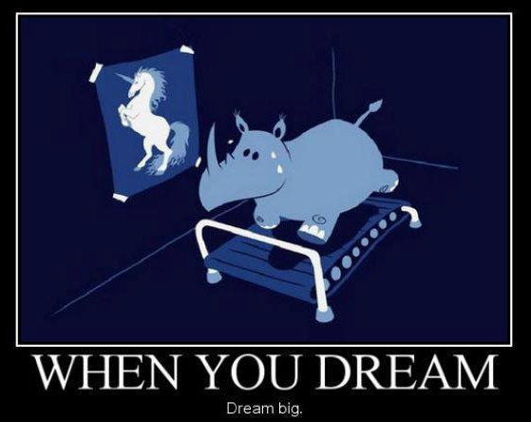
What is your idea?
Club Sports Tournaments
Roundtables
Talent Shows
Charity Events
Recruitment Events
Fundraisers
Go ahead - dream big!
Speakers
Performances
Video Game Tournaments
Cultural Events
Dances

Slide 3

The Basics
Let’s start chipping away……
Is it feasible?
Is there interest?
Get price quotes and available times of speakers or performers
Get price quotes from services on campus
Are there facilities that will accommodate your event?

Slide 4
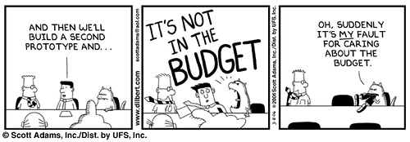
Let’s Run Some Numbers….
Facilities Fees
Licenses
Costumes
Food for Event
Proceeds?
Come up with a budget
Speaker/Performer Fee
-what does contract include?
Accommodations
Transportation
Posters/table tents
Advertising

Slide 5
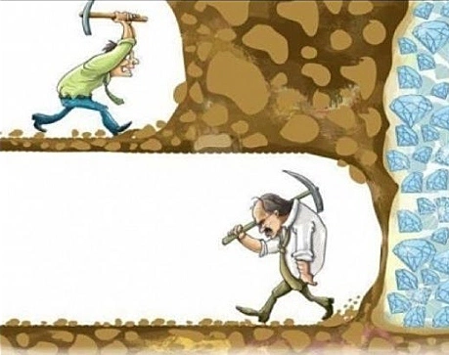
Don’t get discouraged!
Can you reasonably fund this?
You’ll be surprised!
It might take a little bit of elbow grease though.
You might have to pound the pavement.
Seek out funding sources
Seek donations from related departments
Charge a fee for admission?

Slide 6
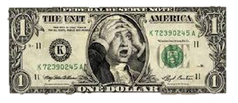
Funding Sources
Undergraduate Student Government
-Opportunities Fund
-Reserve Fund
Parents’ Fund
Alumni Association
Visiting Women Minority Lecturer/Scholar Series (VWMLS)
Graduate Student Government
Related Departments
Corporations
Alumni
Fundraising Events
Proceeds

Slide 7

Piggy-back with:
An academic department
-recommendations from Chair/Faculty
Another Student Organization
Another Campus Activity or Event
A Community Event
Another University
Midwest tours

Slide 8
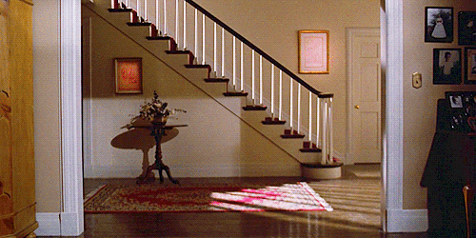
Is it Risky Business?
Risk Management Coordinator
-Jessie Stapleton, Student Activities
-Outside Space Request
Do you need to check with local authorities?
-Public Safety and Police Services
-Coast Guard
-City of Houghton

Slide 9
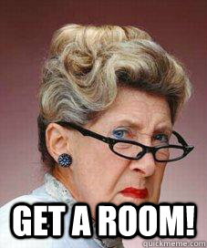
Book a Venue
Availability of venue is key!
-How many people are you guessing?
Rosza Center
-fees
-proceeds
Memorial Union Bldg.
SDC
-ice arena area
-Wood Gym
-parking lots
Grounds (e.g. Walker Lawn)
Lecture Halls (e.g. Fisher 135)
Community Venues
Continental Fire Company
Franklin Square Inn
Dee Stadium
Houghton County Arena
Copper Country Mall
Orpheum Theater
Brownstone Hall
Local Beach Areas

Slide 10
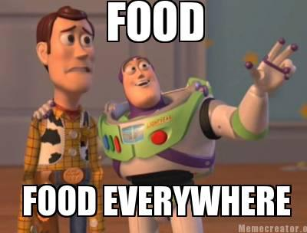
Order Some Food
Makes it Welcoming
Dining Services Policy at Michigan Tech
Community Venues
Fry up your own
-get a license first
-licensed kitchen
Dining Services Crossover

Slide 11

Need a contract?
Answer: Maybe
Get something in writing!
Programming Boards - yes
Philanthropic Speakers - probably not
Dancers and Acrobats – maybe
- clarify insurance

Slide 12
Alcohol Use at Student Org Events
It’s not prohibited - just follow the policy
Risk Management Plan
-T minus 30 days
University funds - general, SAF, or organizational – NO!
Unrestricted or public access to alcohol – NO!
-kegs
Drinking games, challenges, competitions, performance, contest - NO!
Co-sponsorship with alcohol distributor prohibited!
Room rentals OK
-not in the same room or area
Organizations may not profit financially from the event where alcohol is sold.
-fundraisers vs. charity events
Leave it up to the 3rd party
-Dining Services
-Magnuson
-Continental Fire Company
Alcohol can’t be used during recruitment events

Slide 13

Publicity
Lots of Free ways to publicize your event:
Student News Briefs
Tech Today
Involvement Link is a must!
WMTU
Electronic Display System (EDS)
DMG Community Events Calendar
-looking for story ideas
Get on a radio talk show
Social Media (Facebook, Twitter, etc.)
MUB Kiosk
Booth in the MUB, Fisher or any high traffic area
Word of Mouth
Chalking
Cheap ways to advertise your event:
Film Board
Lode Ad
Posters and table tents
-posting matrix, departments
-MUB manager’s office for tt policy
Bookmarks and “business cards”

Slide 14

Design a Poster
Recruit your organization’s talent
Hire a graphics artist
-Homestead Graphics
-use same for print services
Organization Sponsoring Event
What, where, when
-include day of week
Use of University Logo
-UMC Guideline for Student Orgs
Printing Services - get a quote
University Printing Services
Homestead Graphics
Book Concern Printers

Slide 15
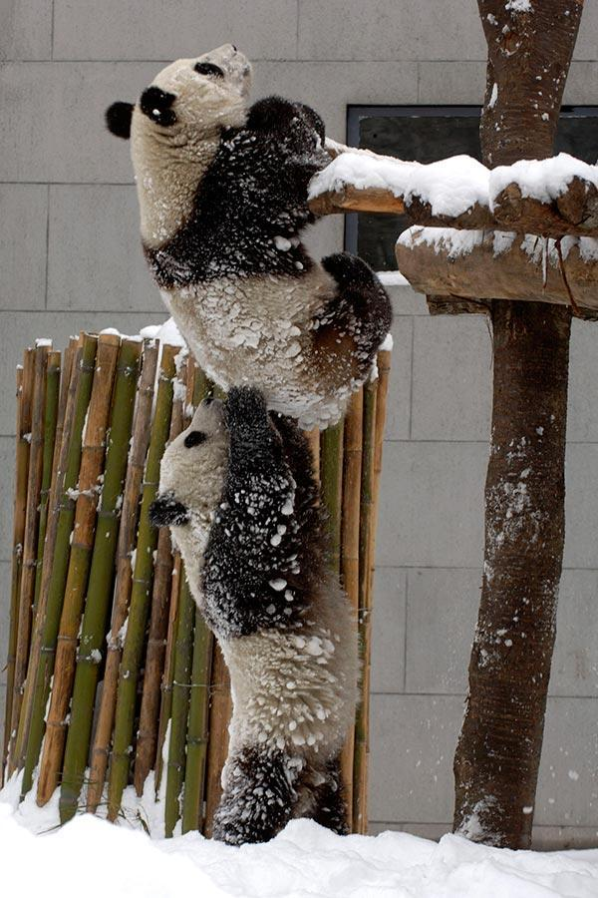
Other Orgs/Departments/Businesses
That Can Help You
Sound & Lighting Services (SLS)
Audio Engineering Society
Film Board
WMTU
The Lode
APO
Photography Club
-don’t forget to take pictures!
SDC Facilities - Recreation
-table and chair rental
Superior Rent-All
-tables & chairs
-tents
-helium tanks
-stages
Homestead Graphics
Superior Monogramming
The Book Concern Printers

Slide 16
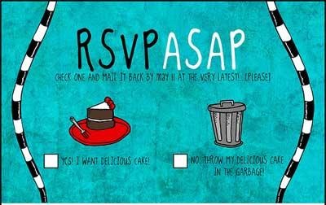
Need to Sign up?
RSVP’s
-formal dinners
-Evening With Industry
Sign-ups
-game tournaments
-3-on-3 teams
Take your chances
EventBrite
- online ticketing system
Ways to collect information:
Google Forms
Old-fashioned hard copy forms

Slide 17
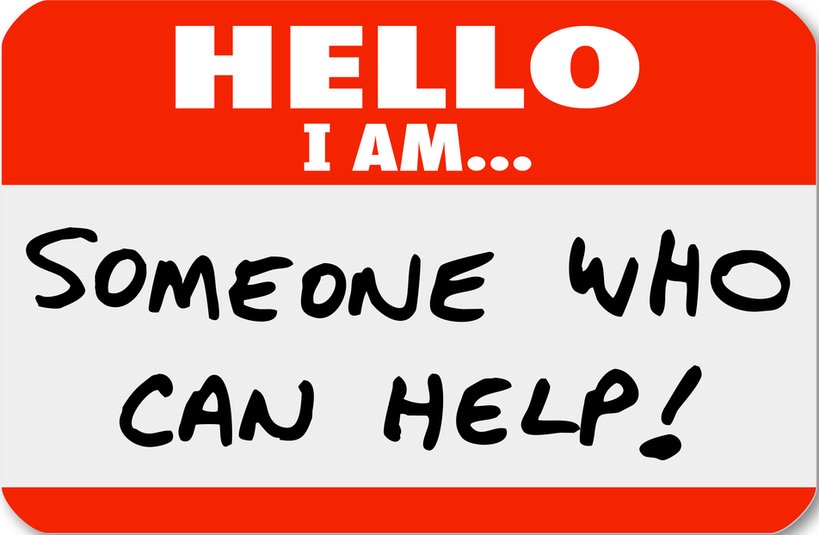
Speak to those who have gone before you
Talk, talk, talk, talk
Ask other successful (and not so successful) event planners
Talk to faculty, staff and advisors
Talk to MUB Board, SEB and other programming organizations

Slide 18

Accounting (big yawn)
Organization Checking Accounts
USG Funds
GSG
Parents Fund
Other Departments
Inter-account billing
Check Requests
Purchase orders
Independent Contractors
Michigan Tech Fund
-Corporate Donations
-Taxes!
-Cohesiveness

Slide 19

With Student Activities, all things are possible!
We can guide you!
Overall planning of your event
Room reservations
Coordinating finances
Publicity ideas
Where to go for what
Who does what
What are the policies and guidelines
MUB Kiosk
Community resources
Funding sources
Accessing your funding
University services
Contacts for other orgs

Slide 20

Recipes for Disaster
Not planning ahead
Not seeking help
Not talking to other people
Not planning your advertising properly
-Not too early; not too late
Not advertising at all
Not checking the University calendar
Not anticipating nationwide popular events
What is the first word of everything listed?

Slide 21

Wrap It Up
Plan for clean-up
Send thank yous
Pay your bills
Assessment
-Improvements
-Fresh ideas for next year
-Demographics
-Best times
-Best locations
SurveyMonkey
Google Forms
Old-fashioned paper forms or cards
Keep records - documentation

Slide 22

Questions or Ideas?

