Slide 1

Welcome to
University Senate!

Slide 2
Just Another Thursday
“About once a month, on scores of college and university campuses around the United States, dozens or hundreds of people mill into the auditorium, resigned to the fact that it’s going to be a while. There is gavel-pounding. There is heated debate over comma vs. semicolon usage in biology department literature. The institution’s president is barraged with questions. And, yes, there are PowerPoint presentations.” - J.B. Jones, Chronicle of Higher Education, Sept. 2011

Slide 3
University Senate Vision
“The University Senate will be regarded as a respected, relevant and independent representative body that leads by promoting faculty and staff interests in the shared governance of the University. Its actions support the University mission and the day-to-day professional activities of faculty and staff. The University Senate is an active partner in University decisions affecting academic and administrative affairs.”

Slide 4
Role in Supporting this Vision
Provide oversight of academic quality by promoting a rigorous and relevant curriculum with attractive and innovative degree programs that best serve students and society
Serve as the legislative authority for academic policies and educational guidelines that encourage and ensure student learning
Promote ethical behavior, professional discourse, and mutual respect among all members of the University community
Ensure that academic freedom and tenure is encouraged and protected in all forms
Provide a source of advice and support for the University administration and Board of Trustees by making recommendations regarding faculty and professional staff issues, University finances, compensation, and the workplace environment

Slide 5
“A-List” Items
All curricular matters, including establishment, dissolution, and changes in degree programs
Requirements for certificates and academic degrees
Regulations regarding attendance, examinations, grading, scholastic standing, probation, and honors
Teaching quality and the evaluation of teaching
The appointment, promotion, tenure, dismissal, and leaves of academic faculty
Criteria for positions that are to be accorded academic rank
Regulations concerning the awarding of honorary degrees
Requirements and criteria for unit charters for each academic department
Other areas under authority as may be granted by the Board of Trustees, the University President, or their designated representative

Slide 6
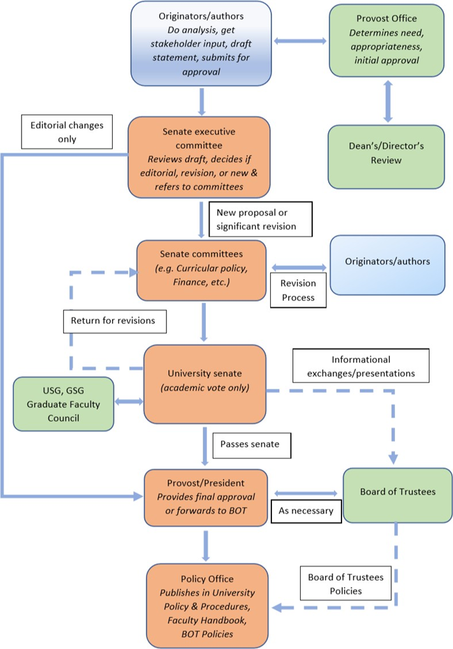
Academic Policy Flow

Slide 7
“B-List” Examples
Fringe benefits
Prioritization of the university's human, fiscal, and physical resources
The Van Pelt Library, computing facilities, audiovisual support, Lauren Bookstore, A.E. Seaman Mineral Museum, et cetera as they affect scholarly, instructional, and research activities
Admission standards and procedures
Student financial aid
Selection and review of the University President, the Provost, and other upper administrators
Administrative procedures and organizational structure

Slide 8
University Senate Functions
Take action in our role as the chief advocate for faculty and professional staff, and use our granted authority on academic policy and shared governance matters
Provide faculty and professional staff feedback to the administration, university committees, and the Board of Trustees when requested
Inform our constituents about current university activities, plans, and policy changes
There are three main categories of meeting agenda items:
  Reports
  Informational items - memos
  Action items - proposals

Slide 9
Agenda Items
Reports may be provided by the president and/or committee chairs as needed
Information items are points of business not requiring action
Action items (proposals) require approval and are discussed and debated over two meetings

Slide 10
Action Items (Continued)
Listed under New Business at the first meeting, background on the topic is provided and initial discussion occurs. Debate is not necessary, but senators seek feedback from their constituents
The proposal returns as Old Business with motion to accept, followed by debate, and one of the following actions:
  Voted up or down
  Send back to committee for revision and resubmission
  Modified via amendments, which are handled separately prior to the vote on the original motion
  Time extension, tabling, or referral to committee if necessary

Slide 11
Rules of Order
Familiarize yourself with Robert’s Rules of Order
  “Cheat sheet” provided on Senate website, copy in senate office
  Voting on motions
    Unanimous consent
    Acclamation – most typical
    Roll-call
    Ballot – takes precedence over all others
  Debate – moderated by the chair
    Only senators speak, when called on by the chair
    Senators are limited to one comment and one retort per discussion
  Legitimate interruptions to the debate process:
    Point of order – question of procedure to the chair
    Point of information – question of expertise to another senator or visitor
    Point of inquiry – request for clarification on a proposal
    *Point of personal privilege – addressing personal comfort/safety (rare)*

Slide 12
General Productivity
Come prepared and engage in the process
  Read materials in advance and prepare questions
  Provide feedback to committees before meetings
  Have questions ready
  Bring alternative views/perspectives to debate
  Focus on issues, not individuals
Act in good faith and assume others are doing the same
Value everyone’s time

