Slide 1
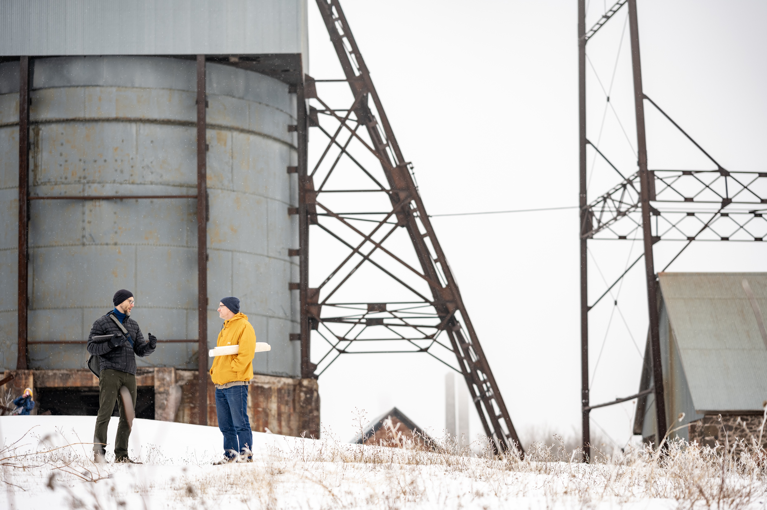

Campaign Orientation
MICHIGAN TECH | MARCH 2023

Slide 2
OUR SERVICES
FUNDRAISING CAMPAIGNS
INTERIM DEVELOPMENT MANAGEMENT
DATA ANALYTICS, SYSTEMS, & RESEARCH
ASSESSMENTS & AUDITS
STRATEGIC PLANNING
TRAINING & LEADERSHIP DEVELOPMENT
SYSTEMS PROJECTS
FEASIBILITY STUDIES

Slide 3



















A SAMPLE OF OUR WORK IN HIGHER EDUCATION

Slide 4
Campaign priorities
Our goal is to raise $350 million to strengthen our unique educational experience.
$110M: Provide undergraduate scholarships and graduate student fellowships to attract talented and motivated students
$100M: Recruit and retain top faculty whose teaching and research will advance technology horizons and bring prestige the University
$35M: Endow centers of excellence to drive research, innovation, and knowledge building
$87.5M: Build and modernize the campus to meet the challenges for education in the 21st century
$17.5M: Enhance the Michigan Tech Experience for students, alumni and the community
10%
25%
5%
29%
31%
Notes:
We see roughly a third of higher-ed campaign goals dedicated to some form of endowment fundraising

Slide 5

ARC OF A SUCCESSFUL CAMPAIGN
QUIET PHASE
Strategic
Planning
Acceleration Phase
Organizational
Phase
Leadership &
Major Gifts
Public Phase
Affirm mission
Test case
Solidify Case
Lead gifts
Public launch
Future vision
Goal
Prospecting
Steering Committee
Communications
Strategies
Timeline
Recognition
Participation
Financial plan
Strategy
CAFG
Cultivation
Stewardship
Resource / Staffing
20-30% of goal
70-80% of goal
Over goal
You are here

Slide 6

Acceleration Phase
KEY TAKEAWAYS | HIGHLIGHTS
Notes:
Some of you know, some new. Recap the steps we’ve taken, where we are now, and our immediate future. Began with

Slide 7

Highlights
Michigan Tech invited approximately 60+ stakeholders across various constituencies to participate.
01
From this group, CCS conducted 27 interviews with 29 individuals.
02
Participants included current and former members of the Board of Trustees, members of the Michigan Tech Fund Board, and many current and former members of advisory boards for specific schools.
03

Slide 8
MTU COMPARES FAVORABLY TO BENCHMARKS FOR READINESS
Several key markers demonstrate MTU’s readiness to continue campaign design based on comparative CCS benchmarks.
Participant Perspective | Michigan Tech | All CCS Higher Ed Studies | All CCS Studies Since March 2020
Overall Positive Perception | 92% | 76% | 86%
Positive Reaction to the Case?* | 100% | 81% | 81%
Goal is Seen as Achievable? | 88% | 40% | 41%
Is Now the Right Time? | 96% | 78% | 81%
Consider a Gift to the Campaign? | 88% | 76% | 90%
Highest or High Philanthropic Priority? | 100% | 70% | 63%
Serve as a Campaign Leader?** | 75% | 45% | 39%
Serve on a Committee? | 83% | 63% | 66%
Solicit Gifts from Others? | 83% | 52% | 67%
*Includes “very positive” and “positive” responses
**Includes “yes” and “maybe” responses

Slide 9

NEXT STEPS
Notes:
Adjust transparency for photo and legibility

Slide 10
A successful campaign team
Prospects / Donors
Advancement Team
Board
President
Provost/Deans/Campus Community
Board
Advancement Team
Prospects/ Donors
President
Provosts/ Deans
■ 10
Notes:
- A successful campaign includes not just the Advancement team, but also members of the Board, Deans, the President, and the donors/volunteers themselves.

Slide 11

Thank You

