Slide 1
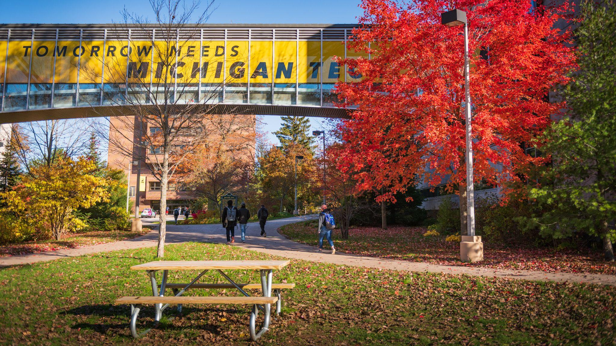
Enrollment Update
Senate/USG
March 1, 2023

Slide 2
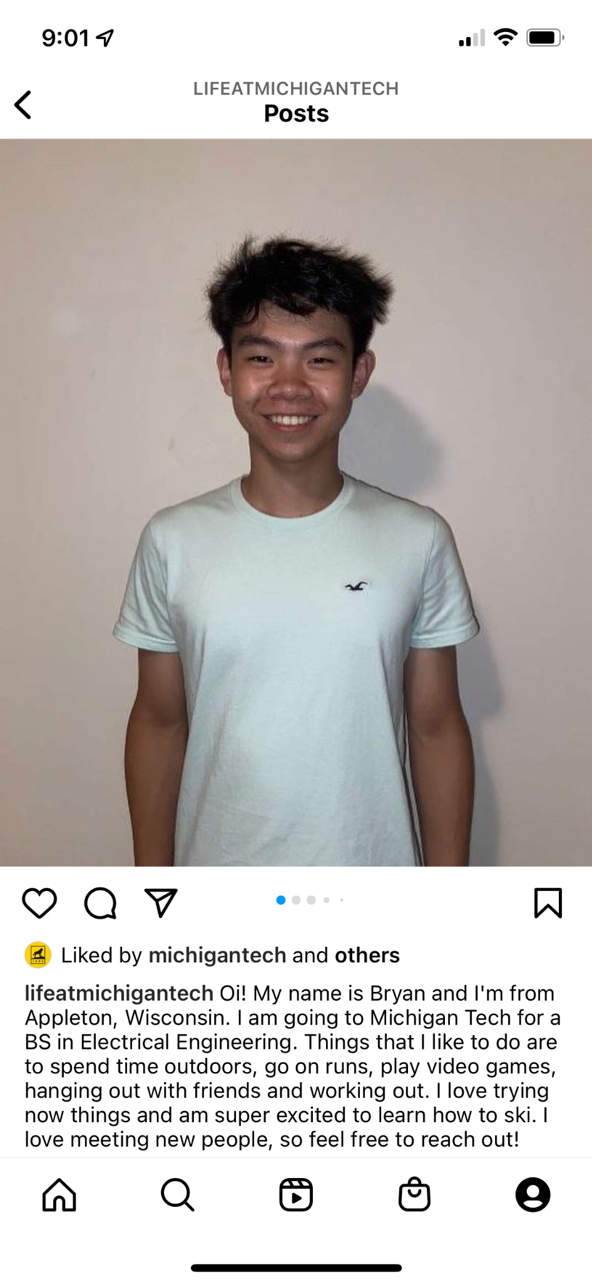
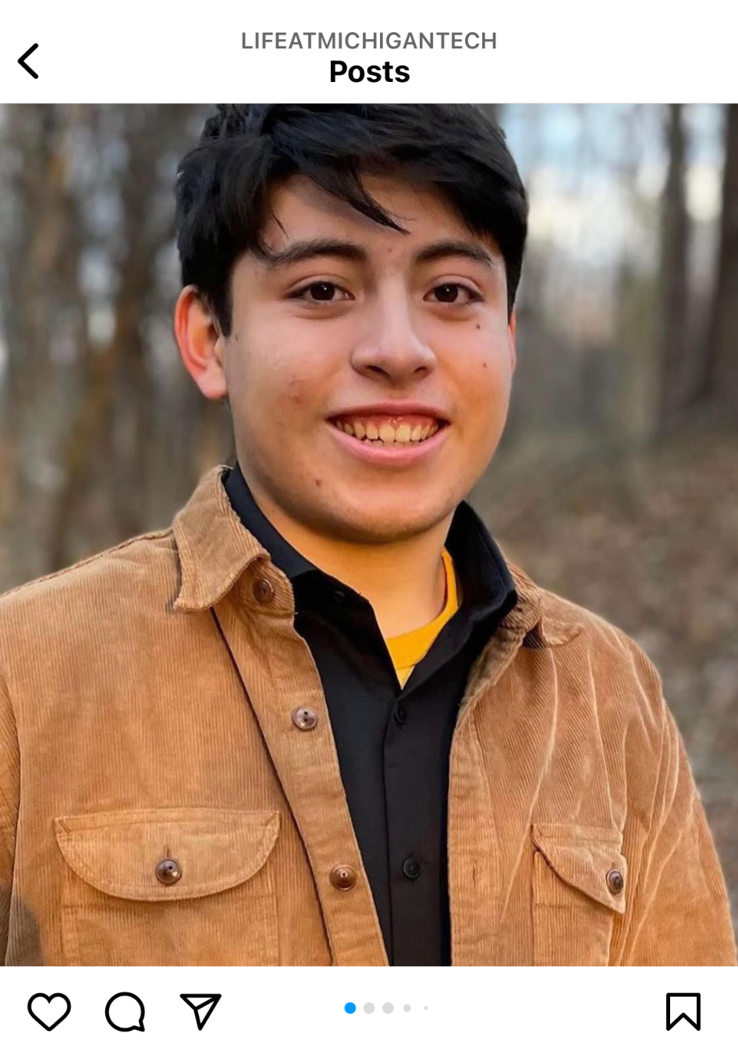
Allison Lewis
Class of ‘26
Theatre & Entertainment Tech
Micaela Geborkoff
Class of ‘26
Medical Lab Science
Bryan Zhang
Class of ‘26
Electrical Engineering
Daniel Martinez
Class of ‘26
Civil Engineering
Abby Leagjeld
Class of ‘26
Biomedical Engineering

Slide 3
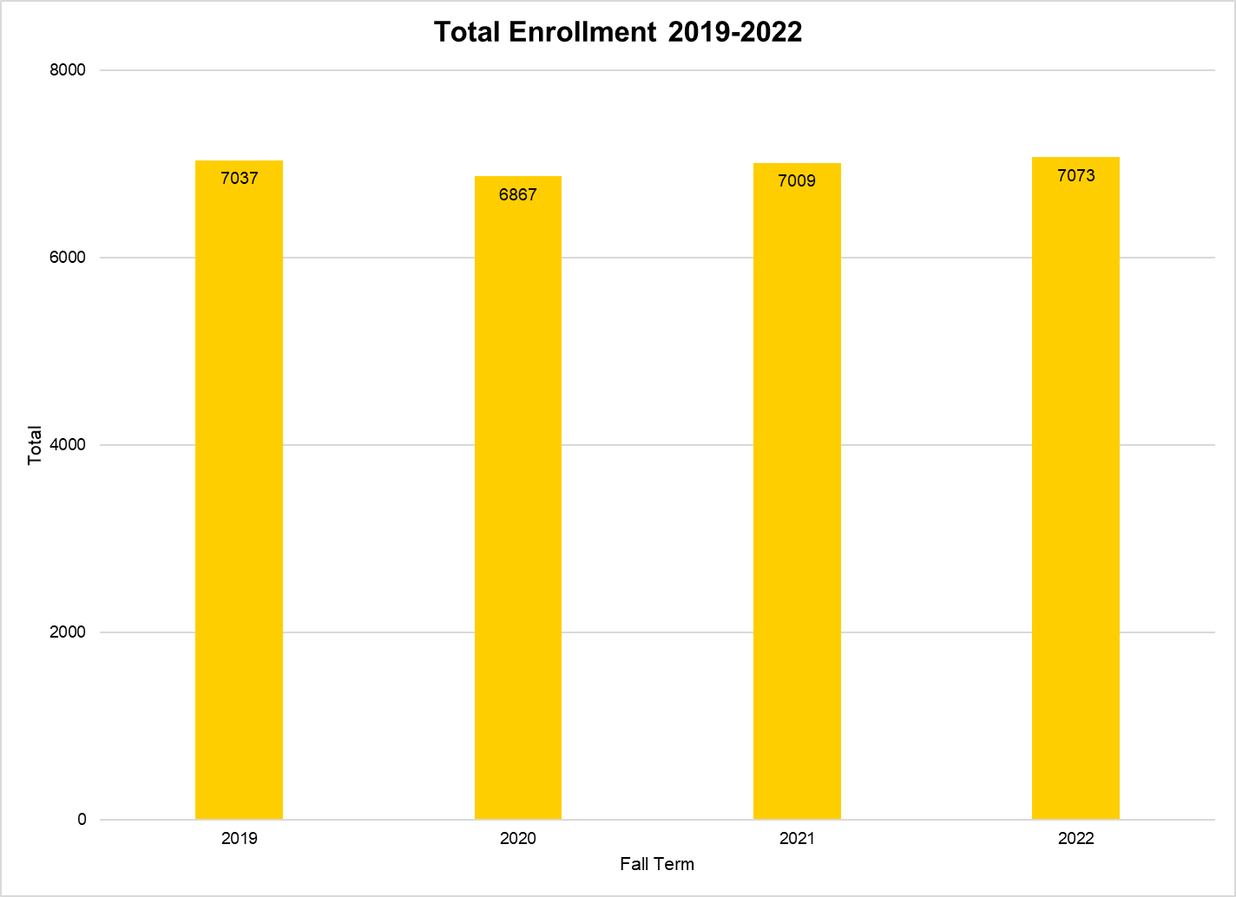

Slide 4
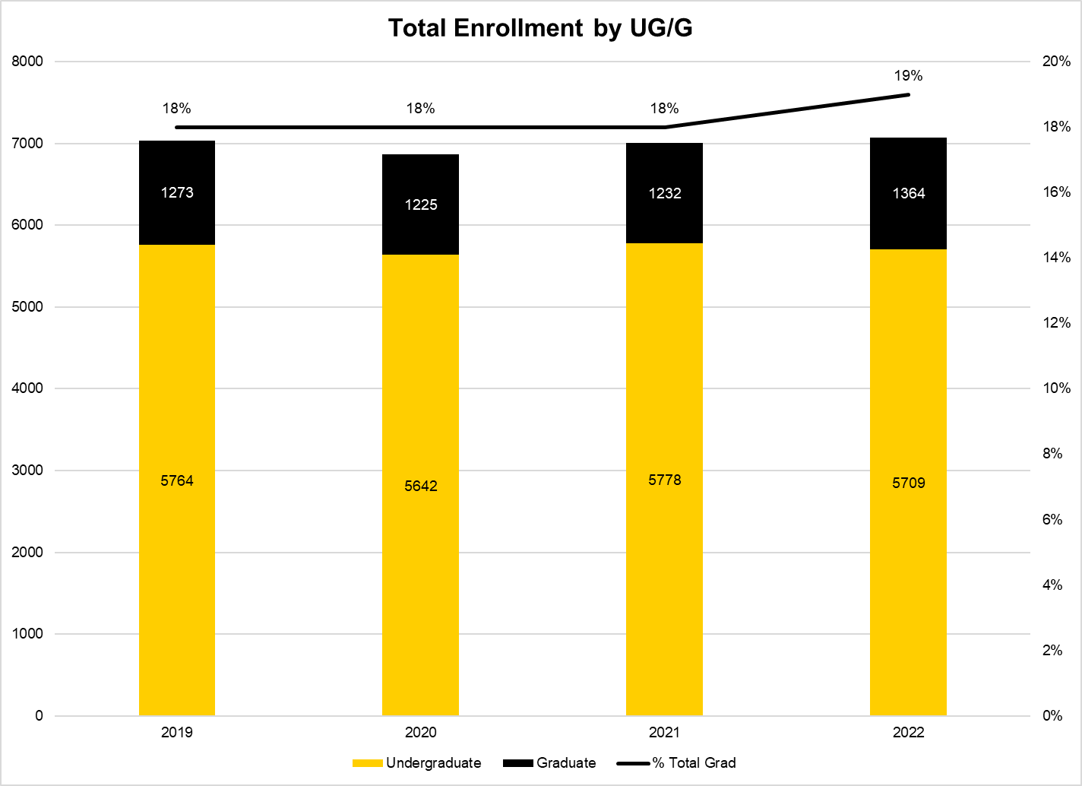

Slide 5
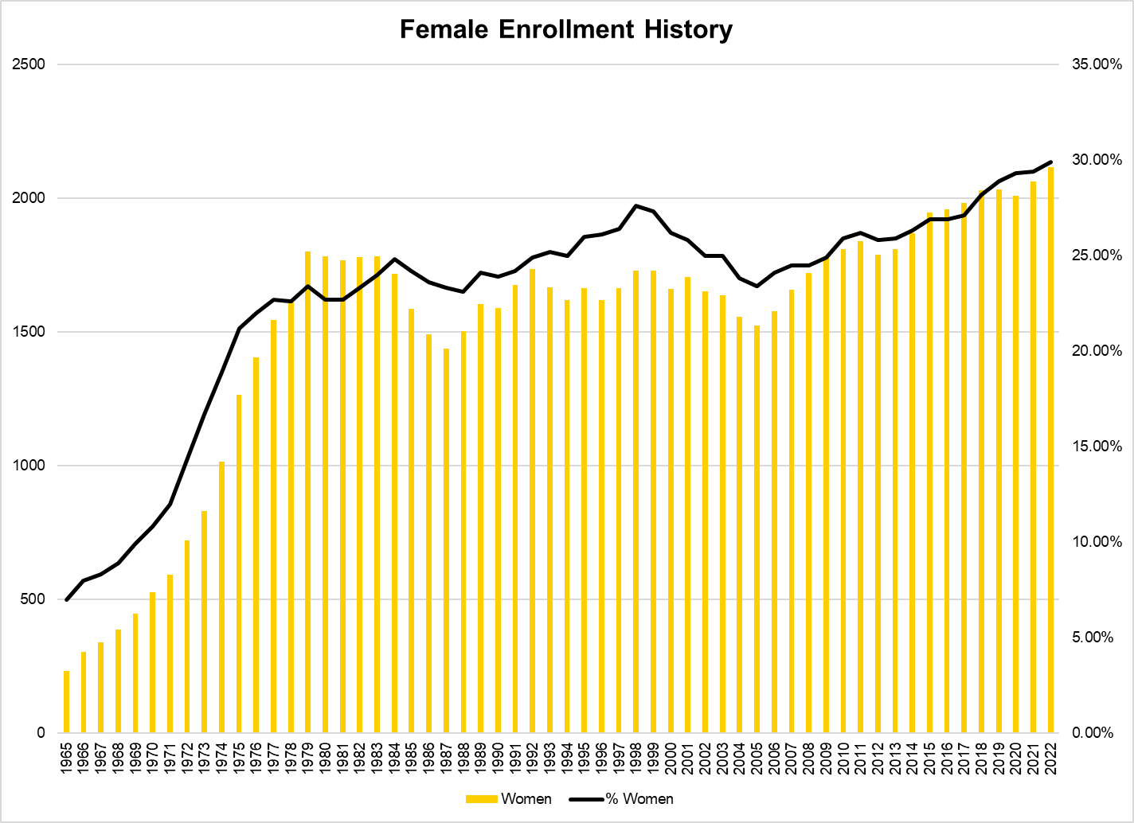

Slide 6
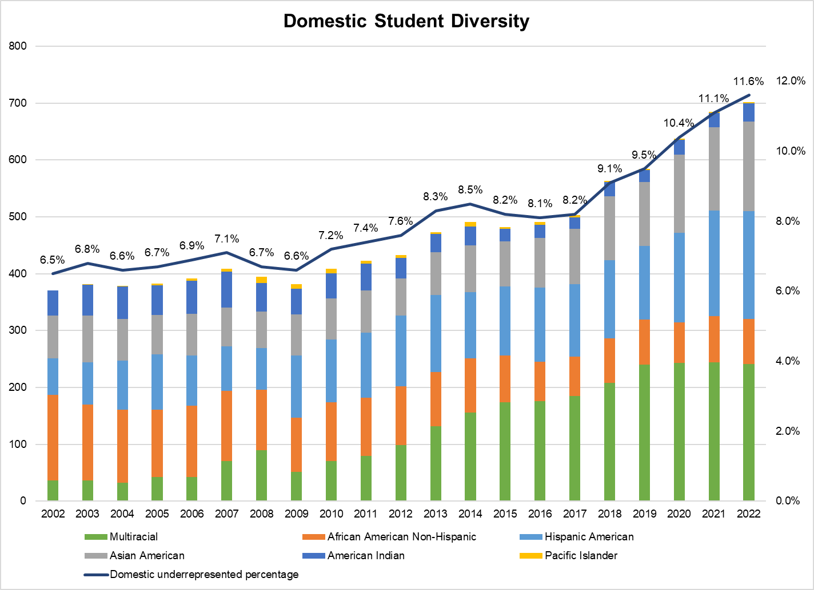

Slide 7
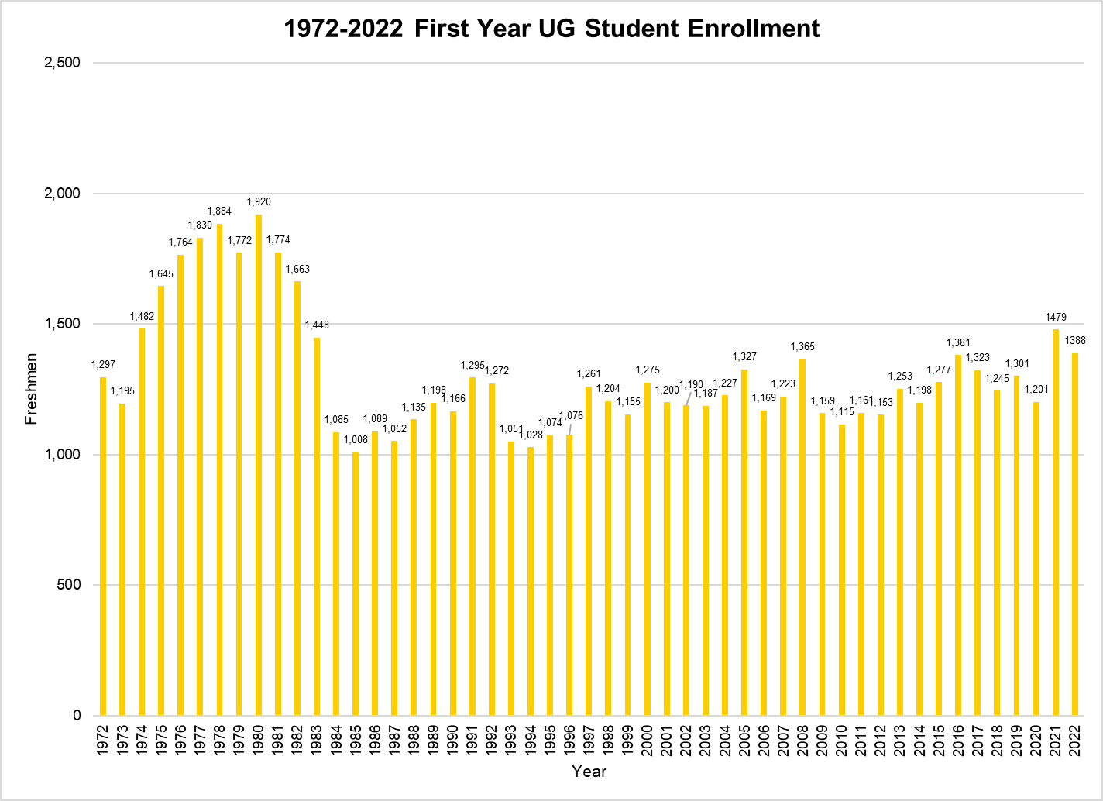

Slide 8
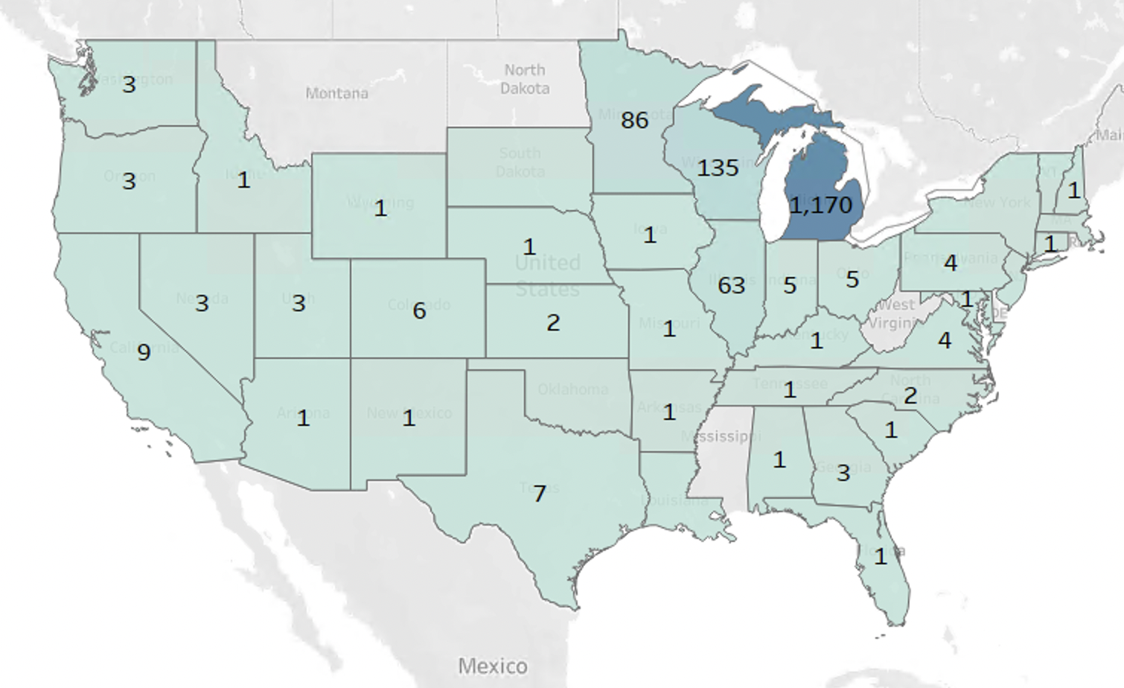
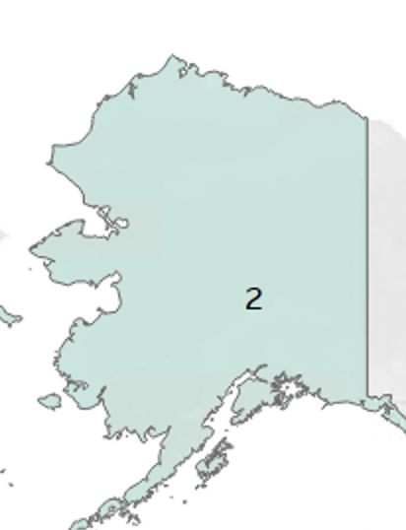
Enrolled First Year Undergraduate Students by State

Slide 9
Spring Registrations
As of 1/19/23 | 2022 | 2023 | Change | (Fall 21 to Fall 22 differential reminder)
UG | 5,307 | 5,322 | 15/.3% | -68/-1.2%
Grad | 1,176 | 1,359 | 183/15.6% | 133/10.8%
Total | 6,483 | 6,681 | 198/3.1% | 65/0.9%

Slide 10
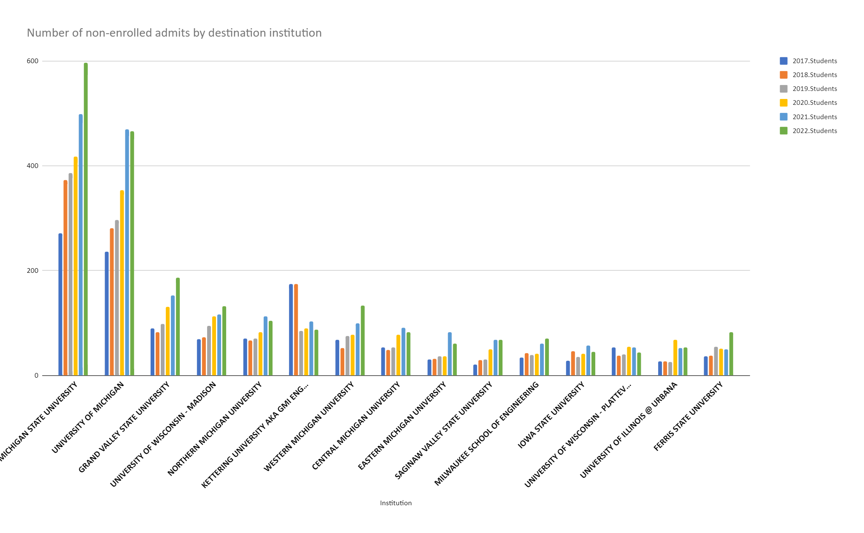
Destination institution of non-enrolled admits
This fall, non-enrolled admits enrolled at 660 different institutions vs 355 in 2017

Slide 11
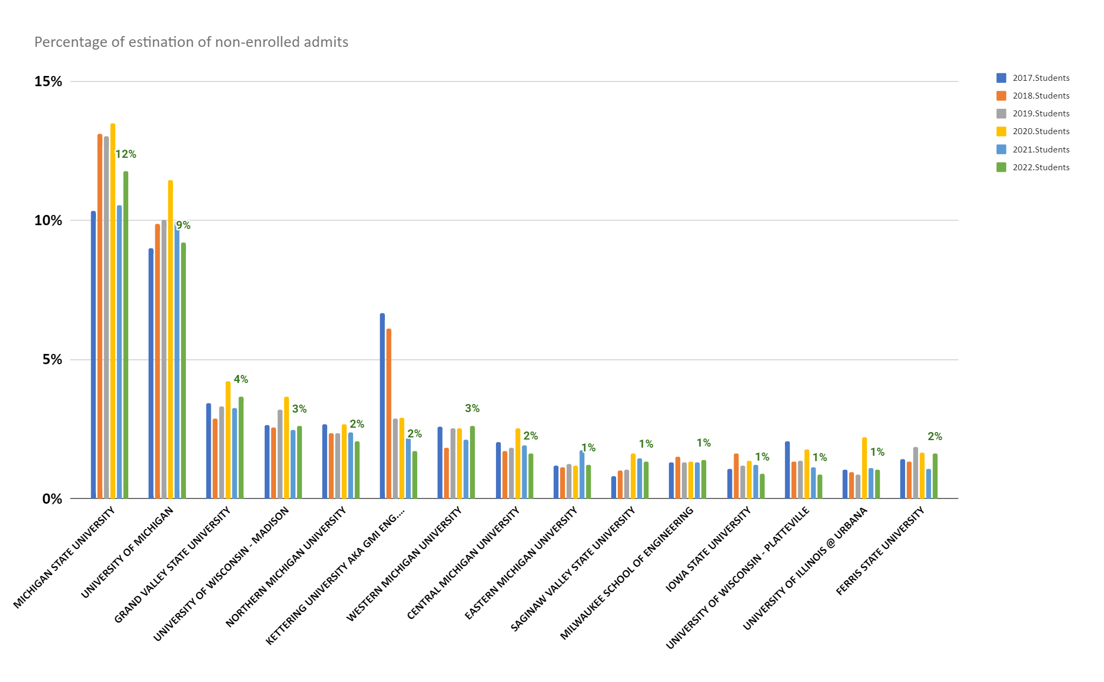
Destination institution of non-enrolled admits

Slide 12
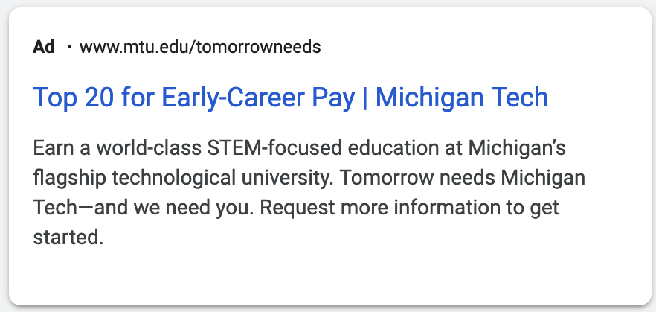

Slide 14
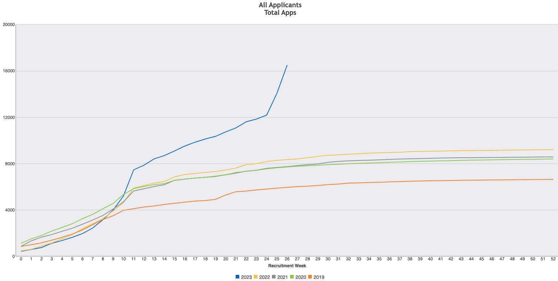
We loaded ~1900 international applications two weeks ago
+97% over last year
+33% domestic
+20% resident
+56% non-resident domestic

Slide 15
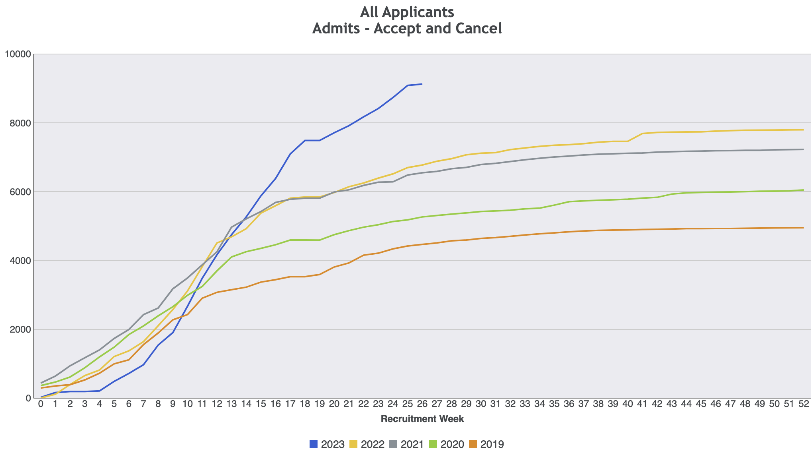
+35% over last year
+18% resident
+48% non-resident domestic

Slide 16
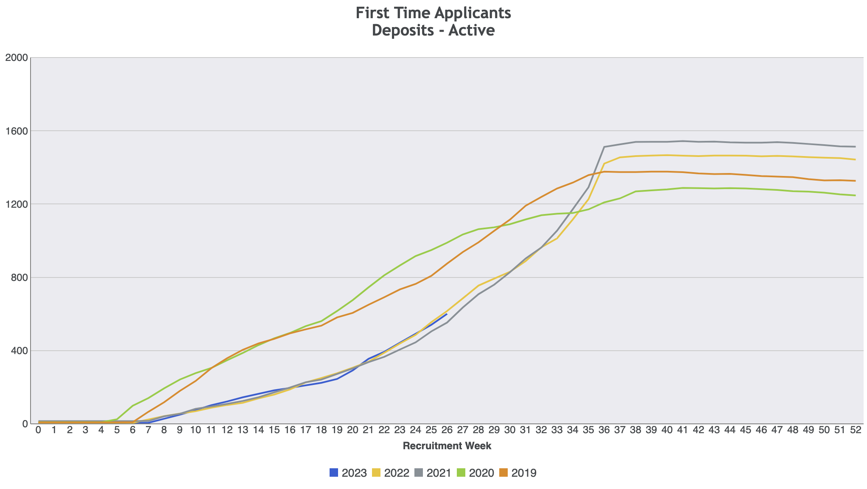
Tracking with last year (and year before)

Slide 17
Admits
State | 2022 | 2023 | Change
Michigan | 4205 | 4941 | 18%
Illinois | 443 | 925 | 108%
Wisconsin | 591 | 667 | 13%
Minnesota | 364 | 454 | 25%
Texas | 100 | 153 | 53%
California | 105 | 160 | 52%
Colorado | 31 | 55 | 102%
All others | 487 | 786 | 62%
International | 95 | 530 | -

Slide 18
Admits
College | 2022 | 2023 | Change
College of Business | 679 | 730 | 51 | 8%
College of Computing | 1,022 | 1,541 | 519 | 51%
College of Engineering | 3,315 | 3,824 | 509 | 15%
College of For Res & Env Sci | 284 | 348 | 64 | 23%
College of Sciences & Arts | 1,677 | 2,823 | 1,146 | 68%
Interdisciplinary Programs | 90 | 127 | 37 | 41%
TOTAL | 7,067 | 9,402 | 2,335 | 33%

Slide 19
Admits
 | 2022 | 2023 | Change
Underrepresented | 1567 | 2316 | 48%
Majority | 4512 | 5589 | 24%
Female | 2642 | 3550 | 34%
Male | 3838 | 5373 | 36%

Slide 20
THANK YOU

