Slide 1
  Information Technology Update
  Josh Olson
  Chief Information Officer
  29 November, 2017
  Presentation to the University Senate

Slide 2
Information Technology Update: 29 November, 2017
Annual Satisfaction Survey
This year’s results once again indicate an improvement in almost every aspect of satisfaction.
IT will continue to focus on customer service,
with a goal of average scores of >=4.0 in all key metrics.

Slide 3
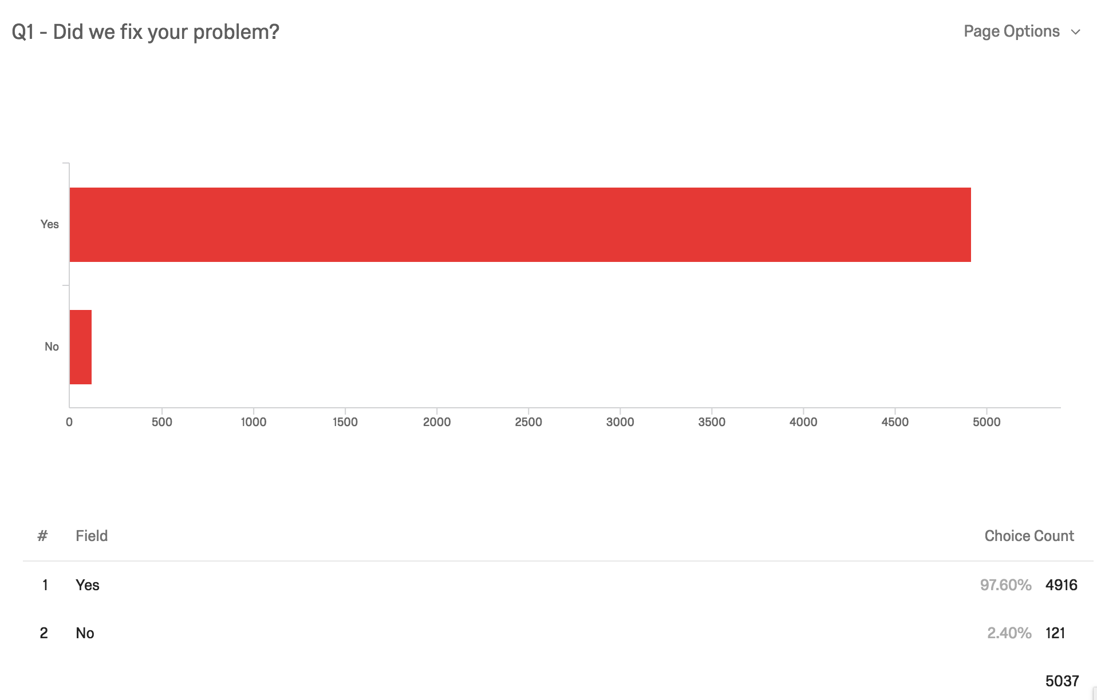
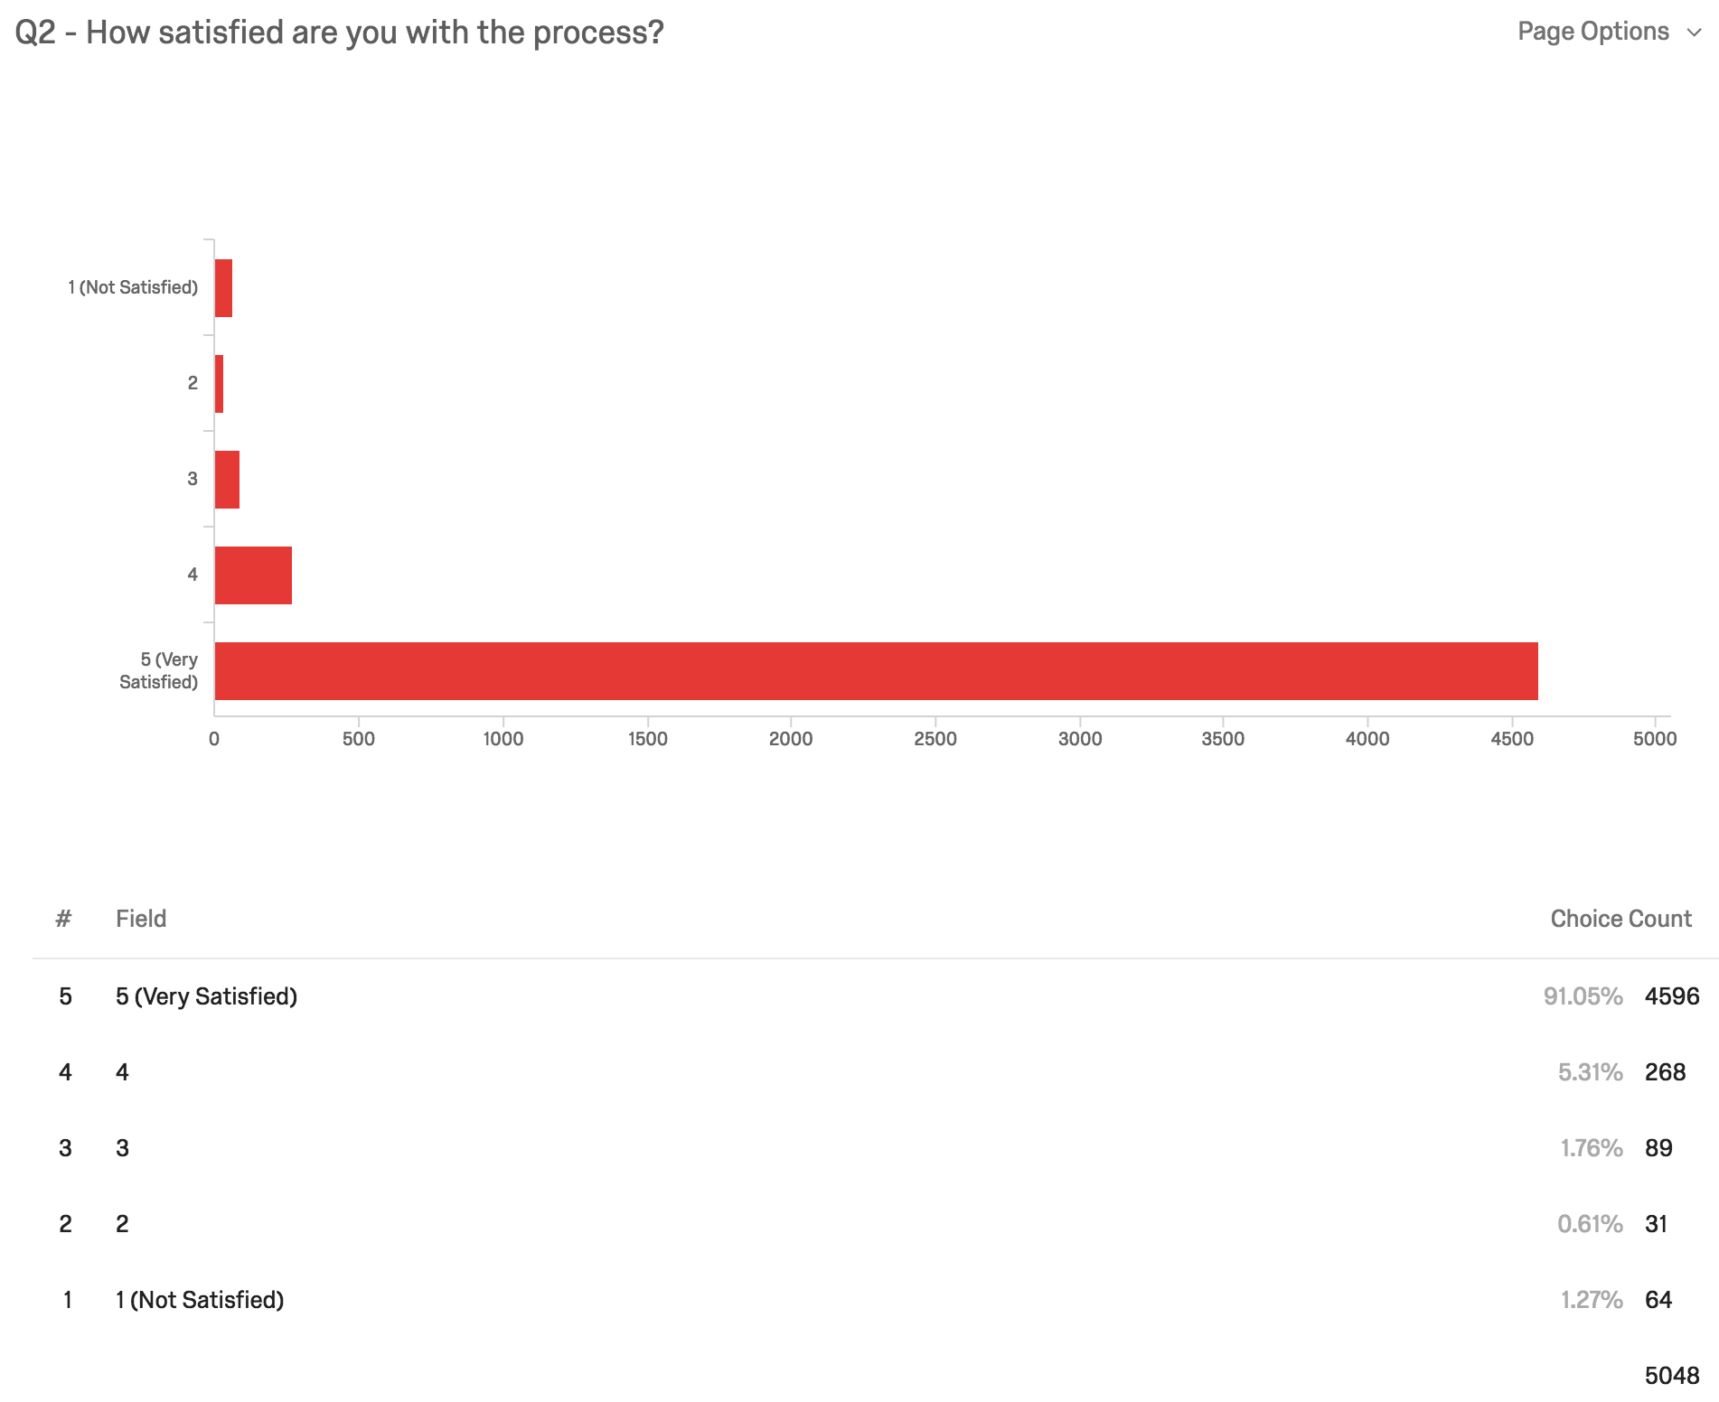
Information Technology Update: 29 November, 2017
3-question survey
4.84/5 mean satisfaction

Slide 4
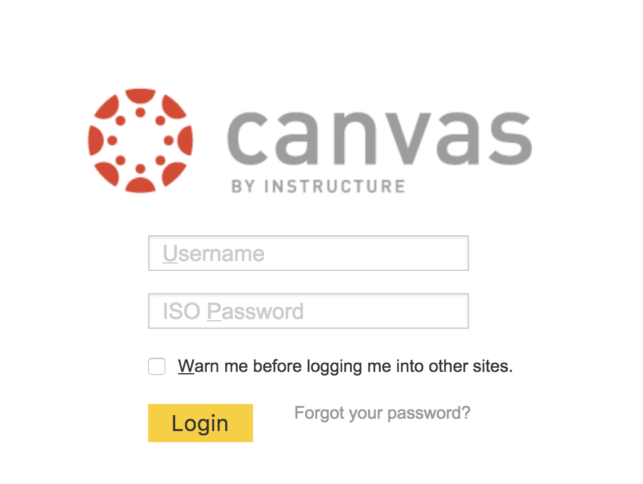

Information Technology Update: 29 November, 2017
New Faculty and Chairs
28 faculty
Two department chairs

Slide 5
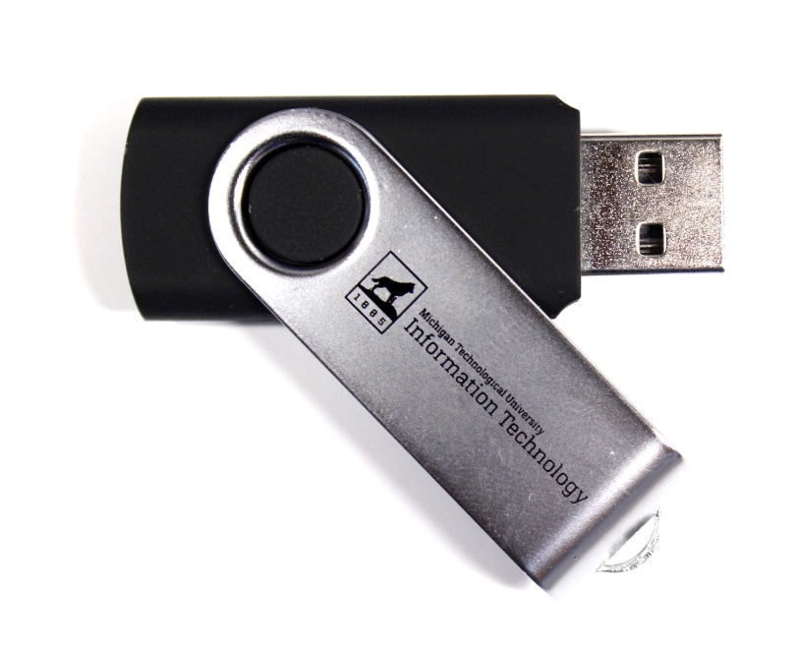

Information Technology Update: 29 November, 2017
First-year Engineering Laptops
Flash drives with software for all first-year students
Loaner laptop fleet (20)

Slide 6
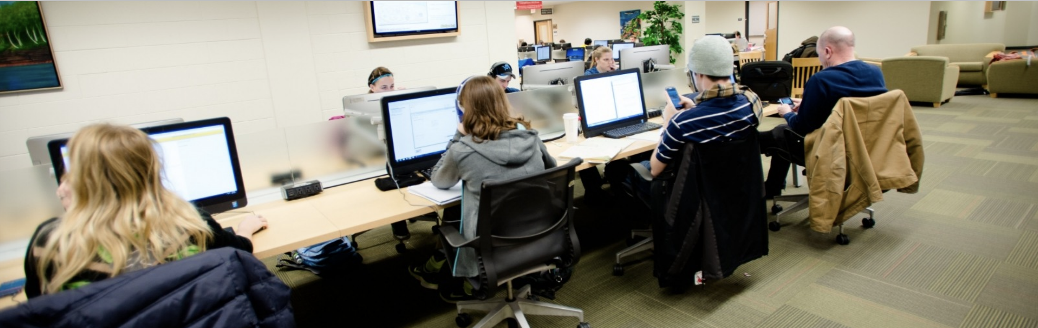
Information Technology Update: 29 November, 2017
Library Computers
Replaced:
  256 in the Library
  60 in podiums throughout campus (SSDs)

Slide 7
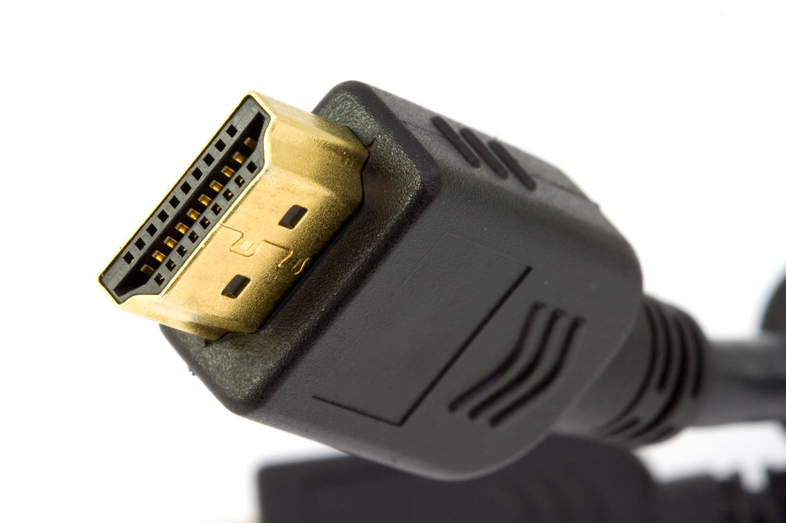
Information Technology Update: 29 November, 2017
HDMI in Classrooms
20 classrooms

Slide 8
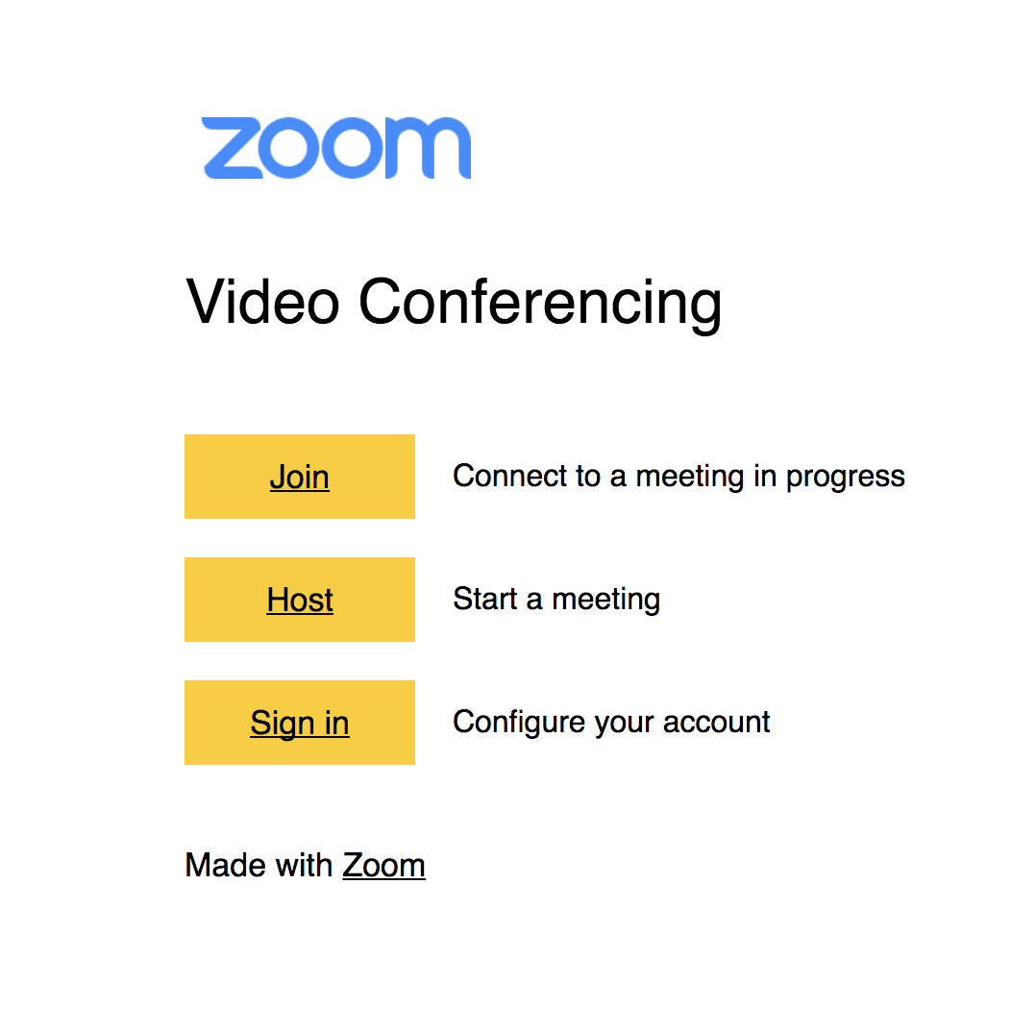
Information Technology Update: 29 November, 2017
Zoom
michigantech.zoom.us
International H323 support
Logins for all students, faculty, and staff

Slide 9
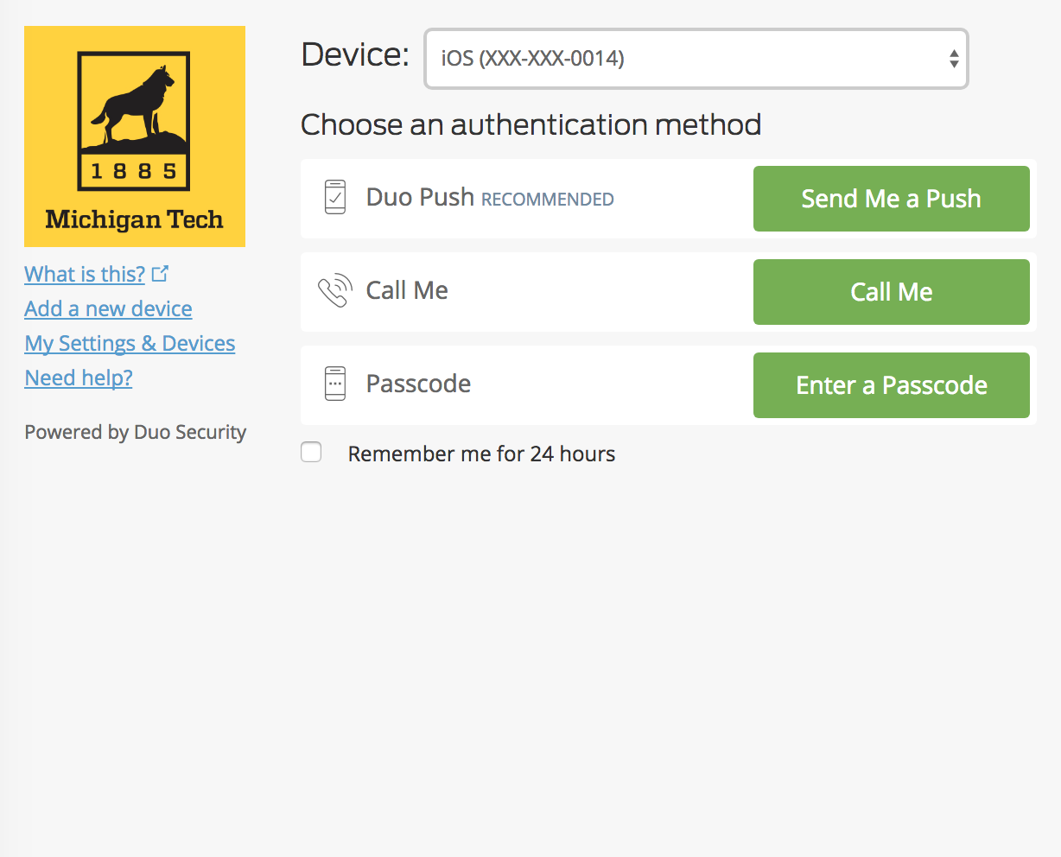
Information Technology Update: 29 November, 2017
Multi-factor Authentication (MFA)
Duo 2-step

Slide 10
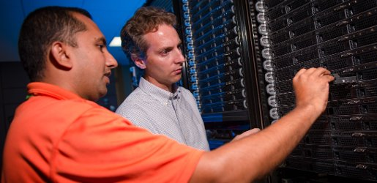
Information Technology Update: 29 November, 2017
Research Computing
Compute capacity expansion is nearly complete with gen 2 nodes
Storage capacity expansion will likely happen over holiday break
Superior and Portage are now a part of the HPC Core Facility
Non-HPC Research Computing focus

Slide 11

Information Technology Update: 29 November, 2017
Network Upgrades
Replaced DSL internet service
  Improved network service for many graduate students

Slide 12
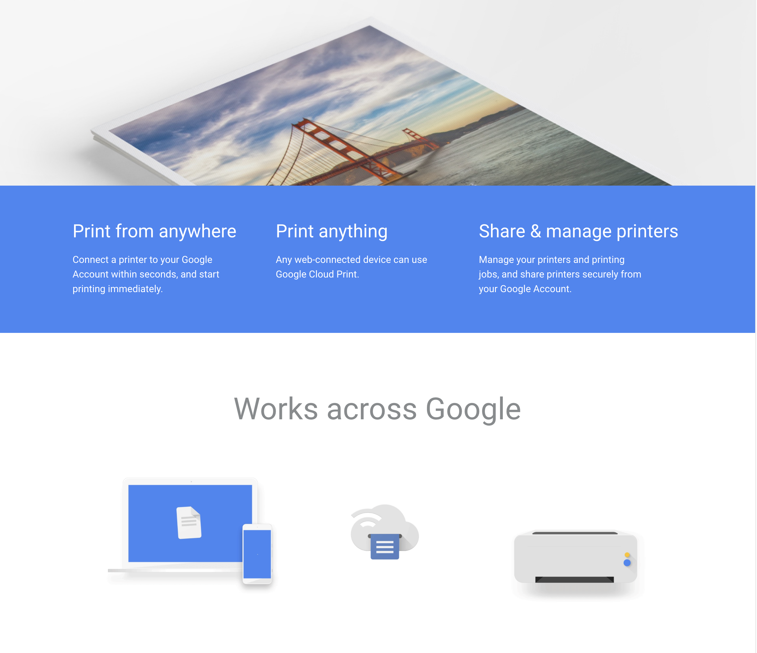
Information Technology Update: 29 November, 2017
Printing Upgrades
Cloud print

Slide 13
Information Technology Update: 29 November, 2017
IT Governance
Project management
Graduate student computing

Slide 14
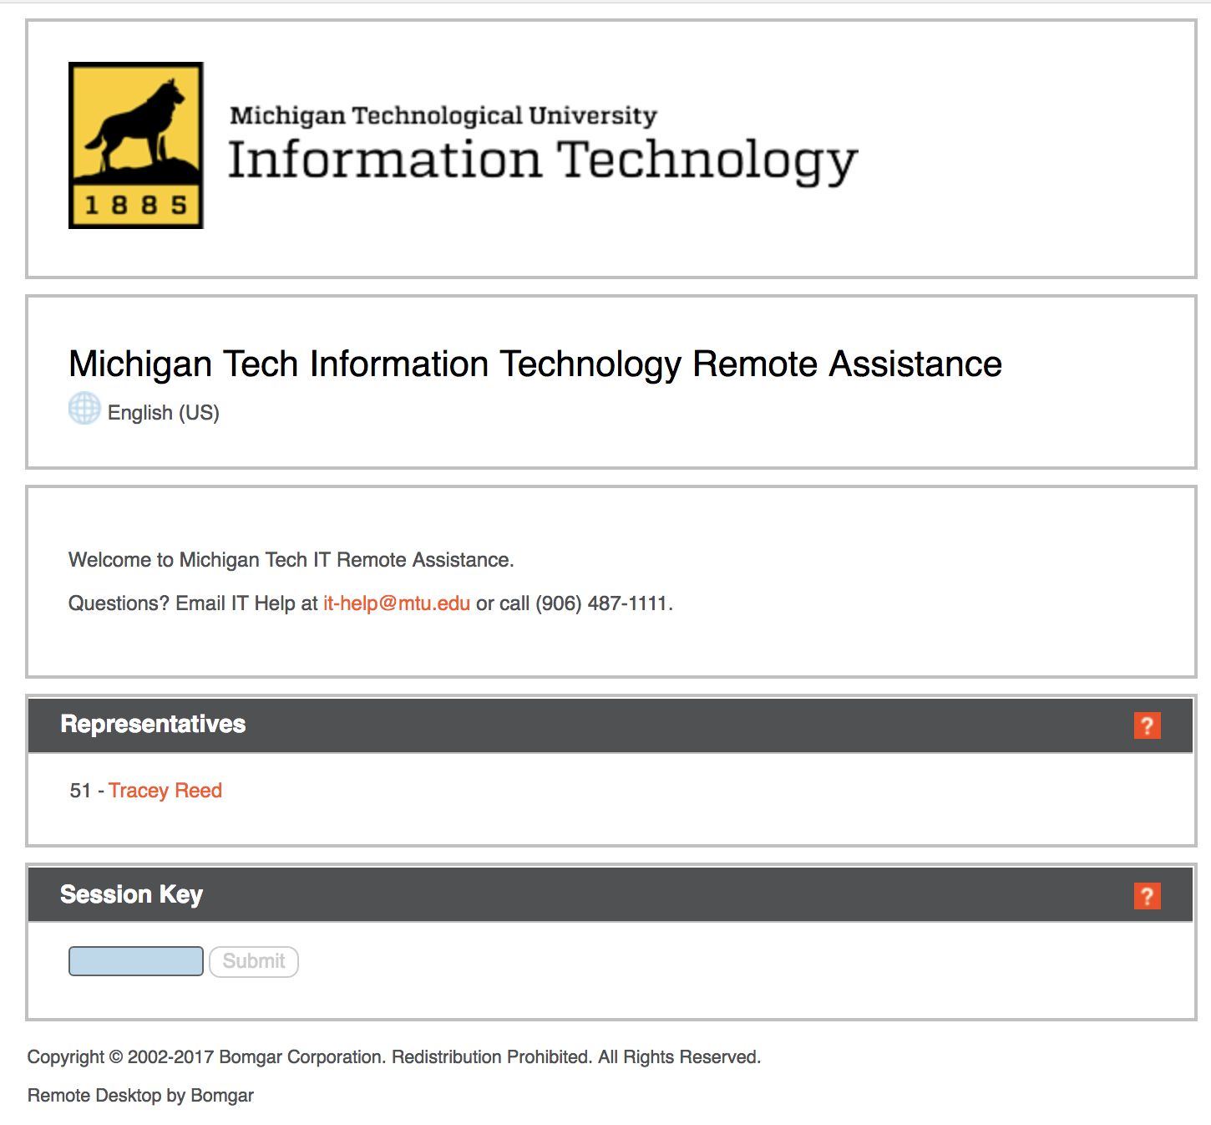
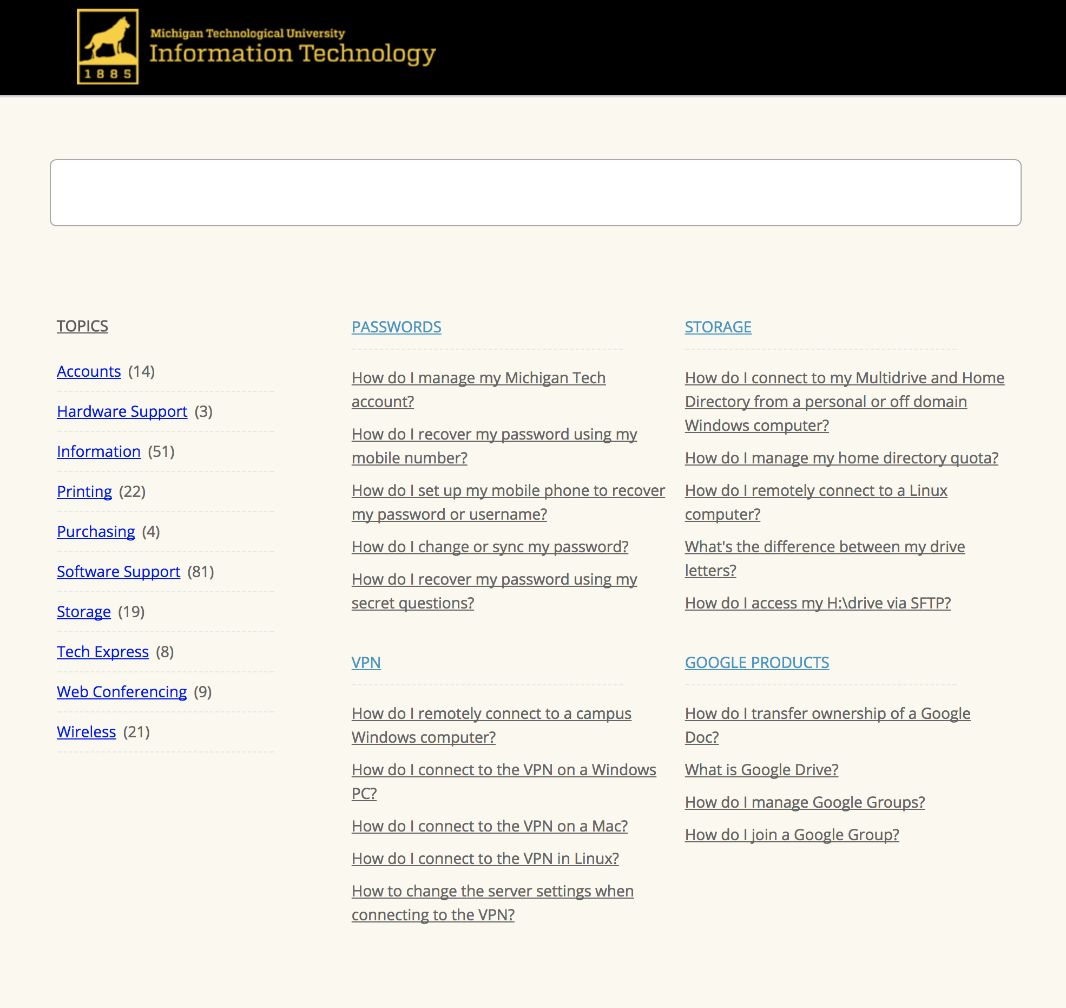
Information Technology Update: 29 November, 2017
Online Support
Remote assistance
support.it.mtu.edu

Slide 15
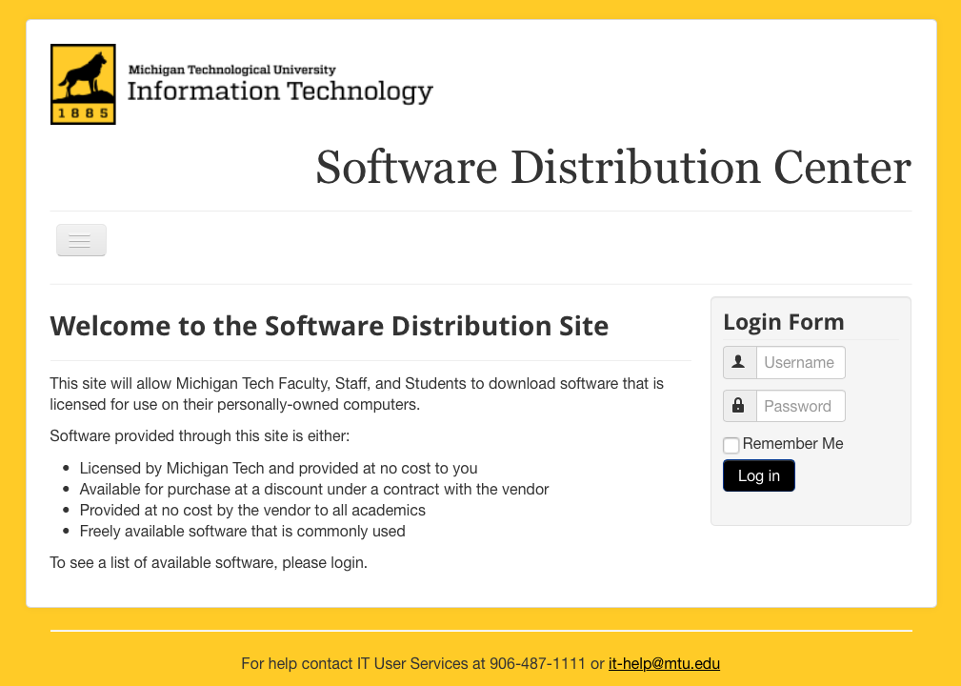
Information Technology Update: 29 November, 2017
Computer Software
downloads.it.mtu.edu

Slide 16
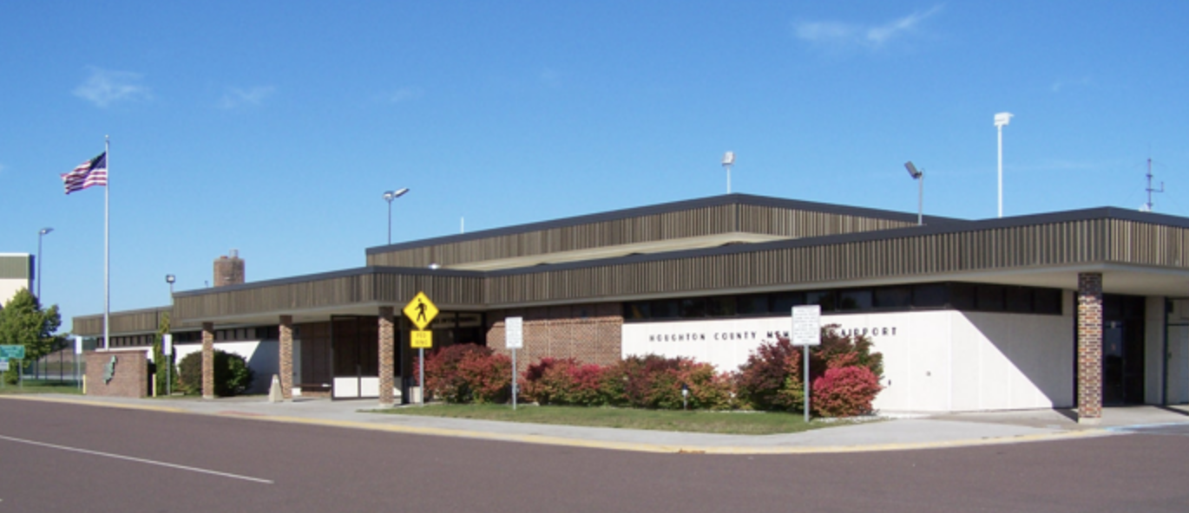

Information Technology Update: 29 November, 2017
Airport Wireless
Michigan Tech SSID

Slide 17
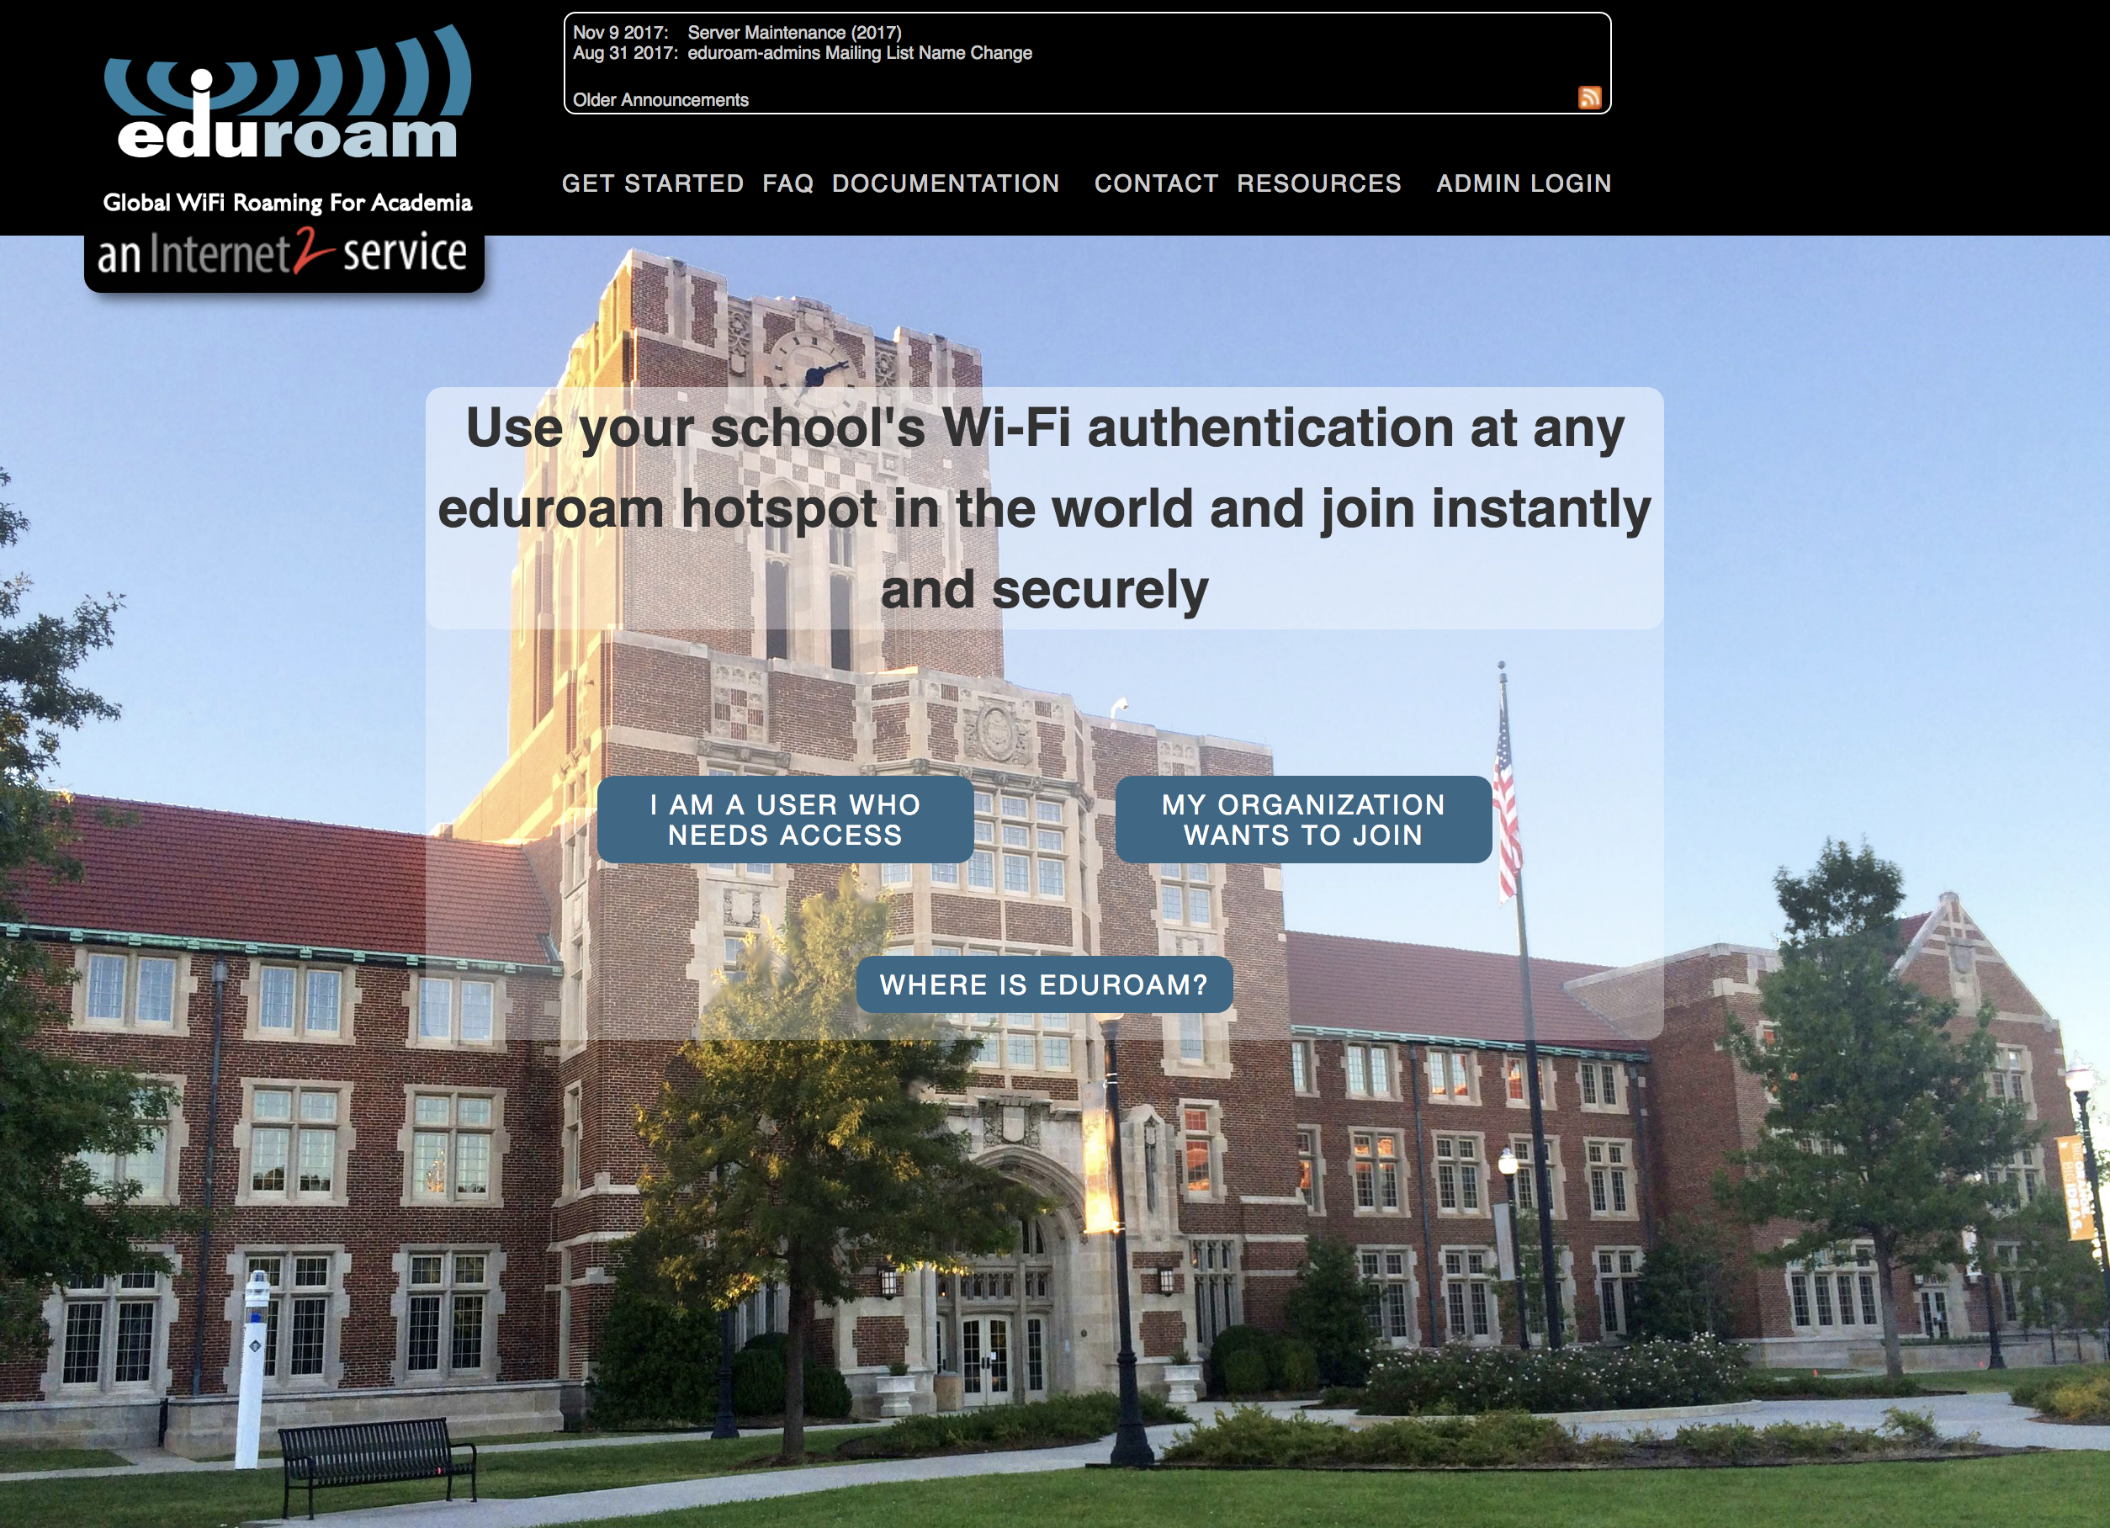
Information Technology Update: 29 November, 2017
Coming Soon

Slide 18
Information Technology Update: 29 November, 2017
Coming Soon
DFARS-7012 / NIST 800-171

Slide 19
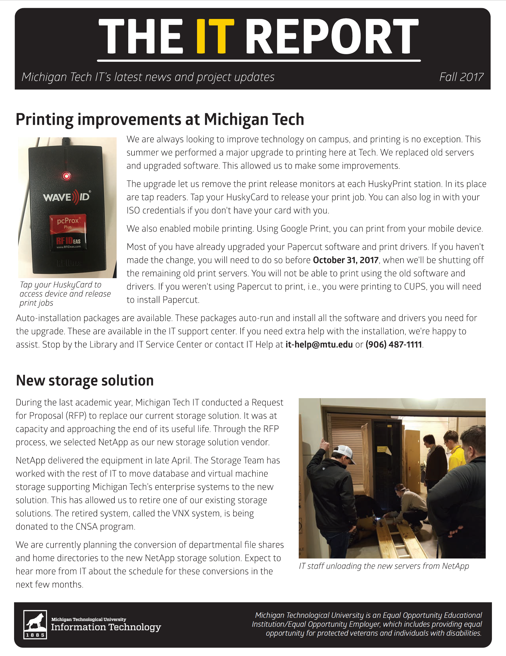
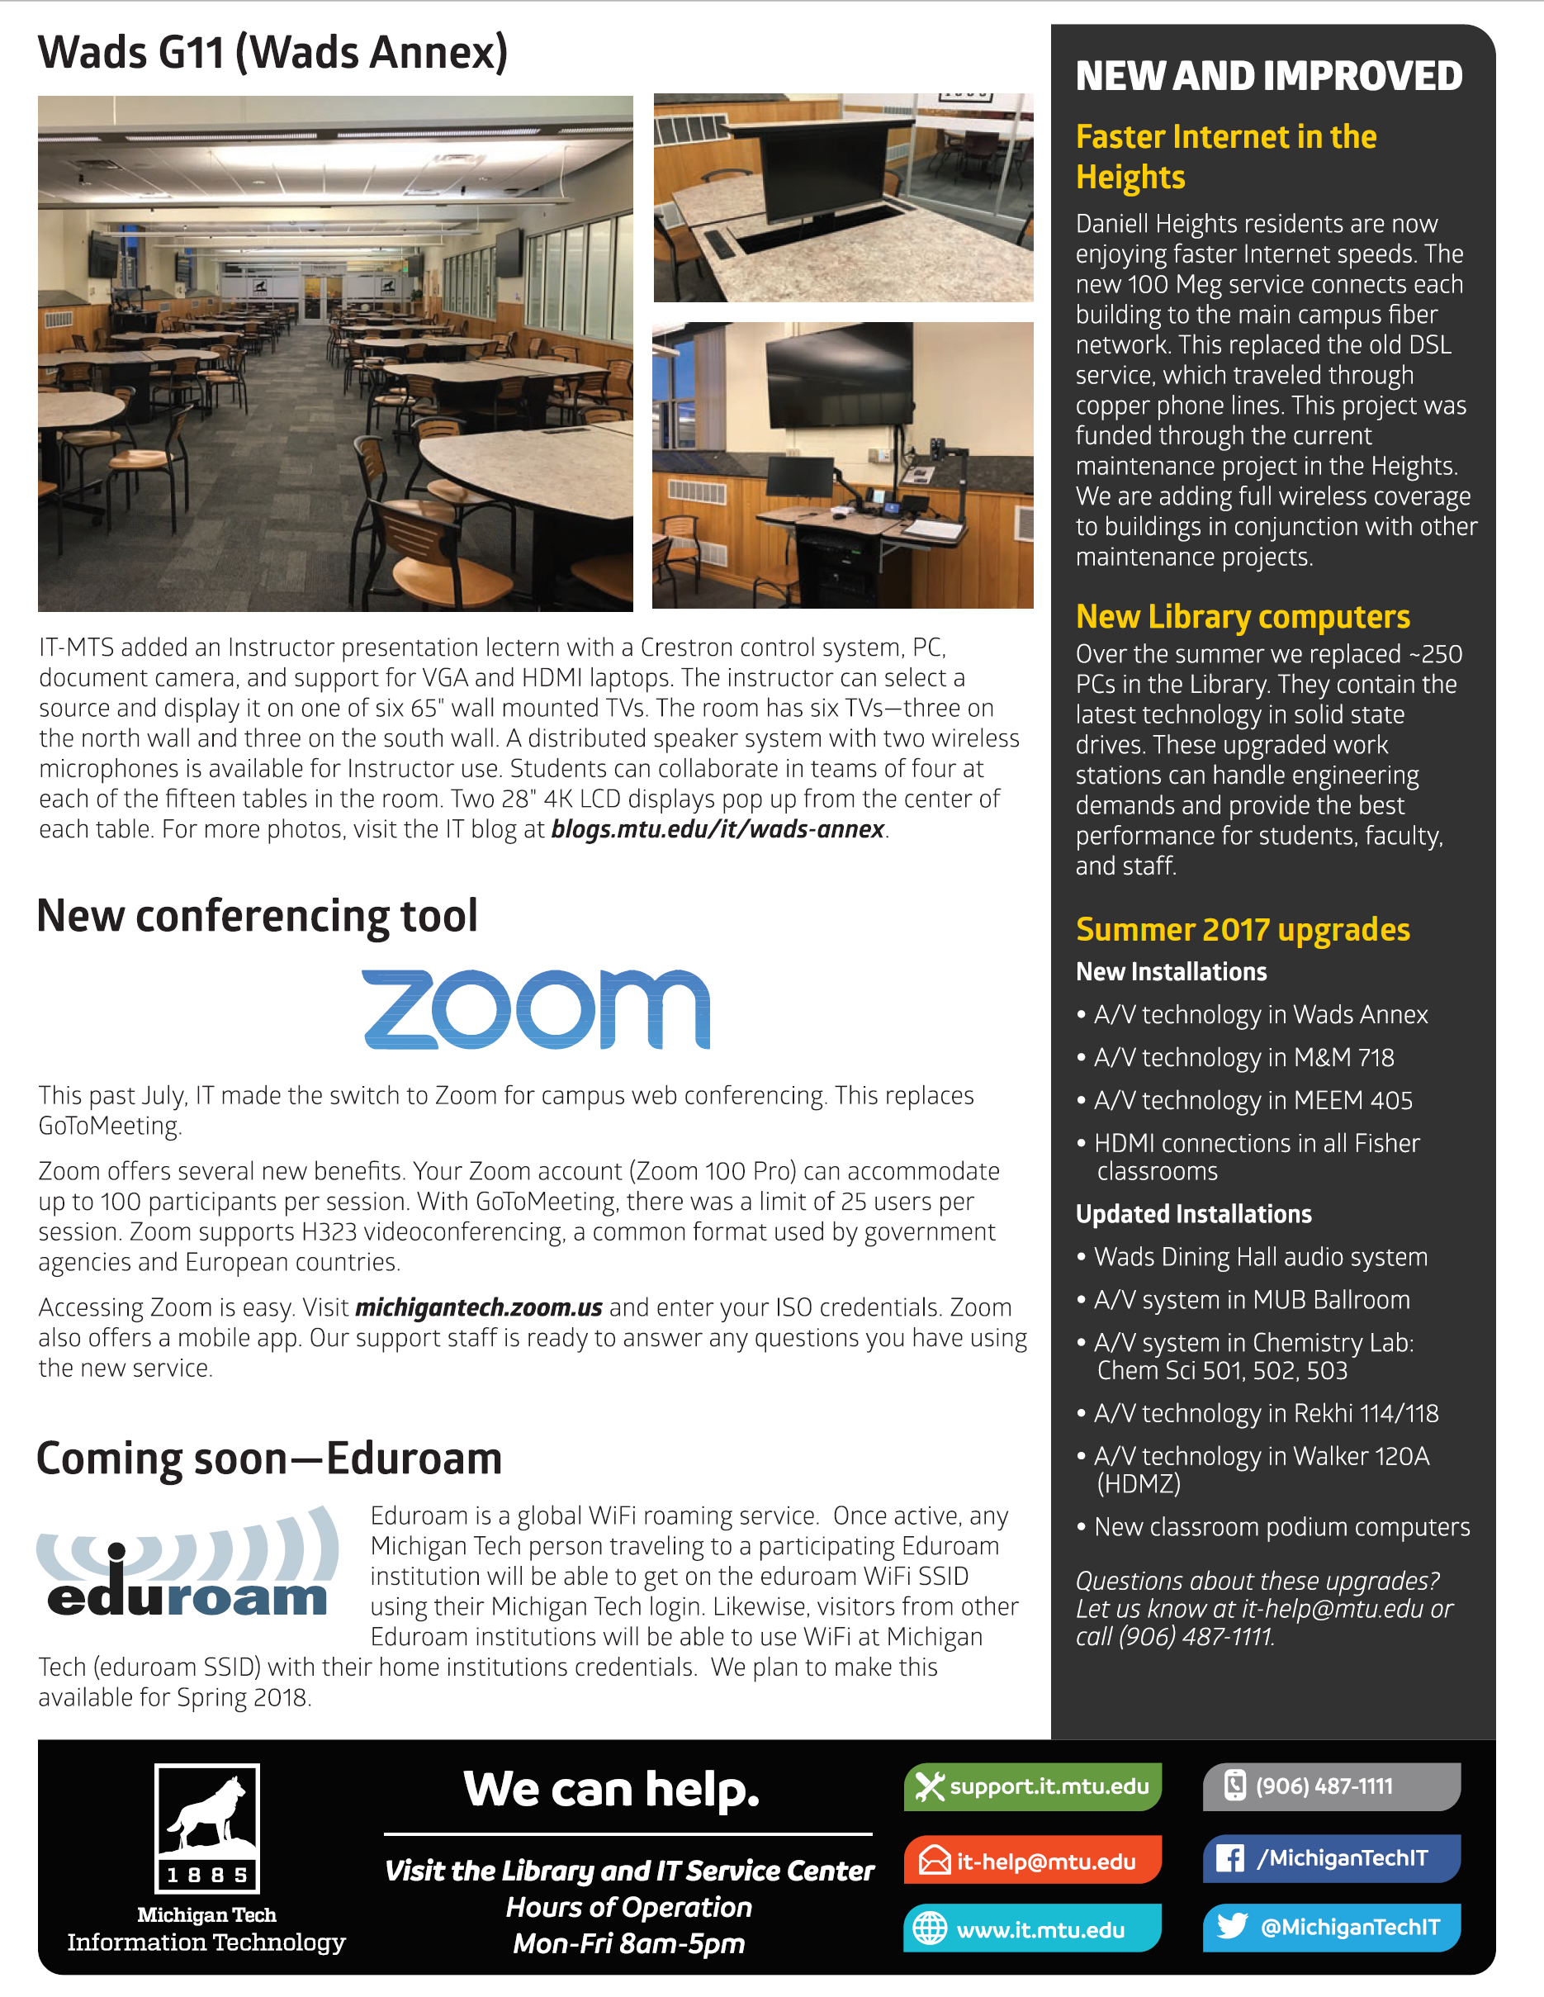



Information Technology Update: 29 November, 2017
Communication
/MICHIGANTECHIT
@MICHIGANTECHIT
@MICHIGANTECHIT

Slide 20


