Slide 1
<Center/Institute Name>
<Director’s Name>
<Mission>

Slide 2
Center/Institute Overview

Slide 3
Center/Institute Background
Provide an overview/background on the center/institute. For example:
Year of establishment
Previous renewal years
Staff
Types of contracts/grants received

Slide 4
Governance Structure
Describe how your center/institute is governed:
How are major decisions made?
How do people become members?
How are members involved in major decision making?
Does your center have bylaws describing governance?

Slide 5
Facilities Overview
Provide information on any facilities that are a part of the center/institute. For example:
Location
Square footage
Use fees

Slide 6
Summary of Activities and Highlights
since last Renewal

Slide 7
Activities and Accomplishments
Describe activities and accomplishments that would have not happened without your center (i.e. large interdisciplinary externally funded research projects/grants). Also please make sure to answer the following questions:
  How many new members joined since your last renewal?
  What have your membership numbers been each year since your last renewal (include a list of current members and their department/college in an appendix)?

Slide 8
Activities and Accomplishments
Describe what you have done to involve members in center/institute activities since your last renewal
Describe what you have done to build member capacity to pursue external sponsored funding in your focal area since your last renewal

Slide 9
Budget Overview

Slide 10
Summary of Budgets since last Renewal
Provide a summary of your yearly expenditures and revenues by major category since your last renewal
Describe how your IRAD revenue was used to enhance member capacity to pursue externally-sponsored research funding

Slide 11
Total Center/Institute Proposals Submitted & Awarded Per FY
Provide a table of the total number of proposals submitted through your center/institute, with the total requested amount, and number and amount of awards. For example:
 | FY## | FY## | FY## | FY## | Current FY
Number of proposals | 35 | 30 | 42 | 43 | 36
Number of PI’s who submitted | 10 | 12 | 12 | 12 | 11
Total requested amount | $8,586,486 | $9,435,815 | $13,654,813 | $12,856,474 | $8,685,358
 | FY## | FY## | FY## | FY## | Current FY
Number of awards | 10 | 12 | 25 | 15 | 12
Number of PI’s who were awarded | 5 | 5 | 6 | 5 | 5
Total award amount | $1,586,486 | $1,435,815 | $6,654,813 | $2,687,896 | $1,985,876

Slide 12
Current Awards As of YYYY
Provide a table of the PIs who have received awards run through your center/institute. State the number of associated indexes, PI’s department, and award amounts/FY. Also state the projected Net ICR (indirect cost return), and the projected center/institute IRAD return. For example:
PI | Number of indexes | Department | Current FY | FY## | FY## | FY## | FY## | Total by PI
Doe, John | 2 | MEEM | $10,762 | $8,934 | $7,546 |  |  | $29,242
Doe, Jane | 4 | Chemistry | $23,781 | $24,561 | $20,589 | $14,896 |  | $83,827
Award Balance per FY | 6 |  | $34,543 | $33,495 | $30,135 | $14,896
Projected Net ICR |  |  | $## | $## | $## | $##
Projected Center/Institute Return |  |  | $## | $## | $## | $##

Slide 13
Last Five Years of Total
Expenditures and Revenue
Provide a table showing center/institute total expenditures and revenue balance per fiscal year. For example:
 |  | FY## | FY## | FY## | FY## | Current FY
Expenditures | S&W & Fringes | $## | $## | $## | $## | $##
 | Supplies, Fees & Equipment | $## | $## | $## | $## | $##
 | Travel | $## | $## | $## | $## | $##
 | Student Support | $## | $## | $## | $## | $##
 | PI Requests | $## | $## | $## | $## | $##
 | Total | $## | $## | $## | $## | $##
Income | IRAD | $## | $## | $## | $## | $##
 | Other | $## | $## | $## | $## | $##
 | Total | $## | $## | $## | $## | $##
 | Carry Forward | $## | $## | $## | $## | $##
 | Year End Balance | $## | $## | $## | $## | $##

Slide 14
Last Five Years of IRAD
Expenditures and Revenue
Provide a table showing the Center/Institutes IRAD balance per fiscal year. For example:
 |  | FY## | FY## | FY## | FY## | Current FY
Expenditures | S&W & Fringes | $## | $## | $## | $## | $##
 | Supplies, Fees & Equipment | $## | $## | $## | $## | $##
 | Travel | $## | $## | $## | $## | $##
 | Student Support | $## | $## | $## | $## | $##
 | PI Requests | $## | $## | $## | $## | $##
 | Total | $## | $## | $## | $## | $##
Income | IRAD | $## | $## | $## | $## | $##
 | Carry Forward | $## | $## | $## | $## | $##
 | Year End Balance | $## | $## | $## | $## | $##

Slide 15
IRAD Return Split
Provide a breakdown in the overall IRAD Return Split. For example:
10% PI - $XX
9% Department - $XX
9% College - $XX
18% Center/Institute - $XX

Slide 16
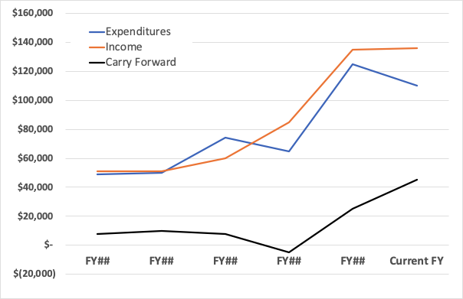
IRAD Income vs Expenses Per Fiscal Year
Provide a graph displaying IRAD income and expenses over each fiscal year. For example:

Slide 17
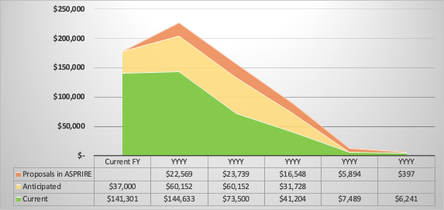
Projected Center/Institute IRAD Based on ASPIRE Information
Provide the projected center/institute IRAD balance based on data out of ASPIRE. For example:

Slide 18
Projected Five Year Budget Plan
Expenditures and Revenue
Provide a table showing projected center/institute total expenditures and revenue balance per fiscal year. See chart below for example potential expenditures and categories:
 | Category | FY## | FY## | FY## | FY## | FY##
Expenditures
Personnel | Director | $## | $## | $## | $## | $##
 | Asst. Director | $## | $## | $## | $## | $##
 | Comms. Dir. | $## | $## | $## | $## | $##
 | Research Scientist | $## | $## | $## | $## | $##
IRAD Exp. | General | $## | $## | $## | $## | $##
 | Research Start-up | $## | $## | $## | $## | $##
Other | Supplies, Fees & Equipment | $## | $## | $## | $## | $##
 | Travel / Other | $## | $## | $## | $## | $##
 | Total | $## | $## | $## | $## | $##
Revenue | IRAD | $## | $## | $## | $## | $##
 | Other | $## | $## | $## | $## | $##
 | Total | $## | $## | $## | $## | $##
 | Carry Forward | $## | $## | $## | $## | $##
 | Year End Balance | $## | $## | $## | $## | $##

Slide 19
Future Plans and Goals

Slide 20
Future Plans and Goals
What are your strategic goals for the next year, five years?
Describe financial and membership goals directly related to enhancing research expenditures. Provide and describe metrics if appropriate.
Describe any space or facility goals for the center/institute and its members
How much of a financial gap does your center/institute anticipate having in working toward meeting those goals?
What strategies will you use to fill this gap?

