Slide 1
Navigating Mental Health in the Workplace
Prepared for Michigan Technological University
Northstar EAP

Slide 2
Objectives
Train Managers on mental health awareness in the workplace
Provide knowledge and resources to support MTU leaders and their employees
Help Managers/Leaders/Supervisors understand their role and responsibilities supporting mental health in the workplace
Rules of engagement

Slide 3
Mental Health Quiz
How many people in the US will experience a mental health problem every year?
a. 1 in 4 b. 1 in 8 c. 1 in 2
What proportion of people with mental health problems believe that workplace stress contributed to their illness?
a. 1 in 5 b. 1 in 3 c. 2 in 3
What proportion of people with mental health problems experience stigma? a. 10% b. 50% c. 90%
How long do the majority of people with a mental health problem wait before telling their closest family and friends about it?
a. 2 months b. 7 months c. Over a year
Which of these famous people experienced mental health problems?
a. Abraham Lincoln b. Winston Churchill c. Simone Biles d. Robin Williams
Which country’s Prime Minister was re-elected in 2001 after publicly taking time off for depression?
a. Mexico b. Norway c. Poland

Slide 4
How would you describe 'good mental health'?

Slide 5
Definitions of Mental Health
Mental well-being describes your mental state:
Emotional, psychological, and social well-being Impacts how we think, feel, and act
How we handle stress, relate to others, and make choices
Mental health is important at every stage of life Mental wellbeing is dynamic
Includes Work Life Balance

Slide 6
Types of Mental Health Issues
Anxiety Depression Eating Disorders Schizophrenia Phobias
Obsessive Compulsive Disorder
Bipolar disorder Personality disorders PTSD
And more...

Slide 7
How do you define stress?
What does being stressed cause?

Slide 8
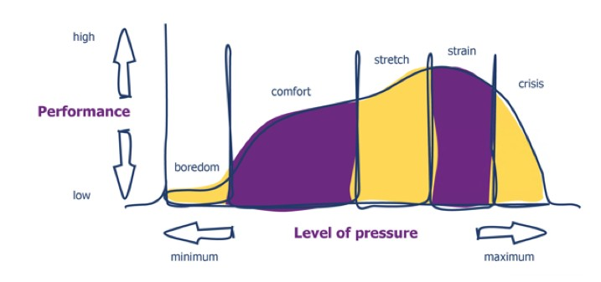
“Stress is the adverse reaction people have to excessive pressure or other types of demand placed on them”

Slide 9
Current Employee Mental Health
Work Stressors: Understaffing Morale issues
Health safety concerns Work deadlines
Perceived uneven responsibilities
Home/personal Stressors:
Increase obligations: financial, childcare, eldercare Traumatic events: COVID, Political
Relationship problems/family conflict

Slide 10
Implications of Mental Health Issues in the Workplace
Employee retention/turnover Employee morale
Loss of productivity
Inflated expenses (medical, etc) Employer brand becomes impaired Low Emotional Commitment Workplace violence Death/Suicides

Slide 11
Leadership Role and Responsibilities
Soft Skills
Demonstrate care, understanding, and safety Recognize warning signs Employ empathy
Offer resources
Be ready and nimble
Tactics
Legal Basics
Hiring and Termination Accountability and Documentation Consistency
Performance Management
Discrimination, harassment and retaliation

Slide 12
Right of privacy in the workplace
"Refers to an employee’s information that an individual regards as personal or private"
Medical information Work activities
Off-duty behavior
Right of that individual not to have such information shared with others
You can't unhear information, nothing is off the record

Slide 13
Mental Health Related Laws
The Occupational Health and Safety Act (1970) Provide for a balanced and nationally consistent framework to secure the health and safety of workers and workplaces General duty of care to ensure the health, safety and welfare of all their employees and this includes employees' mental health
Americans with Disabilities Act (ADA) (1990) Regulates use of medical information, maintenance of medical documents and access
individuals with diagnosed mental health conditions are covered under the ADA and have a right to job accommodations
Health Insurance Portability and Accountability Act (HIPAA) (1996)
Regulates the use and disclosure of protected health information by employers with health plans Lawsuits
Protected Leaves
Family Medical Leave Act (FMLA) (1993)

Slide 14
~pause here for break~

Slide 15
Breakout Session #1

Slide 16
How to engage with an employee regarding mental health?
Supervising or line managing people requires demonstrating care and value for each member of your team, this is a ‘soft’ skill that can be difficult to exhibit.
This contributes to building a strong, motivated team who also perform at optimum levels
Building a strong Manager/employee relationship opens the door to open conversations about mental health

Slide 17
Communication Tactics
Find a quiet place
Actively listen to the person Use positive body language Check your understanding
Reflect back actual words they have used to them Respond by using empathetic statements
Avoid clichés
Try to avoid asking too many questions
Is the individual aware of sources of support?
Have your included HR?

Slide 18
Communication take aways
Do’s
Support employees and their performance
Be compassionate, supportive and confidential Remember your manager hat
Partner with HR Don’t
Apologize for discussing performance deficiencies Be a diagnostician
Get involved in a discussion about possible treatment

Slide 19
Resources and Tools
MTU Human Resources Department EAP Referral Types
Voluntary or Self Referral Informal Referral
Formal Referral/Mandatory Referral Crisis Care
MTU Resources for staff and students*

Slide 20
Northstar EAP Resources
Navigating Your Mental Health Benefits
northstareap.com
Northstar Resource Portal
Available 24/7, self- service website: www.mylifeexpert.com
Access your Medical Insurance
When advanced mental health care is needed
Emergency Support*
Text with Tess (906) 208-4204
Tess delivers emotional support 24/7 wherever you are
EAP Counseling
Virtual or in-person mental health support
If you are someone you know is in immediate harm, call 911 or go to your nearest emergency room
Stress Anxiety Depression
Career Coaching Coping Skills "Someone to talk to"
Reminders and Check-Ins
Financial & Legal Family & Education Health & Wellness Career & Military Everyday Living Topics Articles, Webinars & Podcasts
Health Assessments Soft Skills Courses Resource Locator Employer branded
Relationship Family/Parenting Substance Abuse Support Significant Stress, Depression or Anxiety Work/Life Concerns Mandatory Referrals
Referrals from Primary Care Physician Psychiatric Care Prescription Support Specialized Treatment Ongoing Care
Drug-testing
In-patient Care
Threats of suicide Self Harm
Threats to harm others Crisis or Urgent Situations

Slide 21
Breakout Session #2

Slide 22
Break for Lunch

Slide 23
Take aways/Recap
Mental health in the workplace HIPAA and workplace rules and regs Soft Skills meets technical skills Practical application of learnings Tools and resources

Slide 24
Thank you!
Northstar+
Employee and Student Assistance Program Human Resources and Training
Business Consulting and Coaching
www.northstareap.com

