Slide 1
Leading Diverse Teams
Supervisor Success Series

Slide 2
Series Overview
Supervisors will be equipped with strategies to discuss workplace expectations with their employees.
Supervisors can use what they learn to set expectations in advance, establish clear lines of communication, and build a successful professional relationship.
Tasks may include templates for talking points or key terminology for setting expectations.
Supervisors can apply what they have learned with new or transfer employees as they start their new position, or as new duties or projects are added to departments.

Slide 3
Session Objectives
Recognizing that effective dialogue is the foundation of leading diverse teams
Develop a continued expectation, culture, capacity for understanding lead by and facilitated by supervisors
Assist supervisors with additional strategies to increase effective dialogue and communication, therefore enhancing sense of belonging on teams
Develop the capacity and understanding of how different lived experience influences what team members bring to interactions with their supervisors and colleagues
Identify key aspects of effective dialogue across difference
Identify strategies that can influence and disrupt behaviors that may be a barriers to effective dialogue
Use the strategies from these sessions to build high functioning teams

Slide 4
Why does this matter?
“... the US population is much more multiracial and more diverse than what we measured in the past.” —​Census.gov, 2021
“The nation is diversifying even faster than predicted, according to new census data.” —The Brookings Institute, 2021
“Because a diversity climate fosters a sense of inclusion among all employees and promotes greater feelings of interconnectedness, the potential benefits of [diversity] can enhance organizational performance.” —Moon K, Christensen R. Public Personnel Management, 2020

Slide 5
Ice Breaker: Sticker Activity
Instructions:
I need 10 to 12 volunteers to come up to the front.
Please turn your back to me.
I will place a sticker on your back.
Then read the instructions on the next slide.

Slide 6
Ice Breaker: Sticker Activity
Instructions:
Based on the stickers placed on your back, use the assistance of your group members to get in the appropriate groups without talking.
You have 1.5 minutes.

Slide 7
Keys to effective Dialogue Across Difference
Understanding
Actively listen
Suspend our judgment and any challenge of our assumptions
Lean into vulnerability/discomfort (question perceived truth and history)
Don’t solve, but lead with empathy
Influence and Disrupt
Dialogue vs debate

Slide 8
My Identity
Identity | Agent (Privilege) | Target
Race |  | Black
Gender | Man
Sexual Orientation | Heterosexual
Socioeconomic class | Middle (Education) | Working Class
Physical Ability | Able-bodied
Religion | Christian
Cognitive Ability |  | Learning
Size
Other

Slide 9
My Identity
Identity | Agent (Privilege) | Target
Race
Gender
Sexual Orientation
Socioeconomic class
Physical Ability
Religion
Cognitive Ability
Size
Other

Slide 10
Active Listening
Pay attention. Give the speaker your undivided attention, and acknowledge the message.
Show that you’re listening. Use your body language and gestures to show that you are engaged.
Provide feedback.
Defer judgment.
Respond appropriately.

Slide 11
Practice Active Listening
Instructions:
Share with your partner an item that has value to you. Explain if you wish, why this is item is personally valuable to you.
Now switch roles with your partner.

Slide 12
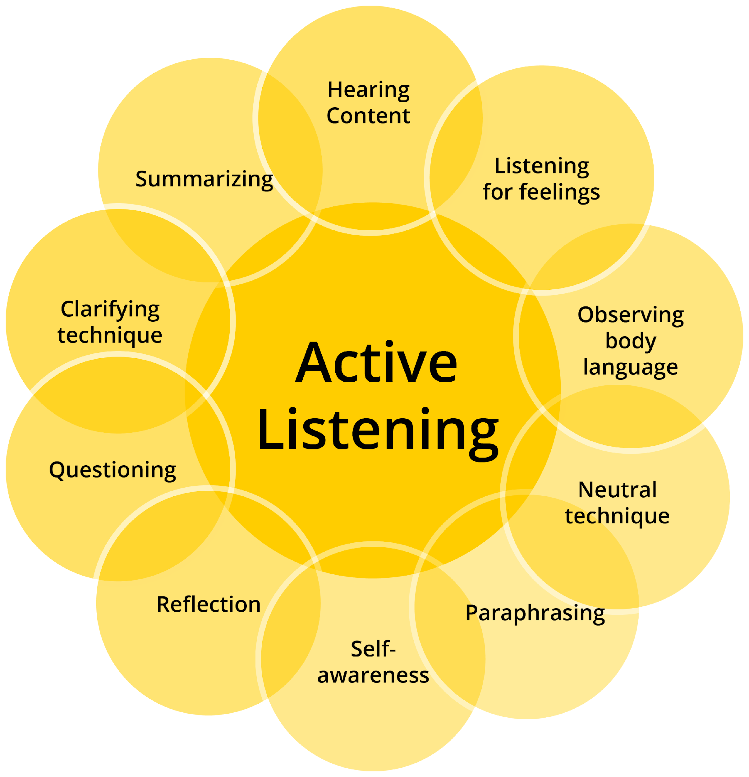
Active Listening

Slide 13
Suspend Judgement and Challenge Assumptions
Blind spots: Challenge assumptions

Slide 14
Suspend Judgement and Challenge Assumptions Activity
Instructions:
Break into teams of two and three and discuss instances where you can challenge your own assumptions and the spaces or opportunities where you can influence your team members to do the same.

Slide 15
Lean into Vulnerability/Discomfort
The Power of Vulnerability

Slide 16
Practice Empathy
Empathy consists of three parts:
Emotional sharing: experiencing the same feelings as others simply by observing them
Empathic concern: the desire or motivation to care for individuals in need
Perspective-taking: the ability to put yourself in someone else’s shoes

Slide 17
The benefit of being empathetic leader
Improves your teams collaboration
Can enhance creativity and problem-solving
Helps you provide better service to your stakeholders (fewer complaints)
Strengthens loyalty/retention
Increases buy in
Boosts morale and sense of belonging

Slide 18
How to influence or disrupt without Blame or Shame
Assume good intent—acknowledge and explain impact-describe
Ask a question—“What do you mean?” (assume good intent)
Interrupt and Redirect—“Whoa, let’s not go down that path.”
Walk away
Broaden to universal human behavior—”It’s not a gay thing, you can describe that to anyone.”
Narrow—Make it Individual, “You mean all (Asians, Black people, Managers) or someone in particular?”
Or just say “Ouch!”

Slide 19
Case Study
Break up into teams of three
Read the assigned case-study and discuss it with your group

Slide 20
Questions?

