Slide 2
•
•
•
•
•
•

Slide 6
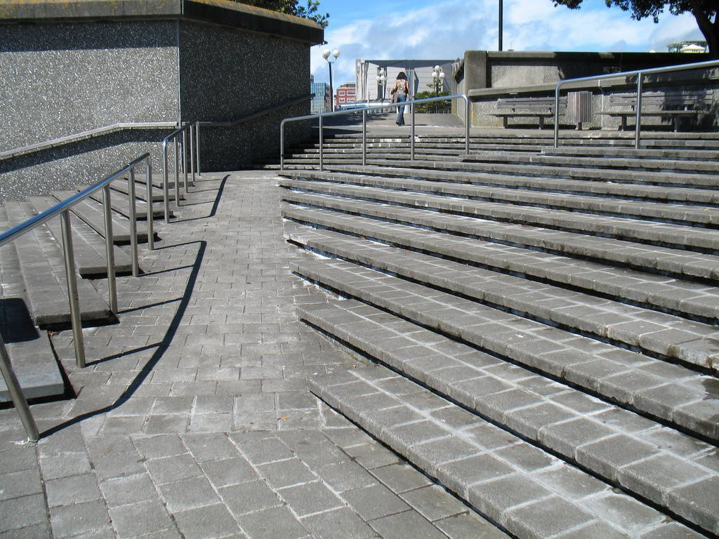

Slide 7
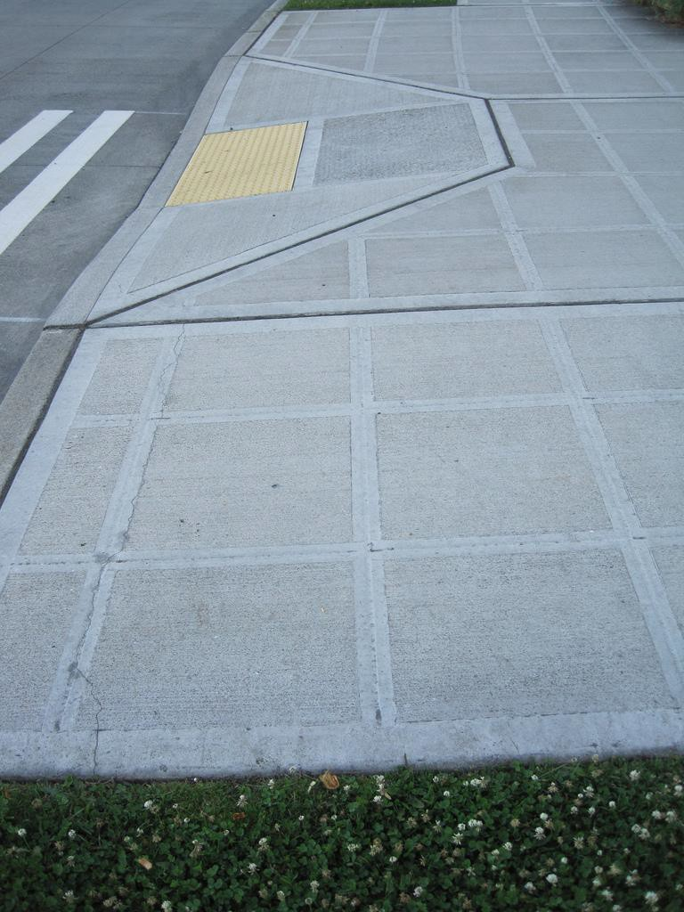

Slide 8
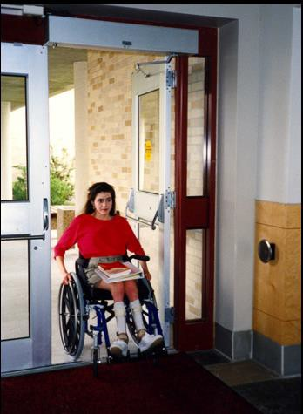

Slide 11
•
•
•
•
•
•

Slide 14
•
•
•

Slide 15
•
•
•
•

Slide 16
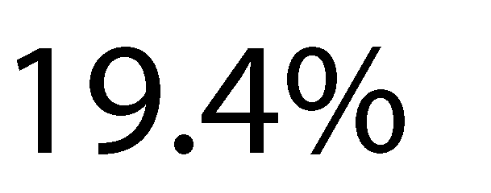
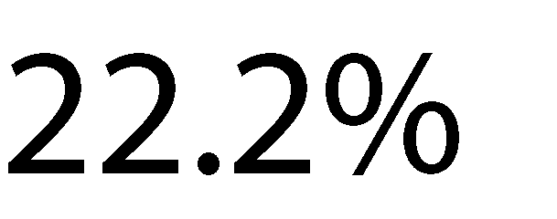
•
•
•
•

Slide 17
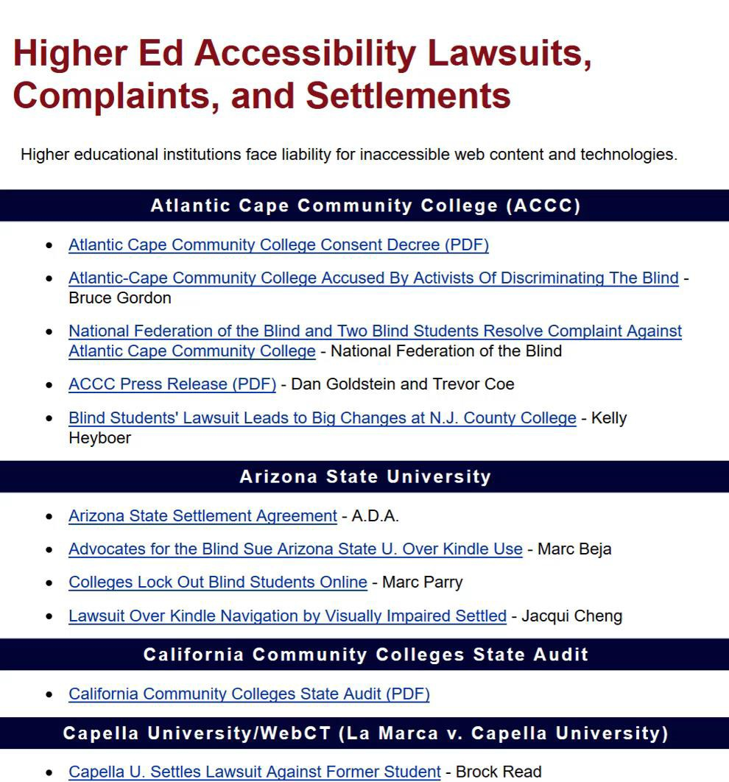
http://www.d.umn.edu/~lcarlson/atteam/lawsuits.html

Slide 19
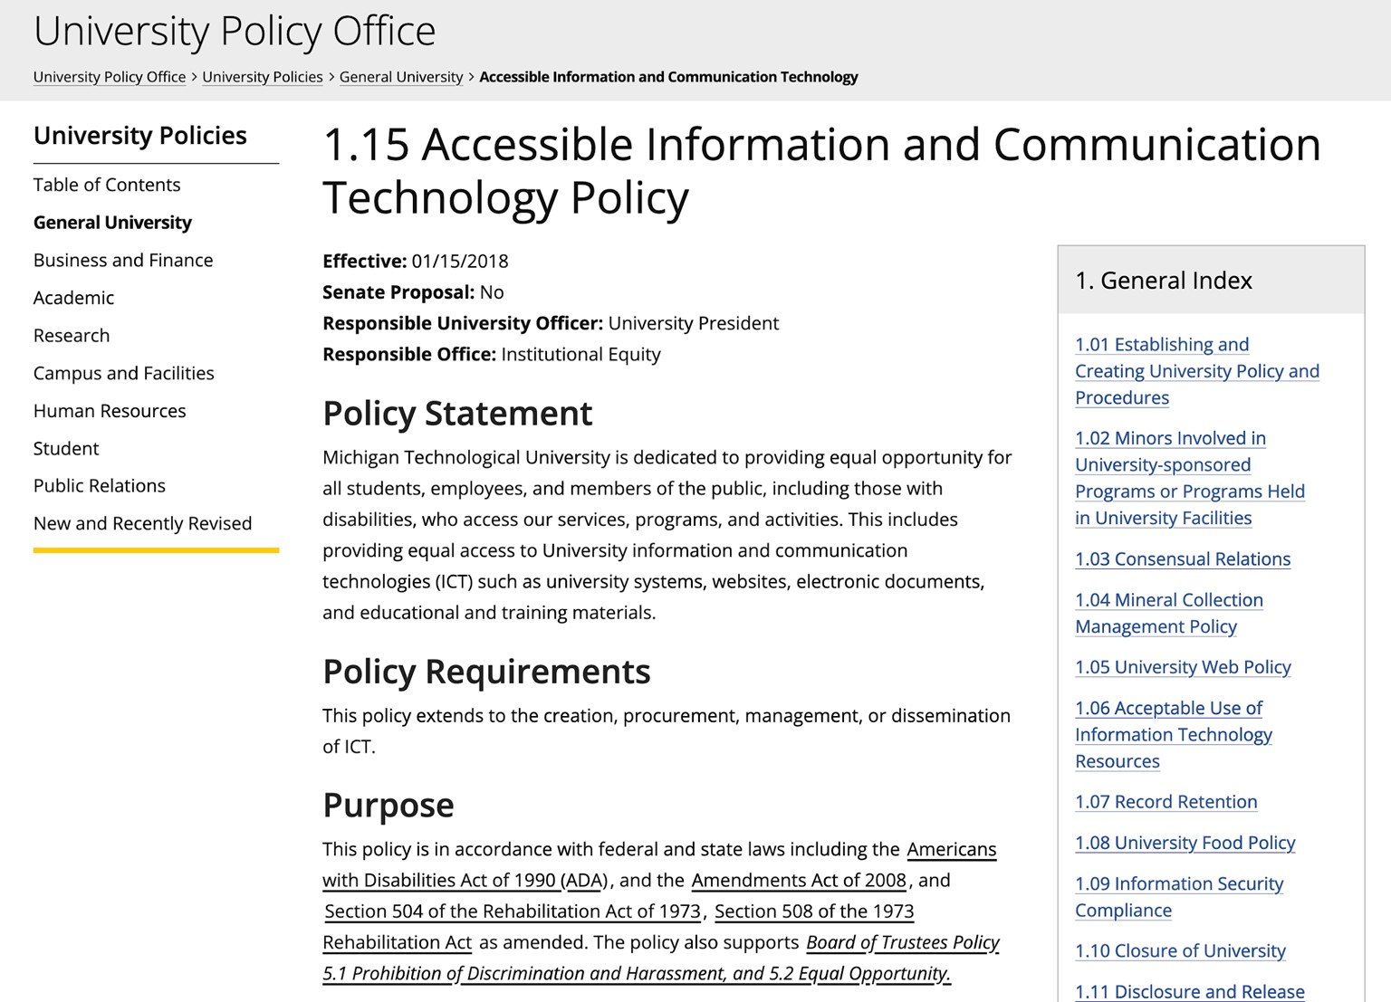

Slide 21
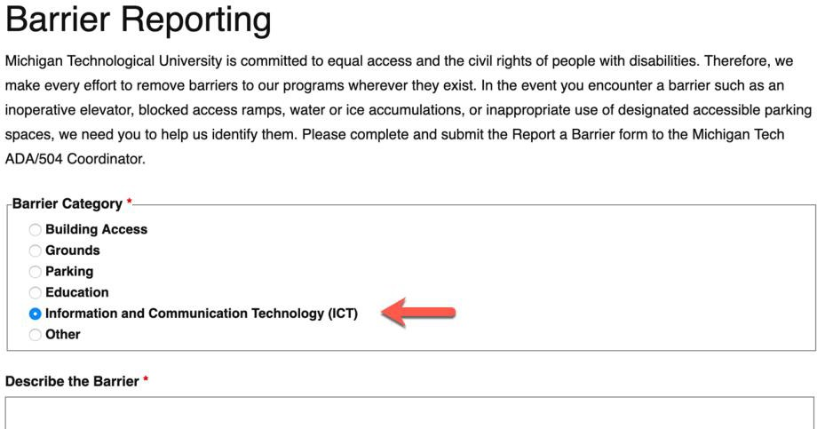
•

Slide 22
•
•

Slide 23
•
•
•
•

Slide 25
•
•
•

Slide 26
Why You Need to Know:
Web Accessibility
You may not be a person in your department or position that is responsible for creating or editing web pages, but you may:
be supervising or working with someone that does
be asking to put something on a web page
need to understand why there may be resistance to certain requests
want to outsource a website and need to ensure the vendor addresses accessibility

Slide 27
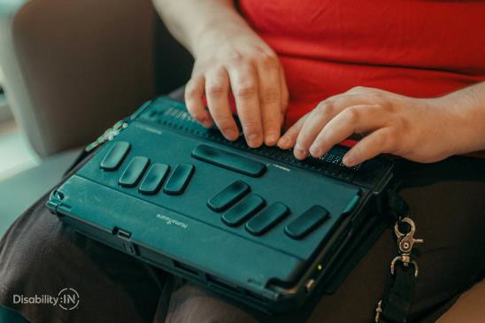
Assistive technology with websites:
Web Accessibility
Screen Readers
Voice Command
Keyboard Only
Refreshable Braille Keyboard, Sip/Puff devices, eye tracking software, etc.
Most of these devices/technologies rely on the same core
accessible code/features.

Slide 28
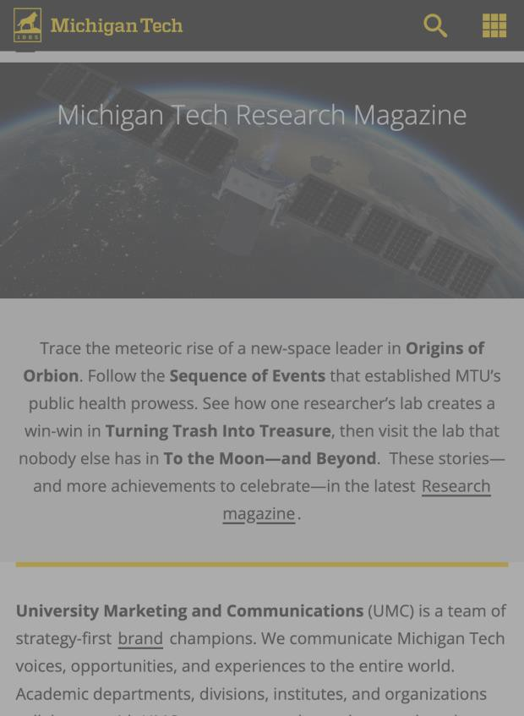
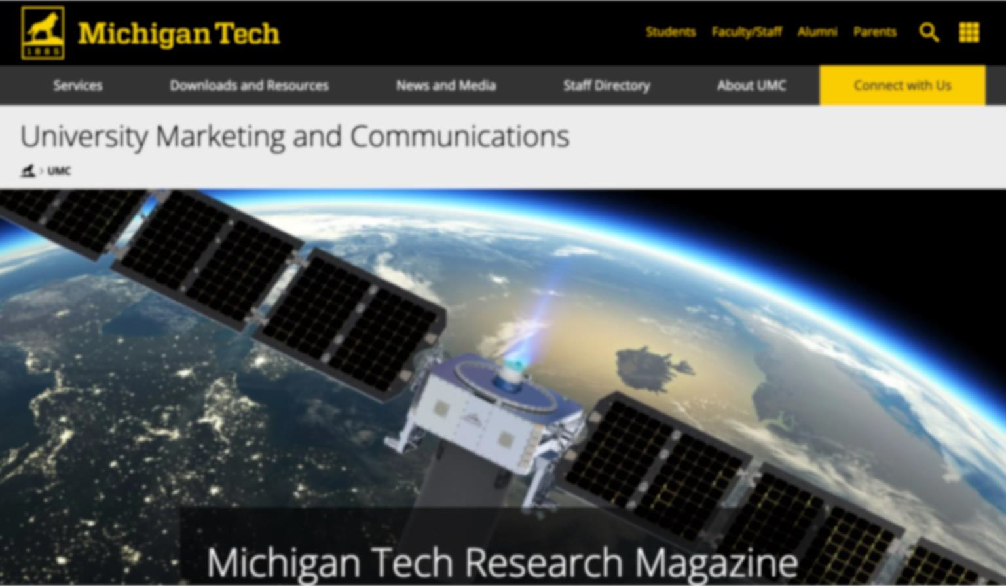
Experiences of Users
Web Accessibility
Making our websites accessible isn’t just crucial for those that have an easily identifiable disability or other challenge.
Blurred Vision/Tired Eyes
Low Contrast/Sunshine

Slide 29
Web accessibility (important elements)
Web Accessibility
Color alone not used to convey meaning
Color contrast ratios between foreground and background elements meet minimum standards (WCAG)
Proper heading structure
Images with alternative text descriptions
Closed Captions/Transcripts
Descriptive link text
Proper Form Labels
Tables with proper header information
Proper Lists

Slide 30
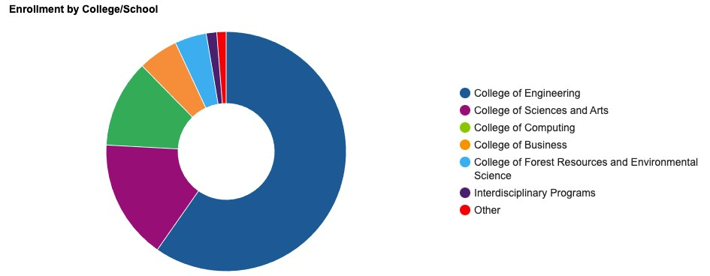
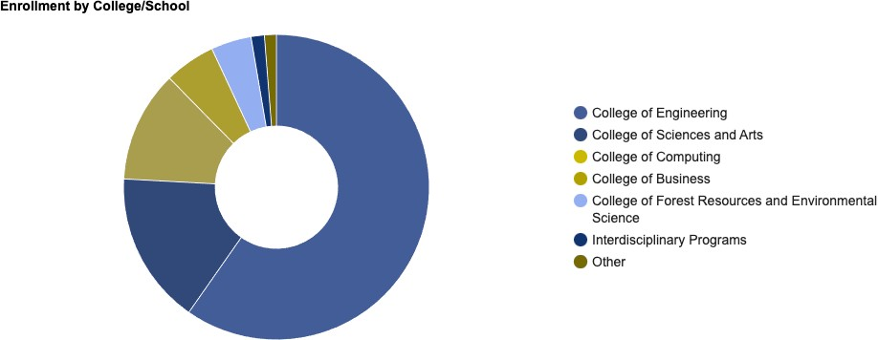
Color For Information
Web Accessibility
Full Range of Color:
Red-Green Color Deficiency:

Slide 31
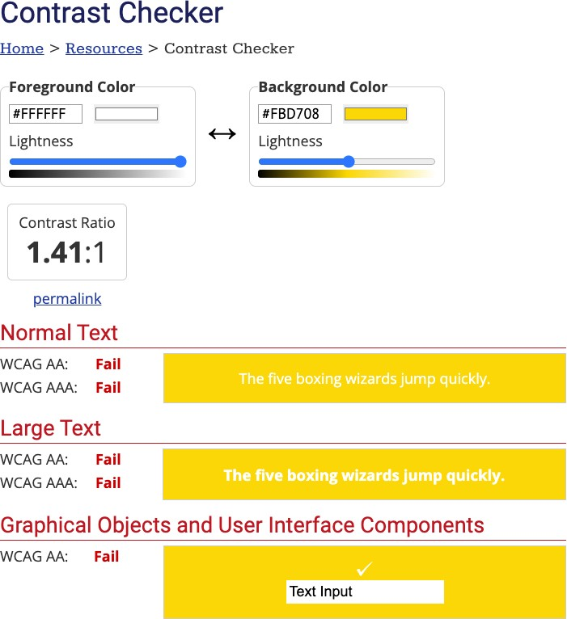
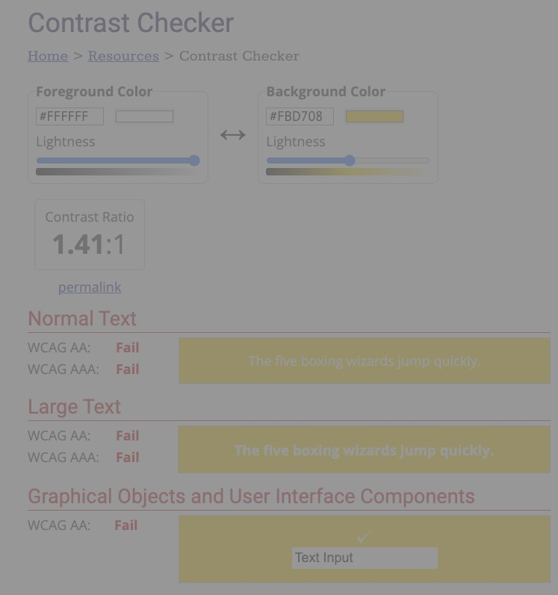
Color Contrast
Web Accessibility
Low Vision
No Color Vision
Sunlight
(phones/tablets)
Full Color
Low Contrast/Sunlight

Slide 32
Screen Readers on Web Pages
Web Accessibility
Not just for those visually impared (learning disabilities, cognitive disabilities etc.)
Navigate/explore by headings/links
Read text on the page
Read table data
Read alternative text
Punctuation matters
Don’t recognize Acronyms

Slide 33
Voice Control on Web Pages
Web Accessibility
Scroll page
Navigate/Click links
Press buttons
Speak to fill in search fields, forms

Slide 34
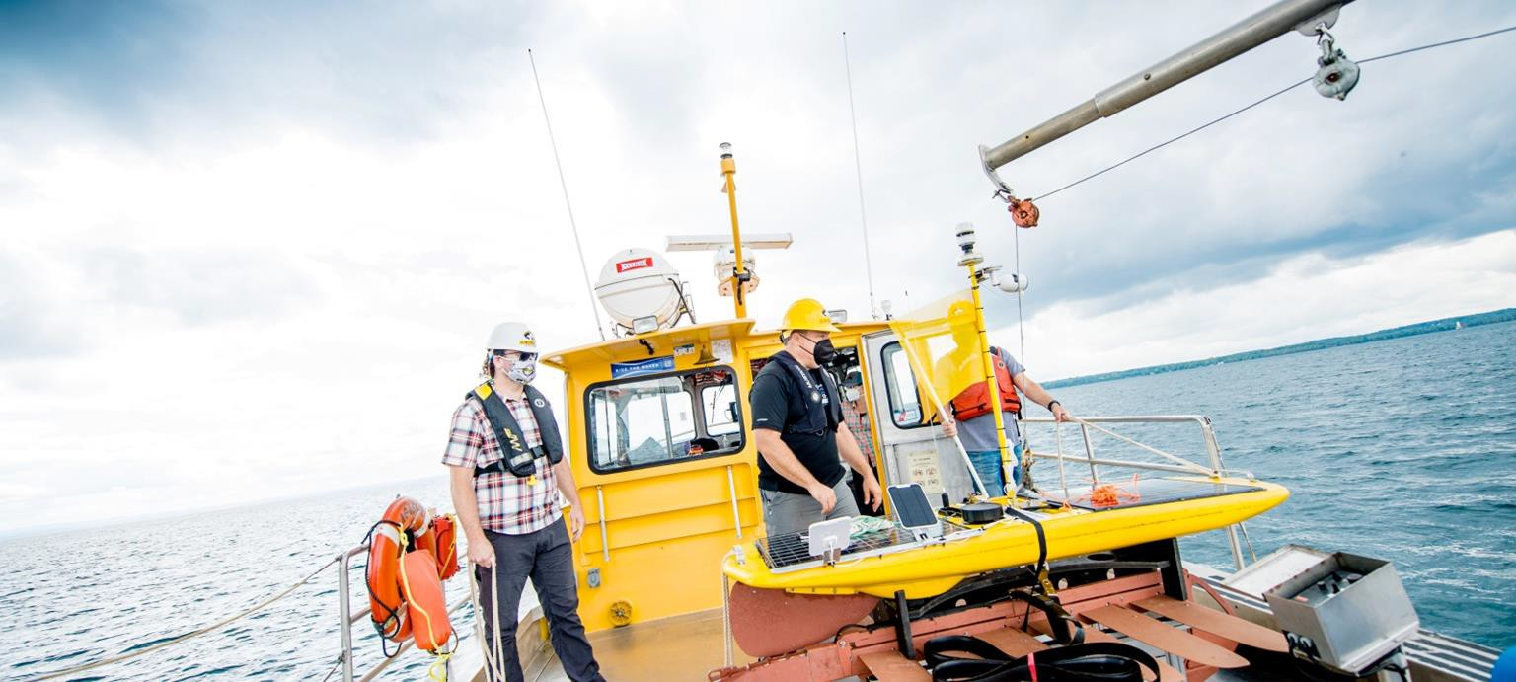
Appropriate Alternate Text
Web Accessibility

Slide 35
Appropriate Alternate Text
Web Accessibility
Three men on a boat - Not descriptive enough
Three men in protective gear onboard the gold colored Agassiz research vessel in Lake Superior. They are unloading a device into the blue water while clouds float overhead - Too much
Researchers on the Agassiz research vessel in Lake Superior
unloading a device - Good

Slide 36
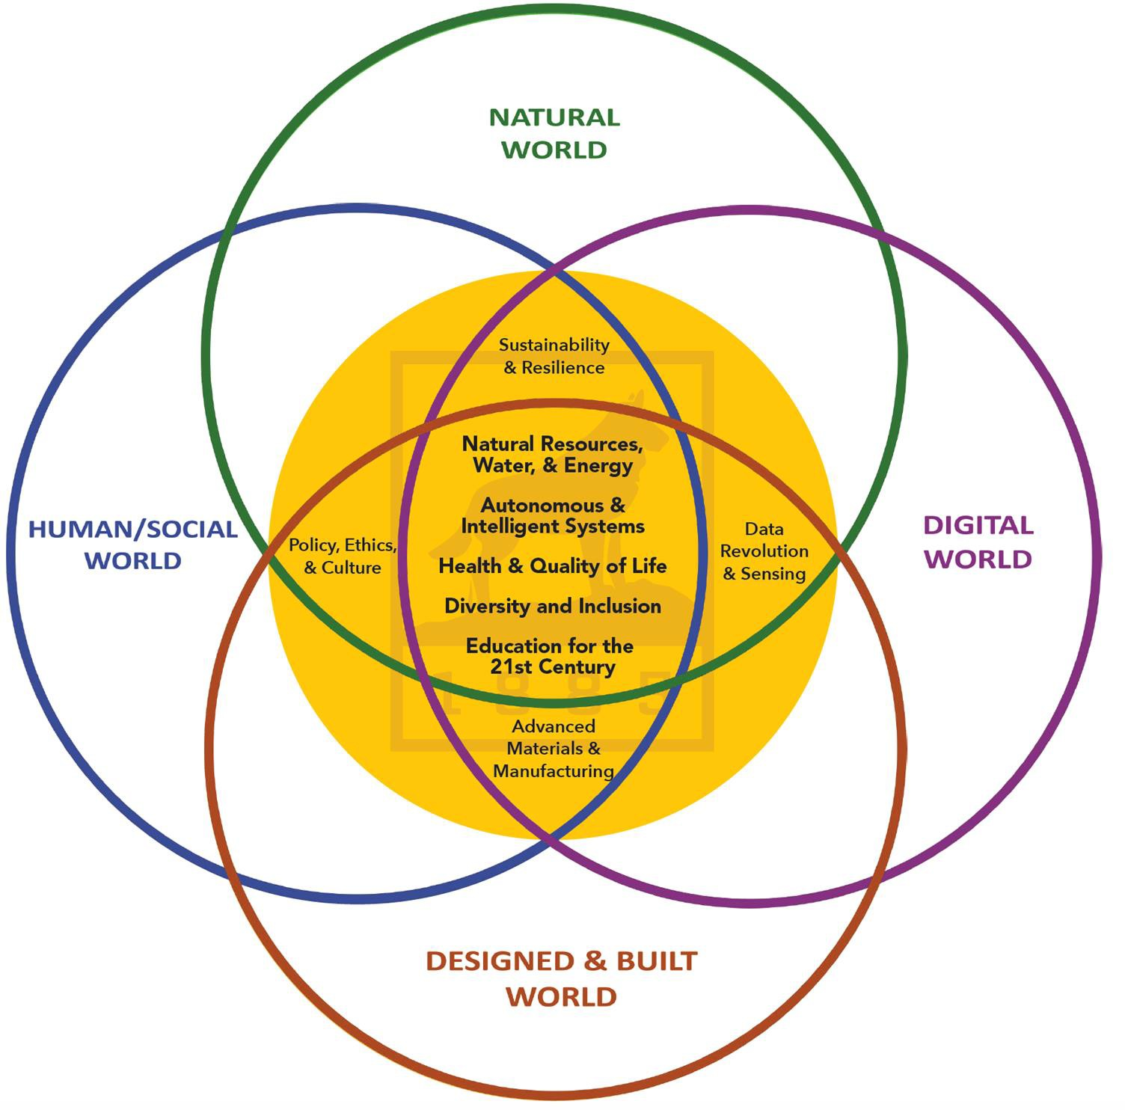
Alternate Text on Infographic
Web Accessibility

Slide 37
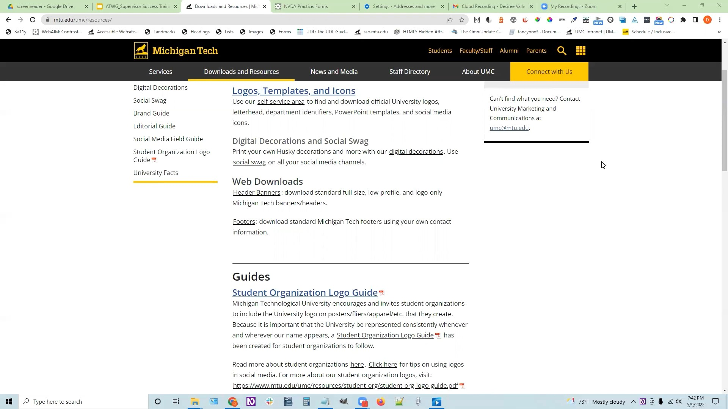
Screen Reader- Link Text
Web Accessibility

Slide 38
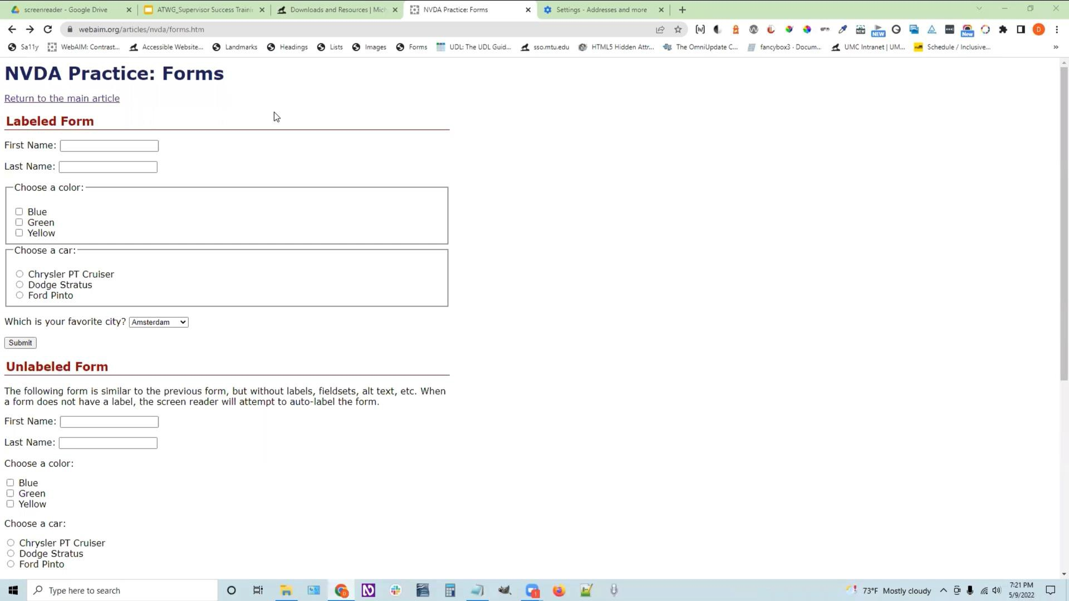
Screen Reader- Form Labels
Web Accessibility

Slide 39
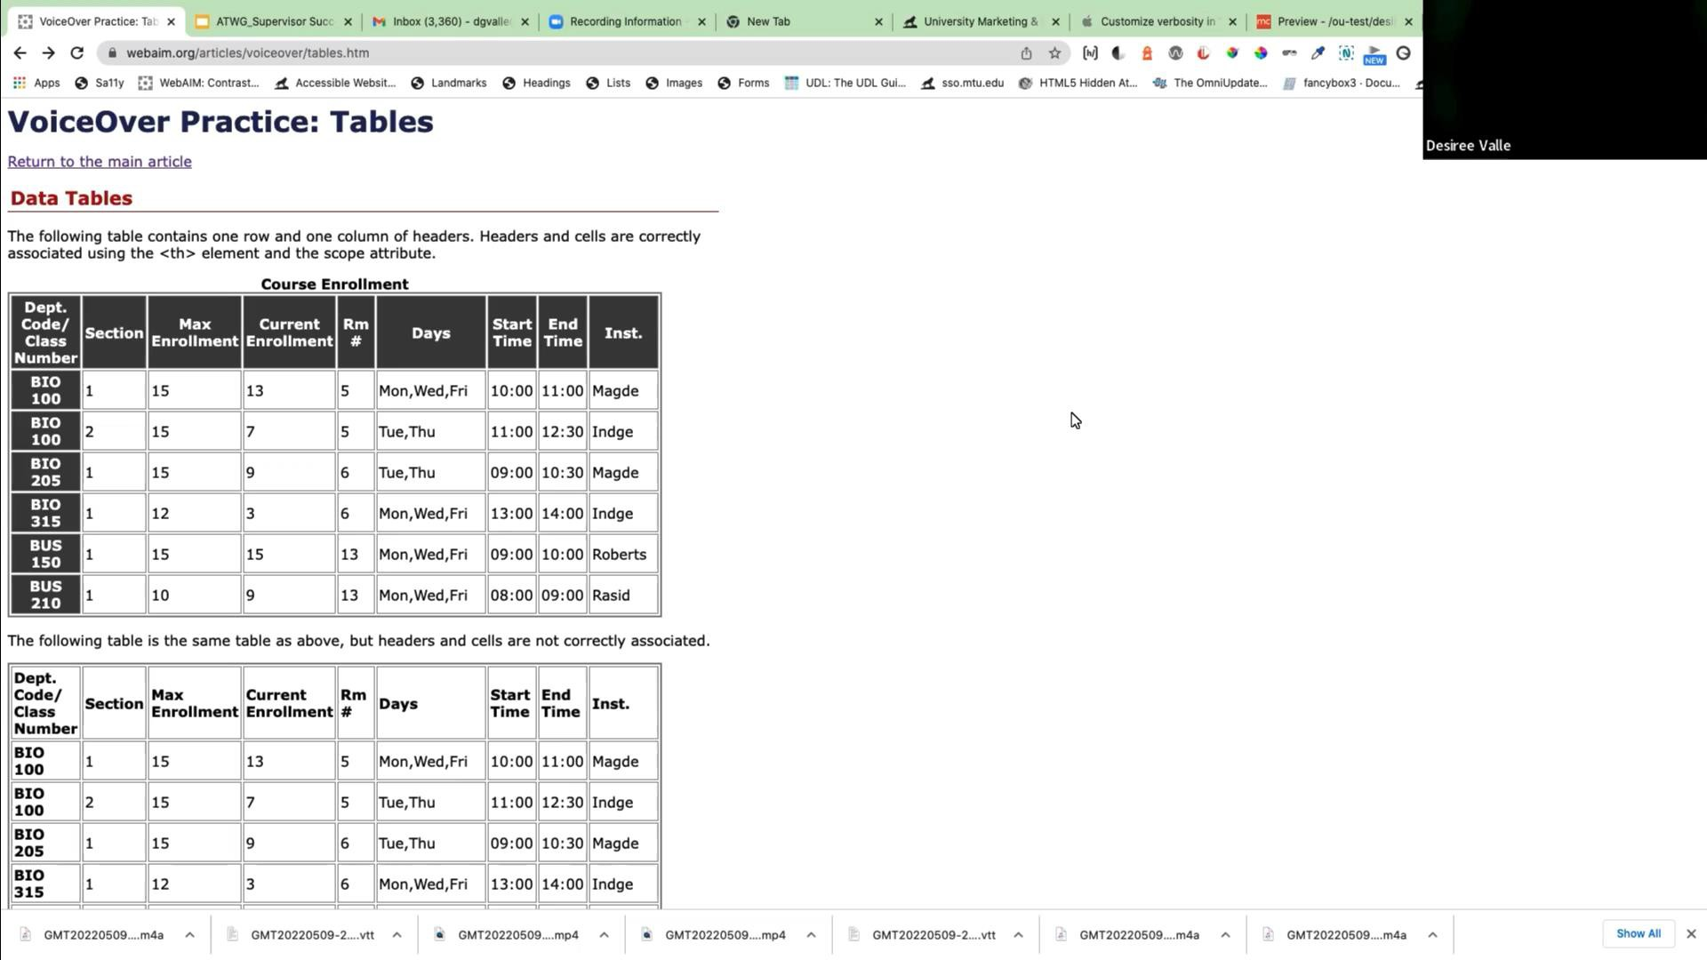
Screen Reader- Table Data/Headers
Web Accessibility

Slide 40
Outside Website Vendors
Web Accessibility
Web content on Michigan Tech public websites must be accessible, as outlined in our University Policy
Ensure verbiage is in the vendor contract to specify that all
products and services will be accessible and meet WCAG 2.0 guidelines in addition to following brand standards and university web requirements.

Slide 41
Accessibility Audits/Reviews
Web Accessibility
Your site may be periodically audited or reviewed. Web accessibility procedures will be followed for any audits or submitted complaints that reveal issues.
Any costs associated with remediation efforts to meet web accessibility guidelines are the responsibility of the Michigan Tech person or group that manages the website.

Slide 42
•
•
•
•

Slide 43
•
•

Slide 44
•
•
•
•
•
•
•
•

Slide 45
•
•
•
•

