Slide 1
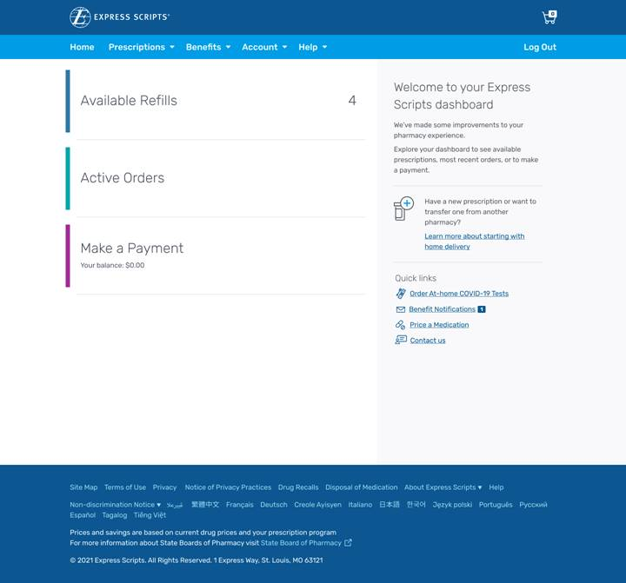
Landing page
COVID-19 Resource Center page provide direct link to landing page after member login
After login, quick link shown on homepage on the right hand side

Slide 2
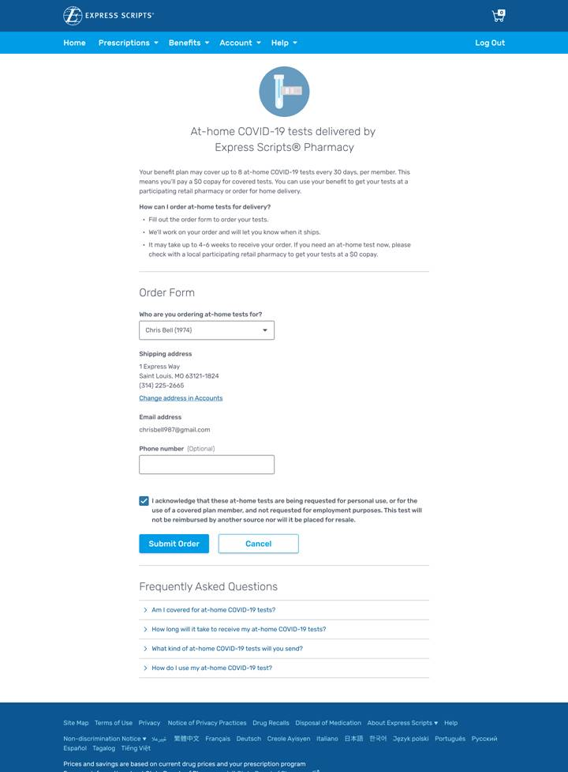
Order form
Drop down section provides members available under benefit to order COVID-19 OTC Test kits
Member information including shipping address and email address auto populated
Member must acknowledge attestation before submitting order
Frequently asked questions available below form

Slide 3
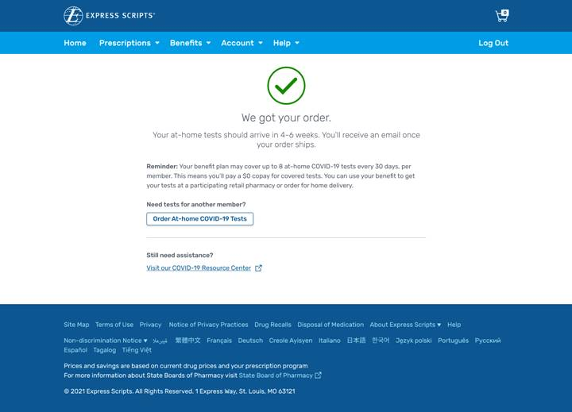
Confirmation page
After order is submitted, the confirmation page is shown
This page also allows for a quick link to order COVID-19 OTC test kits for another member

