Slide 1

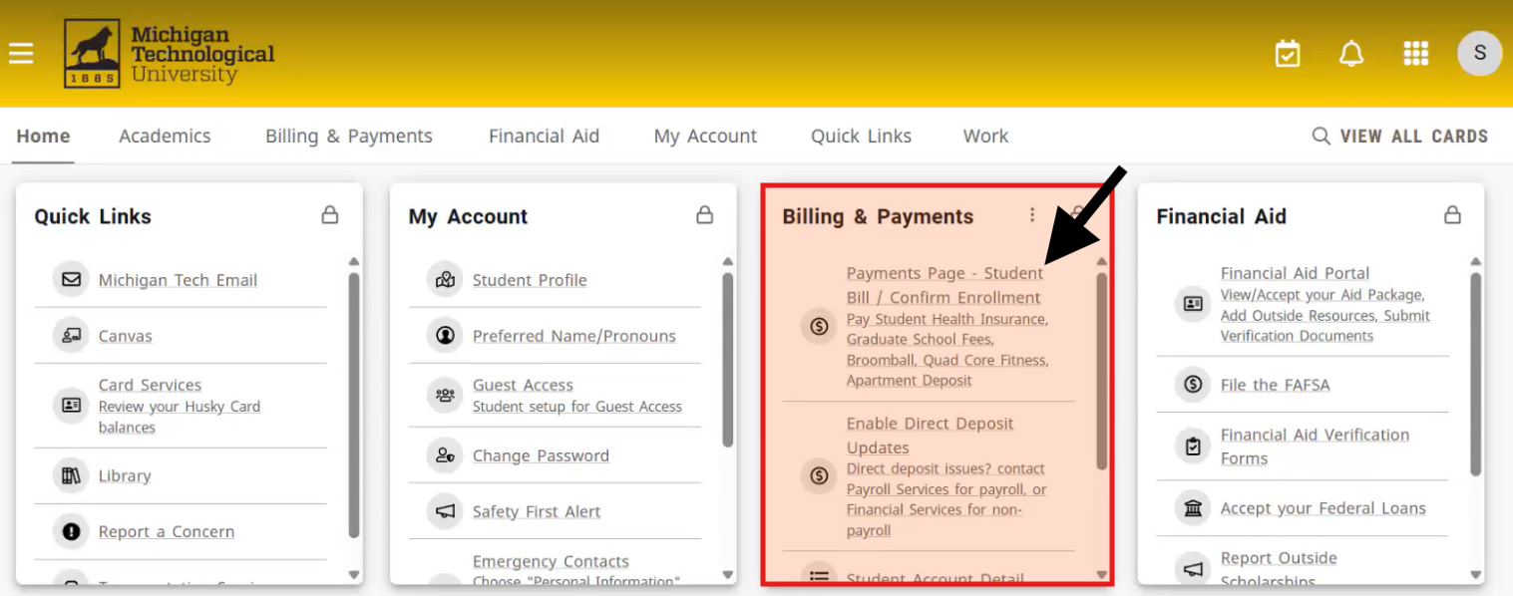
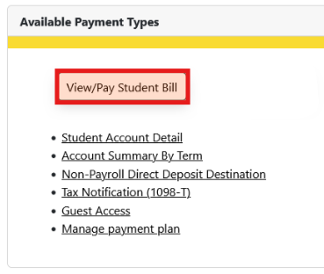
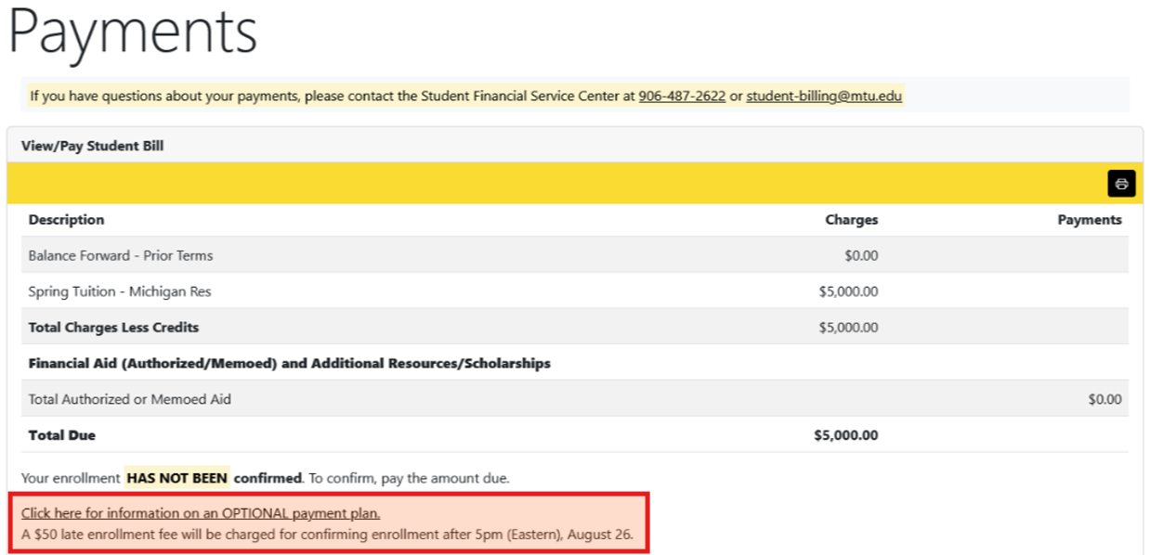
Log into MTU Experience
Log in to the Michigan Tech Experience portal. From the Experience dashboard, locate and select the Billing and Payments card.
Within the Billing and Payments card, click the Payments Page - Student Bill/Confirm Enrollment link. This will take you to the Student Account Services payment page.
Select View/Pay Student Bill from the payment page.
On the Student Bill page, select Click Here for Information on Optional Payment Plans to access the PayMyTuition Payment Center.

Slide 2
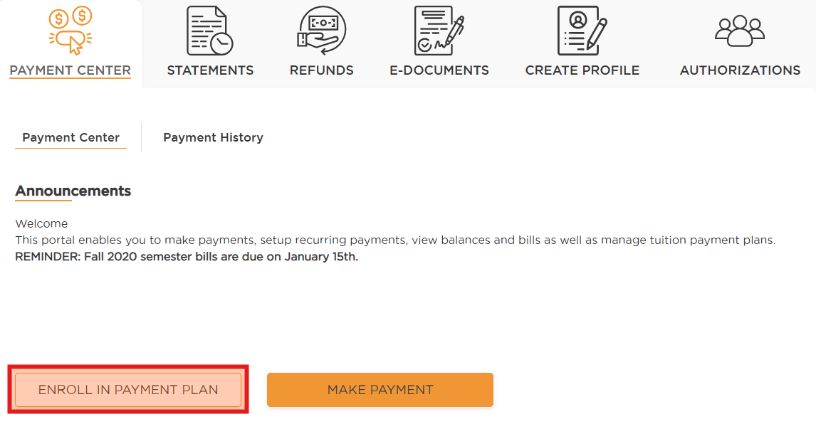
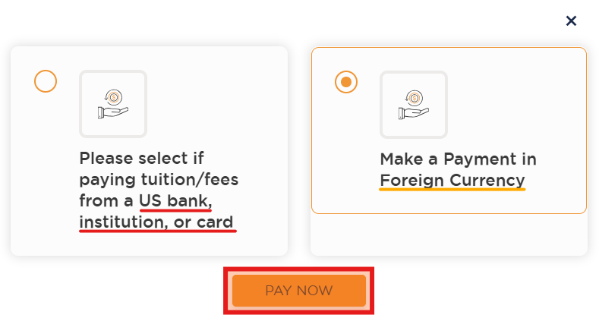
Enroll in Payment Plan
If you are eligible to enroll in a payment plan, the ENROLL IN PAYMENT PLAN button will be available in the PayMyTuition Payment Center.
Only students can enroll in a payment plan. Authorized Users may make subsequent installment payments but cannot enroll a student in a payment plan.
Select the ENROLL IN PAYMENT PLAN button to begin the enrollment process.
Note: International students will be given the option to pay from a domestic bank or card, or from an international bank, institution, or card. Ensure you are making the right selection according to your source of funds.
Domestic students will not have a currency option and can proceed to page 3 of this guide.
Once you have selected your desired currency, if applicable, select the PAY NOW button.

Slide 3
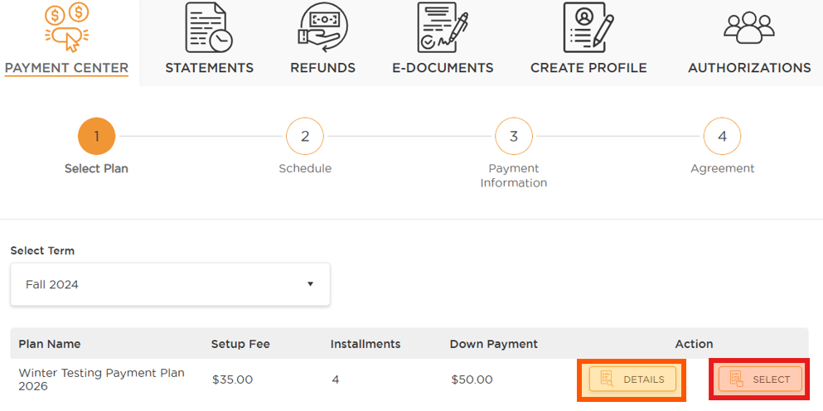
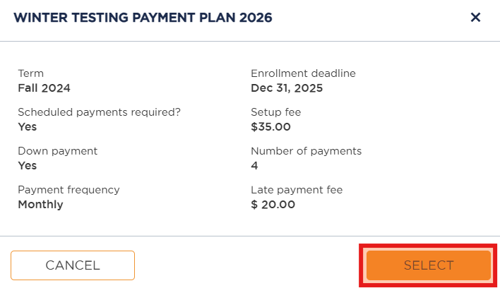
Select Payment Plan
Step 1: Select Plan
The Payment Center will default the Select Term field to an eligible term for a payment plan. Use the drop-down arrow to see if other term plans are available.
To view the plan(s) you are eligible to enroll in, review the available list for the selected term.
Select the Details button to see a preview of each plan, including the applicable term, down payment and setup fee requirements, payment frequency, and more.
After reviewing the plan details, click SELECT to continue or CANCEL to exit the Plan Details pop-up.

Slide 4
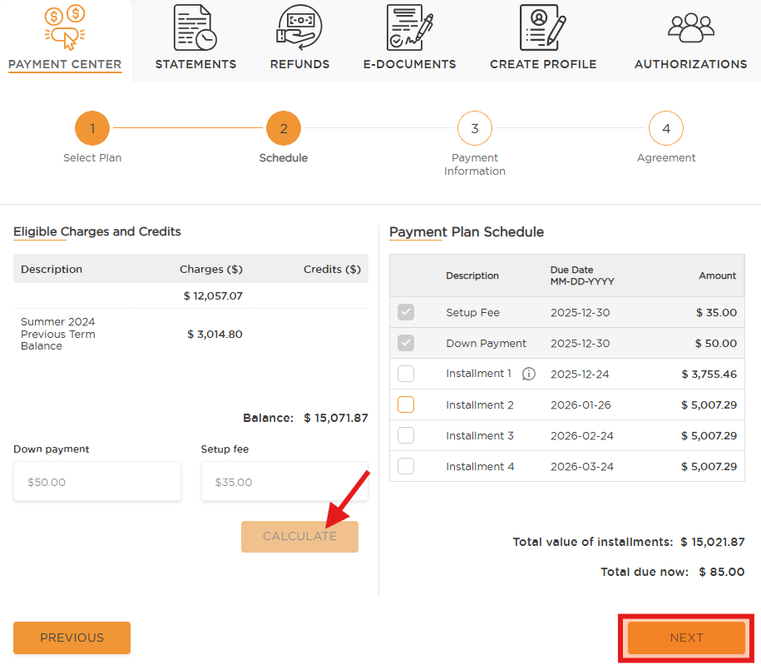
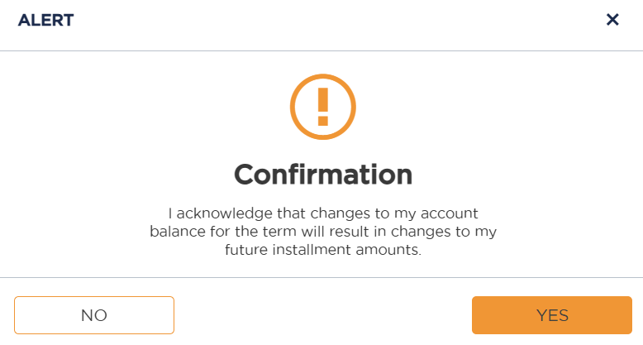
Step 2: Schedule payments
Step 2: Schedule
This section shows the eligible charges and credits for the payment plan, along with the overall balance. If applicable, down payment and setup fees will also be displayed.
Select the CALCULATE button to generate your Payment Plan Schedule.
Installments selected by default must be paid immediately to enroll in the plan.
Installments not selected by default can be added by the payer to increase your initial payment, which will reduce the amount of your remaining plan balance.
Review the payment plan schedule, the total value of installments, and the total due now before proceeding. Click NEXT to continue.
Note: You must acknowledge that any changes to your account balance for the term may affect your future installment amounts before proceeding.

Slide 5
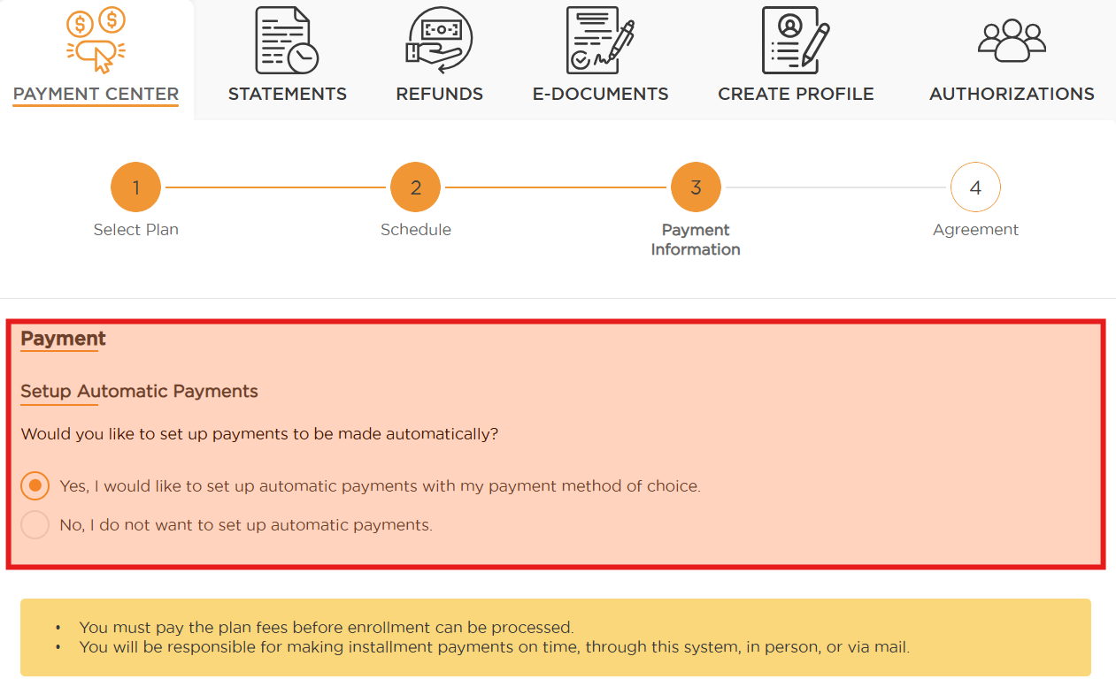
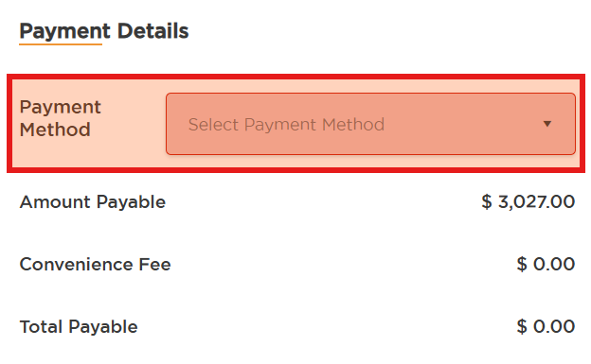
Step 3: Payment Information
Step 3: Payment Information
PAYING FROM A US BANK OR CARD
If your selected payment plan supports automatic payments, you may be asked whether you would like to enable auto-pay using your preferred payment method. If you choose not to enroll in automatic payments, you are responsible for submitting each payment manually before the installment due date.
Note: If you are paying with a foreign bank or card, automatic payments are not available.
Use the drop-down menu to select your preferred Payment Method. Upon enrollment, payment options from US banks or card include ACH or Credit Card.
You will be prompted to enter your ACH banking details or your billing details for credit card payment.
Before clicking ADD, you can set this as your default payment method for future installments; otherwise, a default must be set before your next due date.

Slide 6
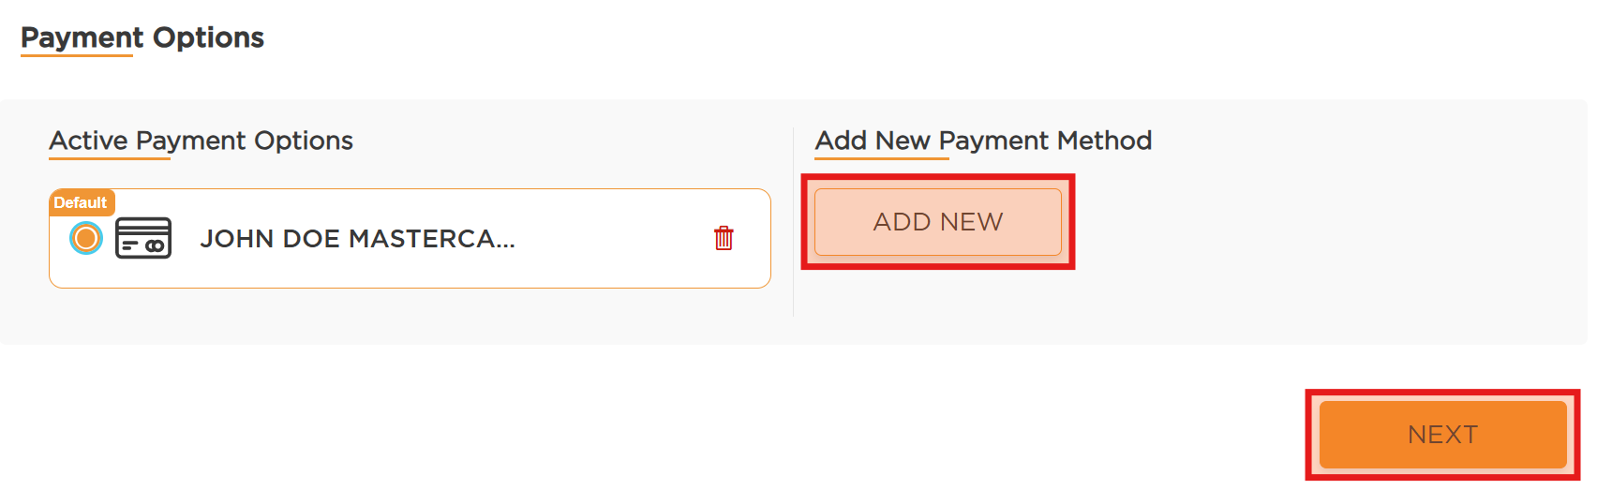
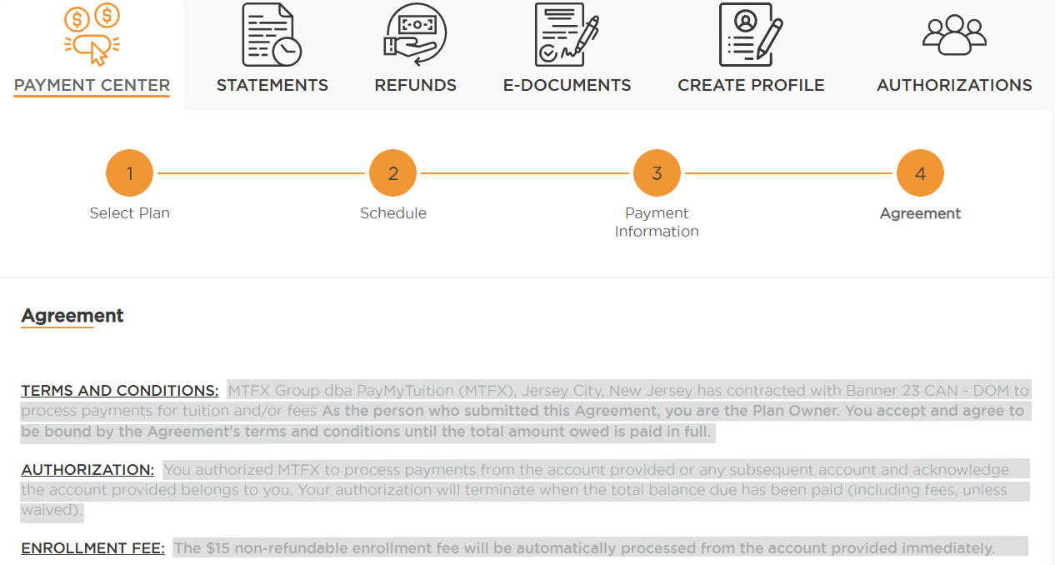
Payment Options / Payment Plan Agreement
If the selected payment method is ACH or Credit Card, select the account from the Active Payment Options section, then click NEXT.
If you already have a saved Active Payment Option you’d like to use, select it (if it’s not automatically selected), then click NEXT.
Step 4: Agreement
Carefully review the entire Payment Plan Agreement to ensure you understand all terms, conditions, and obligations.
Once reviewed, check I agree to the Terms and Conditions, provide your electronic signature, and select PAY NOW to process your payment and enroll in the payment plan.

Slide 7
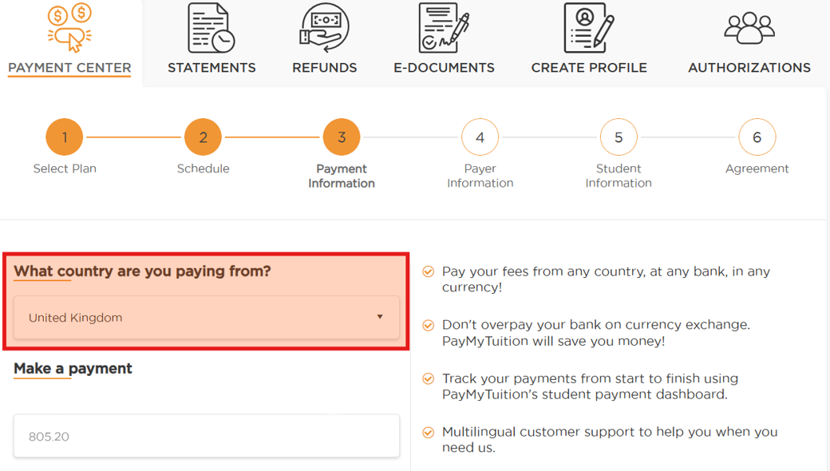
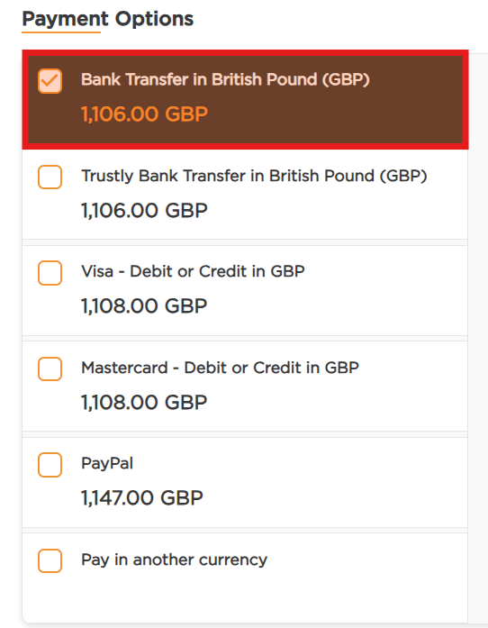
International Payment information
IF PAYING FROM AN INTERNATIONAL BANK OR CARD
follow the steps outlined on pages 3 and 4 of this guide, then proceed to Step 3 below.
Step 3: Payment Information
What country are you paying from?
Use the drop-down menu to search for and select the country you are paying from.
The Make a Payment section will automatically populate the payment amount that will be settled to your institution in US dollars.
In the Payment Options section, select your preferred method of payment. Available options may include local bank transfers, credit or debit cards, and eWallets.
Once selected, click NEXT.

Slide 8
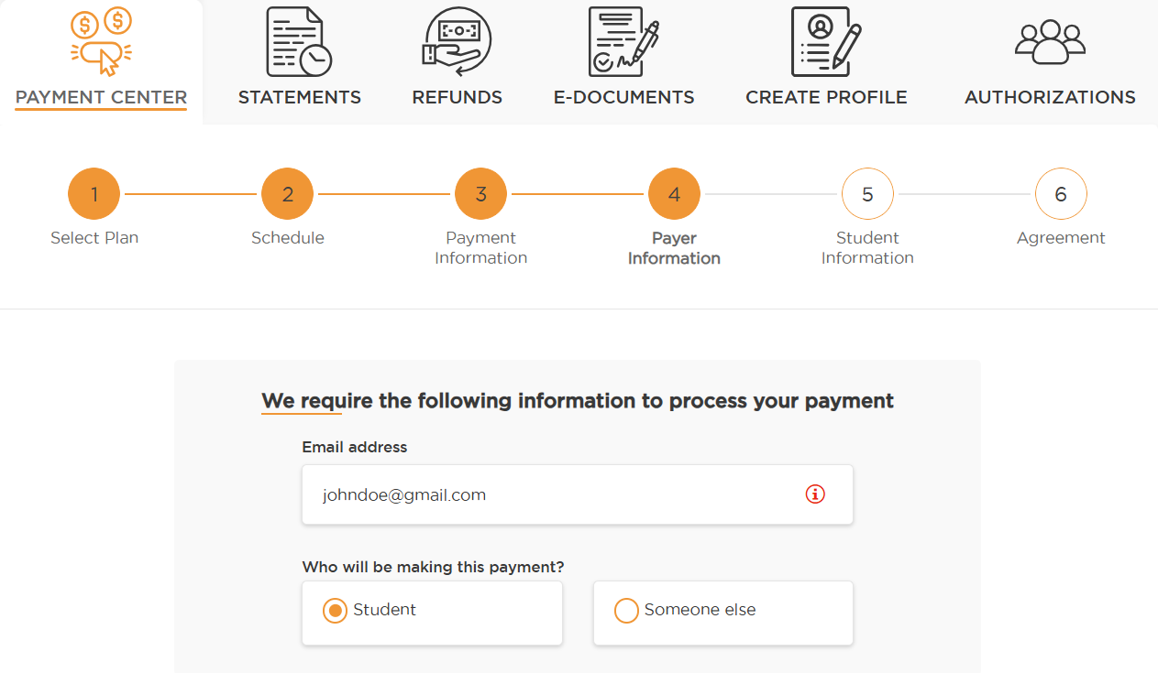
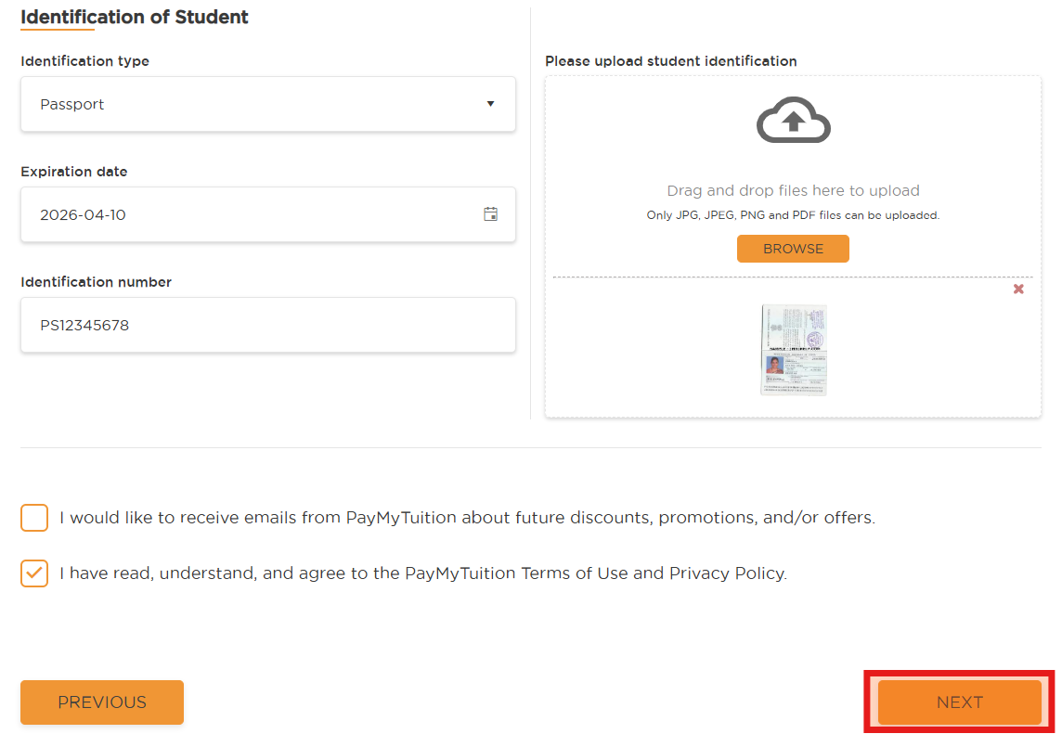
International Payer Information
Step 4: Payer Information
Students or payers paying from an international bank, institution, or card, will need to review information populated in the Payer Information section.
Ensure all required fields are completed accurately.
The Identification of Student/Payer section requires government-issued identification details and a copy of the corresponding ID for the student (or the payer, if different) to ensure compliance with anti-money laundering regulations when making a payment to the institution.
Select NEXT at the bottom of the page to proceed.

Slide 9
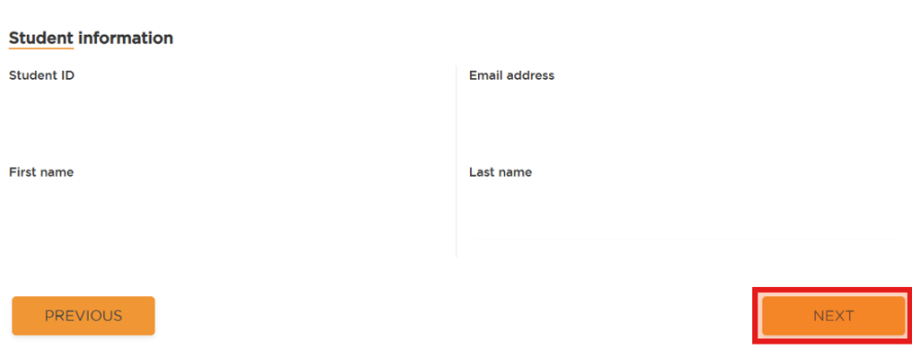
Student Information/Payment Plan Agreement
Step 5: Student Information
The student information section will default according to the information on your student profile.
Select NEXT.
Step 6: Agreement
Carefully review the entire Payment Plan Agreement to ensure you understand all terms, conditions, and obligations.
Once reviewed, check I agree to the Terms and Conditions, provide your electronic signature, and select PAY NOW to obtain your payment instructions.

Slide 10
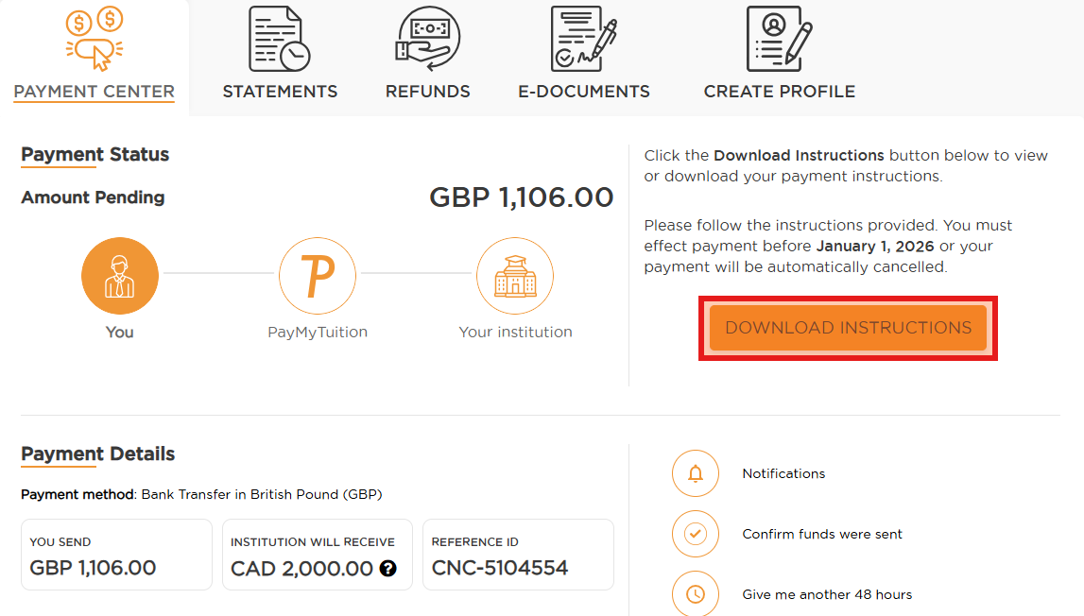
International Payment Status
You will be directed to your Payment Center tracking dashboard.
From this dashboard, you can view payment details and manage your transaction, including adjusting notifications, confirming that funds have been sent, requesting an additional 48 hours on your rate, cancelling your payment, or accessing the Payment Center.
To complete your payment, select DOWNLOAD INSTRUCTIONS (for bank transfers) or PAY NOW (for credit card or e-wallet payments) to retrieve the necessary payment instructions.
Once your payment is successfully processed, you will be enrolled in the Payment Plan.
Note: If you are paying from an international bank, financial institution, or card, installment payments will not be automatically scheduled. You are responsible for completing each payment before the installment due date by accessing the PayMyTuition Payment Center.
International payments may take 2–7 business days to process.

