Slide 1
Supervisor Success Series

Slide 2
Series Objectives
Ensure comprehensive development and training for supervisors
Ensure supervisors have the core competencies to support their employees
Notes:
For the entire 3-section series (18 modules)

Slide 3
Setting and Managing
Workplace Expectations
AGENDA
Section #1
Setting Expectations
Section #2
Performance Management and Supporting Expectations through Workplace Culture
Notes:
Today’s Agenda

Slide 4
Instructional Objectives
Supervisor will be able to review job descriptions and develop employee expectations, onboarding and training based on current roles and responsibilities.
Supervisor will be able to complete the University’s performance management cycle with each employee they’re responsible for.
Supervisor will be able to create and communicate general and specific workplace expectations.
Supervisor will be able to integrate workplace expectations with daily and weekly employee interactions through coaching conversations and structured meetings.
Notes:
Why setting and managing workplace expectations is important. Systems thinking overview of setting and managing workplace expectations.
Operationalizing the job description through onboarding and training

Slide 5
Section 1 Agenda
Discussions of pre-work reflections
Why are expectations important
Lifecycle of expectation setting and management
Job descriptions
Onboarding and training
Industry best practices and critical success factors

Slide 6
Pre-work
View Setting Expectations
View Set clear expectations with individuals
1. What about clear expectations do you value in your own work?
2. How does expectation setting help you be more effective in your work?
3. What is hard about setting expectations?
Notes:
Briefly discuss themes that emerged in the Canvas module reflections

Slide 7
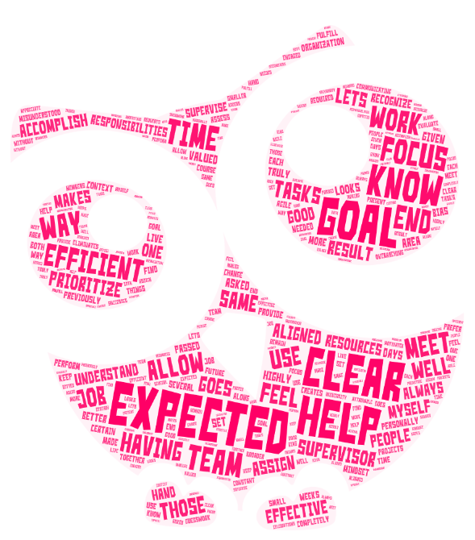
Notes:
What about clear expectations do you value in your own work?
Having clear expectations from my supervisor helps me to prioritize my goals and use my time and resources in the most effective and efficient way. The same goes for the people I supervise.
Clear expectations in my job lets me know what's expected from me so I can focus on what my responsibilities and goals are. This makes me efficient in meeting those goals.
Clear expectations help me to recognize when my work is aligned with the goals of the organization. It always helps to understand "what good looks like", so we can be efficient and effective, personally, and as a team.
Clear expectations are highly valued as I misunderstood one supervisor completely previously. I asked several times on certain tasks but didn't understand their mindset and didn't perform the tasks as expected. On the other hand, when I've been given or passed on assignments with clear expectations the results are better than expected.
Clear expectations allow me to focus on overarching area goals and provide the context for communicating with the team so we can work together to meet those goals.
Clear expectations allow me to focus on what is truly needed or required to fulfill my work. Knowing what is expected of me eliminates the “guesswork” and creates more efficiency.
Clear expectations help me know what things to focus on and how to prioritize my days and weeks.
Clear expectations help me to assess projects, assign them, and in the end result evaluate them without bias.
Having clear expectations allows me to set a course for myself and our team for the present and future. We live in a time of constant change and must remain agile to accomplish all of the requests that are made of each of us. I prefer to have both smaller attainable goals as well as broader, university aligned goals to allow for small successes and celebrations along the way. I find this most helpful to keep myself as well as team members motivated and engaged.
I appreciate clear expectations because I know the end-goal and feel accomplished when I meet it.
Clear expectations help me to feel accomplished.

Slide 8
Notes:
How does expectation setting help you to be more effective in your work?
Setting clear job expectations and role definitions keeps my supervisees focused, reduces confusion, and provides them with the context and goals that they can independently follow. This eliminates the need for micromanagement, making my work more effective.
Expectation setting eliminates guessing and wondering if I am doing the job correctly.
I find that communicating my expectations to my team is the best way to achieve results. While it is sometimes hard work to set the expectations, I am never disappointed with the outcome when I do a good job of sharing my vision for where we need to go. It is fun to do, and it gives me a good opportunity to engage with the team and develop creative ways to get to the goal.
Clear expectations help improve efficiency and productivity.
Setting clear expectations provides a roadmap for impact and empowers team members to own their outcomes which allows me to focus on my own priorities. We have found that clear expectations with tools for deliberate practice has helped everyone be more successful.
Expectation setting provides the needed foundation for employees to feel empowered on. Employees are more focused on their tasks and better outcomes are then produced.
Setting expectations helps me allow my team to accomplish their task with out constant supervision.
Expectation setting allows me to plan and address schedules and budgets.
Clear expectations and job role definitions help to keep me focused. They provide context and understanding. This helps to provide the space for discussion of priorities for myself, my supervisor, our team and how these align with the direction the University is moving.
Expectation setting helps me to prioritize my work, and prevents me from wasting time going down the wrong path. This is important (especially now) when it seems as if we're all doing more with less resources. Also, clearly setting expectations for others allows them to work independently with less supervision.
Setting expectations helps me to know that I am on the right track with what is expected of me.

Slide 9
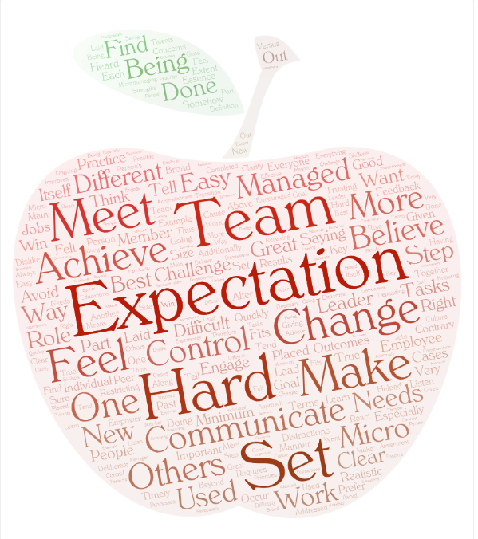
Notes:
What is hard about setting expectations?
To make the expectations realistic and achievable, and to avoid micro-managing.
The hard part about setting expectations is to make them too easy or too hard to achieve.
Setting expectations is hard when the team is not used to have expectations placed on their work. They often feel like new expectations are somehow restricting or controlling them. On the contrary, if done right, a team with clear expectations quickly finds itself achieving great results and feeling IN CONTROL, not CONTROLLED by others. That, to me, is the essence of a good leader. Not to TELL, but to engage and empower others to work together and win.
Expectations can be hard to communicate but in most cases if expectations are given and communication is encouraged, tasks will be completed in a timely manner. I believe in trusting your employees to do their jobs; there's more than one way to do just about everything. Lead by example, not by micromanaging.
Setting expectations can be difficult when team members have different needs in terms of how they like to be managed and want to feel they've been heard and their their needs and concerns have been addressed. Some want very clear step-by-step tasks laid out to meet the expectation and others prefer a broad assignment. Challenges also occur when one person's definition of accomplishment is doing the minimum to meet the goal and another person on the team believes meeting expectations requires going above and beyond the minimum. It was especially challenging when people who were not used to having expectations were resistant and felt they were being micro-managed. Which was true to an extent, but the great outcomes from deliberate practice has helped to change the culture.
I think the main challenge with setting expectations is that everyone has different needs depending on their role, experiences, and competencies. It is not a one-size-fits-all approach. It’s important to meet with each member of the team to listen and learn more about their individual strengths and expertise. Additionally, I believe giving and receiving feedback is key. Feedback improves clarity and employee engagement.
Expectations are hard because communication is hard. People tend to dislike change and therefore react to what they think you are saying and not necessarily what you are saying.
Individual skillsets and talents can often change or alter the expectations, especially in an educational environment.
The difficulty I find in setting expectations in this new role have more to do with the transition of being a peer to being a leader of a team. The familiarity of knowing how this was done in the past, versus what are best practices to achieve the best possible outcomes for everyone. These discussions are not always easy or straightforward.
It can be difficult to set expectations because some processes have distractions/interruptions that cause reprioritization along the way. Additionally, we all communicate differently, so it is important to make sure the means of communication are effective and ongoing.
Expectations can change - there are distractions, resignations, changing priorities, thus changing expectations.

Slide 10
Role of a supervisor
The supervisor's overall role is to communicate organizational needs, oversee employees' performance, provide guidance, support, identify development needs, and manage the reciprocal relationship between staff and the organization so that each is successful.
Notes:
http://www.gnof.org/wp-content/uploads/2015/06/Supervisor-Roles-and-Responsibilities-Packet.pdf
Goal is Clarity and Agreement
Do you agree with this role statement?

Slide 11
Six Steps of Expectations
Be clear yourself
Connect it back to purpose
Meet and discuss
Make them mutual
Write them down
Gain agreement and commitment
Notes:
from video Set clear expectations with individuals
Goal is Strategic alignment through clarity and agreement
Mutual understanding is important - employees have expectations of you too!
Make sure there is an element of challenge

Slide 12
Expectations Lifecycle
Job Description
Hiring Process - Interview (Search Cmte Training)
Orientation and Onboarding
Day-to-day/Baseline Expectations
Task Training
Goal Setting Performance Management
Professional Development
Workplace Culture

Slide 13
Think, Pair, Share
How might you approach expectation setting differently for new hires vs. mid-career employees?

Slide 14
Job Descriptions
Updated job descriptions
A key component for a successful performance management process
Provide a basis for goal setting and competency development plan discussions
HR Job Description Template
Notes:
Call HR Employment Services rep for the most recent job description on file

Slide 15
Job Description Activity
Find examples of where in these job descriptions the first step in setting expectations are observable.
What suggestions do you have for strengthening the expectation-setting in the pre-hiring process?
Notes:
Pull several current job descriptions from HR website https://www.employment.mtu.edu/en-us/listing/
HOW DID THIS EXERCISE HELP YOU SURFACE OR CHALLENGE ASSUMPTIONS?

Slide 16
Staff Search Committee Certification
Covers each step of the staff hiring process, provides direction for effective interviewing, and delivers other resources to support recruitment and hiring.
https://www.mtu.edu/hr/current/training-events/certification/
Notes:
THIS SLIDE IS JUST A PLUG FOR THE STAFF SEARCH COMMITTEE CERTIFICATION
Part I: Bias in the Hiring Process
This short recording explains some of the most common hiring biases. This will help you recognize and acknowledge your own biases so that you can identify them when making hiring decisions. Recognizing your own biases will prevent you from making hiring decisions based upon biased viewpoints.
Part 2: Staff Hiring Process Important Information
This section details information that is important not only to the search committee but also to anyone in a department who may play a role in the hiring process during any step along the way.
Part 3: Search Committees
Part 3 discusses the search committee's responsibilities, the composition of the committee, and the roles of all committee members.
Part 4: Effective Interviews
The hiring process involves identifying, interviewing, and selecting candidates. This course covers the elements of effective interviews, beginning with pre-interview preparation through wrapping up the interview and reference checks. It will explain what to do, and what to avoid, during the interview to help you find the right candidate for your position.
Part 5: Legal Aspects
Legal Aspects covers best practices for meeting legal and university policy obligations in Staff Hiring. This course offers guidelines for participating in a just and respectful staff search process that is accessible to all individuals and free from discrimination.
Participants must complete all five components and pass all five quizzes with a score of 100% in order to receive certification. Below is a complete list of Michigan Tech staff that are currently certified.

Slide 17
Onboarding and Training
Staff Onboarding Form from HR
Example of Job-Specific Checklist
Flow Chart
Notes:
PURPOSE :
● Smooth integration for new employees
● Standard, repeatable process
● Employee will be calm and ready-to-learn transition into a new position
Up front investment
NOTE: Supervisor will be emailed the onboarding checklist for outside hires when they go through the background check

Slide 18
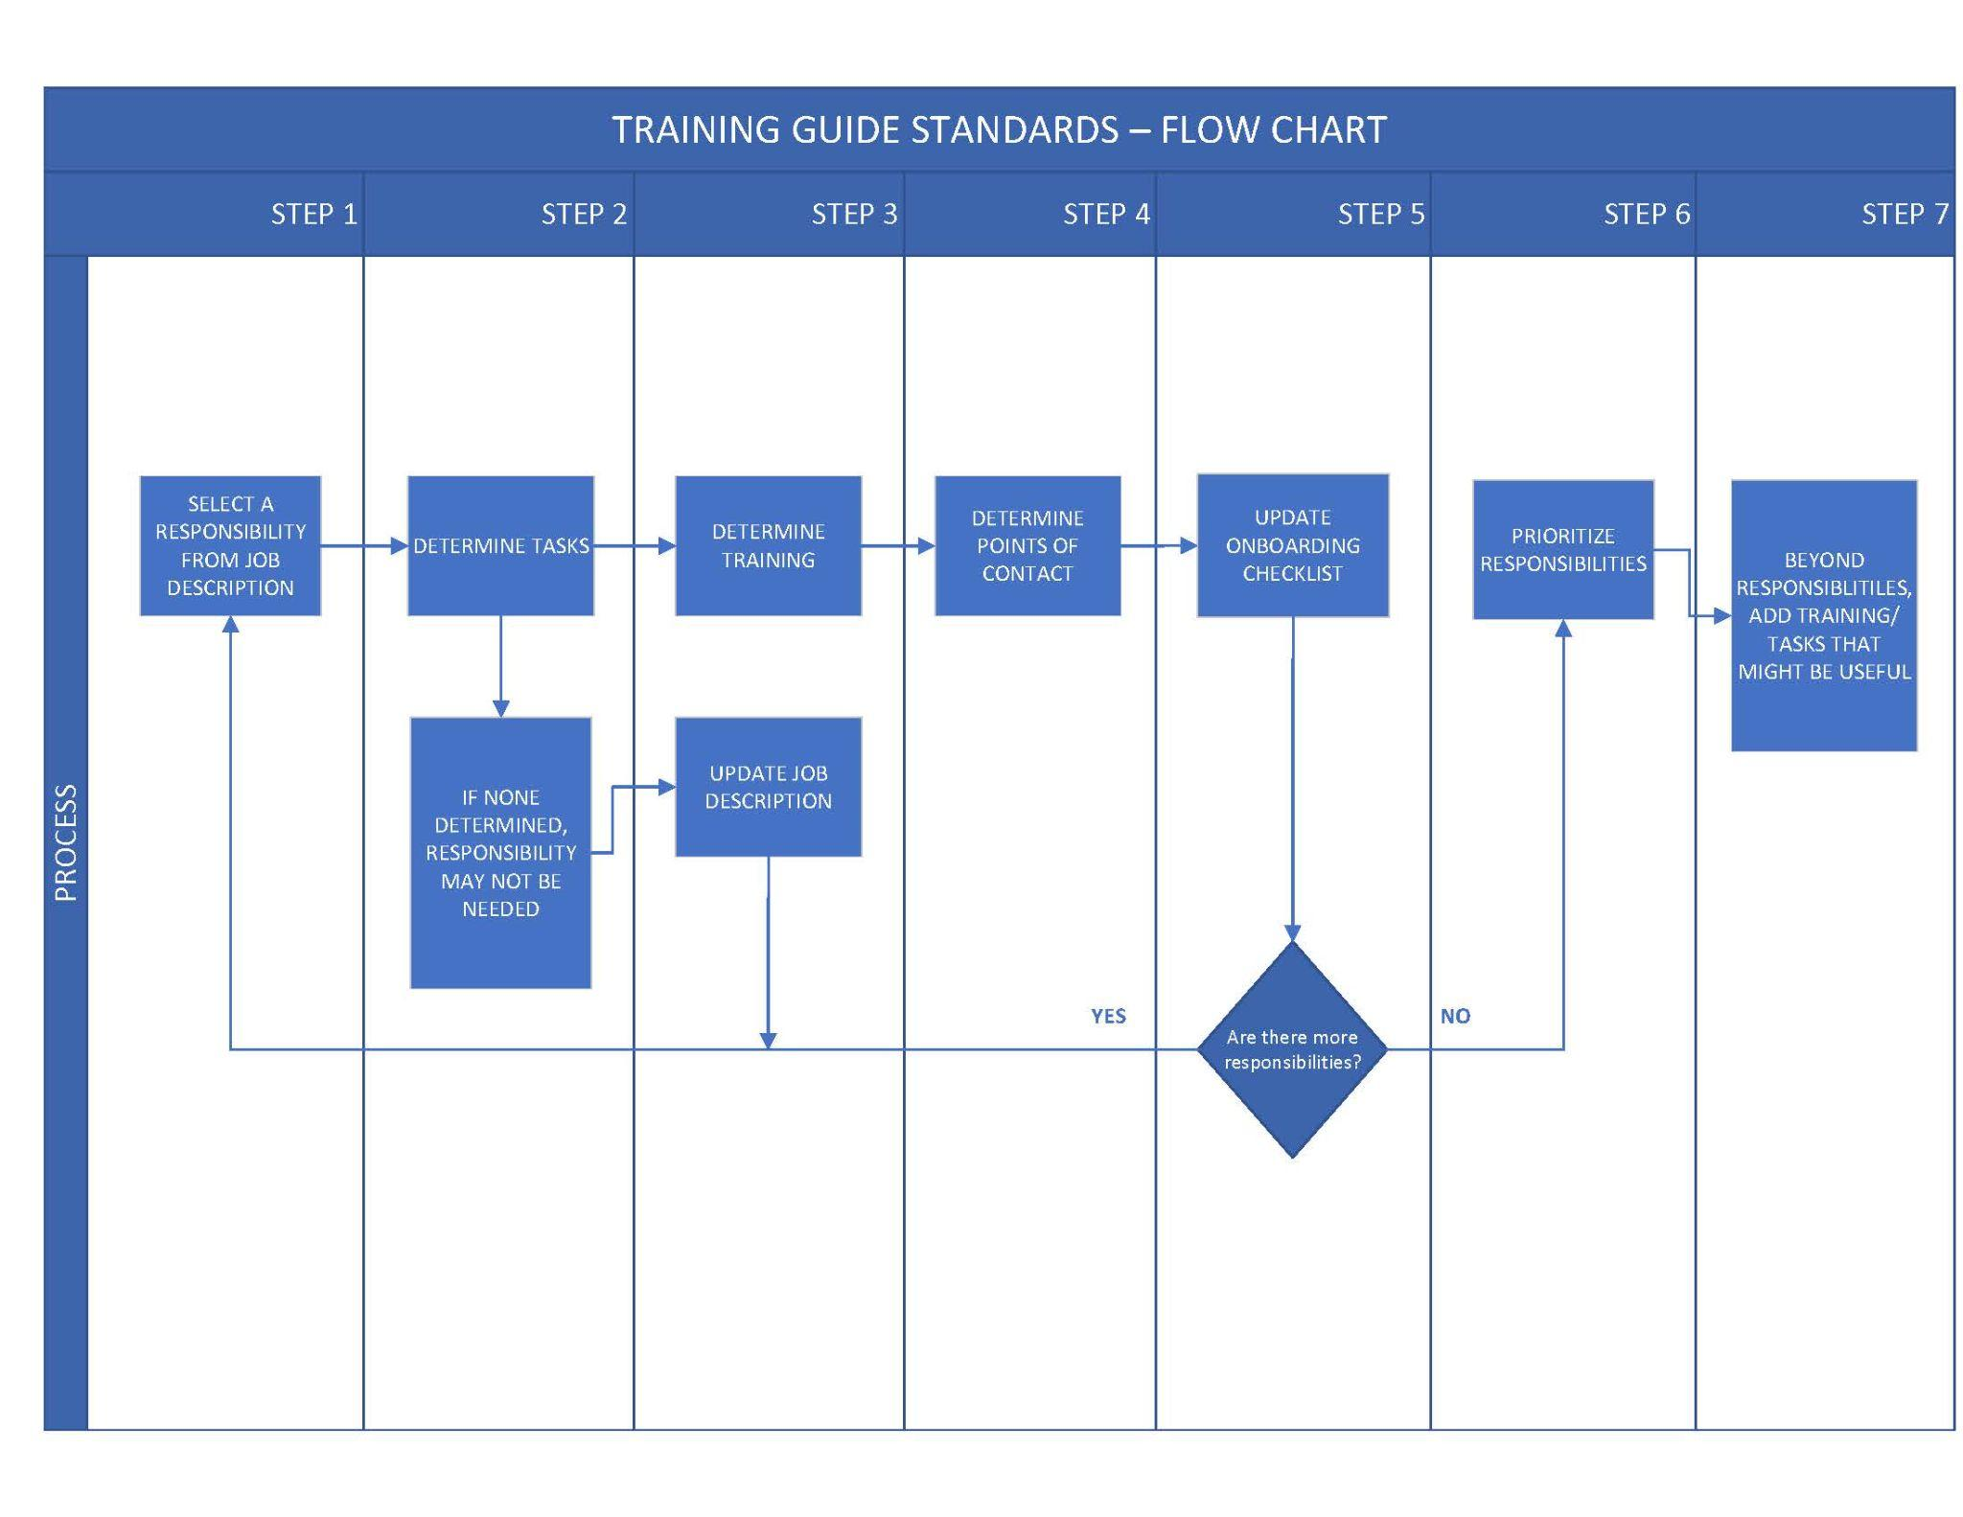
Notes:
Walk through flow of looking at each responsibility and determining task training, POC’s, etc.

Slide 19
Onboarding and Training Integration Activity
Notes:
Handout for processing EPAF’s
Handout for managing departmental budget
Zip file of hand-outs
HOW DID THIS EXERCISE HELP YOU SURFACE OR CHALLENGE ASSUMPTIONS?
This is an up-front investment

Slide 20
How do I set expectations when I’m not the subject matter expert?
Leverage your subject matter experts to bring expectations to the table
Look to industry best practices
Identify Michigan Tech-defined critical success factors
Networking
Mine information available through Professional Associations
Notes:
Leverage your subject matter experts to bring expectations to the table
Industry Best Practices
Michigan Tech defined critical success factors
Networking
Professional Associations
Does anyone have experience with this?
AVPA
Mineral Musuem

Slide 21
Pause for Q&A

Slide 22
Section 2 Agenda
Michigan Tech’s Performance Management
SMART Goals Activity
Q&A
Communicating general workplace standards and expectations
University Code of Conduct
Monitoring and managing expectations as part of the workplace culture
Reflection, action plan, report-out

Slide 23
Michigan Tech’s
Performance Management Process
Why Performance Management
Roles
Job Descriptions
Goal Setting and Development Plan
Mid-year Review
Self-assessment
Year-end Review
Process Timeline and Requirements
Notes:
Focus will be on the expectations-setting portion of the performance management cycle

Slide 24
Why Performance Management?
Promotes a culture of employee development and performance improvement through coaching and feedback
Contributes to increased employee engagement, motivation, and retention
Creates opportunities for learning and development.
Notes:
There are really dozens of reason…..People focus from the strategic plan, accreditation requirements, etc.
Michigan Tech is committed to an annual performance management process that fosters communication and engagement, encourages professional development, supports improvement, and motivates employees to perform at their best.

Slide 25
Performance Management Cycle
Goal Setting/ Development Planning
Continuous Coaching
Mentoring Leadership Supervision
Year-End Review
Mid-Year Status Check-in
Self-Assessment prior to Year-End Review
performancemanagement-l@mtu.edu
Notes:
Performance Management Form Updated for the 2021-2022 Cycle
Completed/Submitted to HR by April 14th each year.
Start with Goal Planning in May, mid-year check in October
Michigan Tech is committed to an annual performance management process that fosters communication and engagement, encourages professional development, supports improvement, and motivates employees to perform at their best.
Human Resources is pleased to announce the updated performance management form is on the Performance Management webpage (https://www.mtu.edu/hr/current/performance/).
As a reminder to supervisors of all non-union staff employees; set goals now if they have not been set already for the 2021-2022 cycle. Mid-year review meetings with employees should be scheduled for October 2021.
Any questions can be sent to performancemanagement-l@mtu.edu

Slide 26
Role of the Supervisor
Initiate the process, ensure timely completion of each phase, and submit all required documents.
Facilitate development of performance goals and set expectations
Encourage employee input and be an active contributor to support employee development
Monitor employee performance and provide coaching and feedback

Slide 27
Job Descriptions
Employee and Supervisor will work to update job descriptions each year
Key component for a successful performance management process
Provide a basis for goal setting and development plan discussions
Job description template available on HR website.
HR Employment Services will send you a job description if they have one on file, please call 7-2280.
Notes:
All checkmarks throughout the presentation are considered “To-Do” items….
Job Classification and Competencies will be added to all job descriptions for 2015.

Slide 28
Performance Management Cycle
Goal Setting/ Development Planning
Continuous Coaching
Mentoring Leadership Supervision
Year-End Review
Mid-Year Status Check-in
Self-Assessment prior to Year-End Review
Notes:
This is an impact area relative to setting workplace expecations

Slide 29
Performance Planning
Supervisor and Employee determine performance goals and set expectations
Together, establish employee development opportunities and/or development goals
Discuss employee resource and support needs to successfully achieve goals
Record all of the above on the Performance Management Process Form
Notes:
Opportunities to set expectations

Slide 30
Performance Goals
Are short-term objectives set with clearly defined expectations for success.
Answer the question “What is expected of the employee in their position?”
Are related to….
Department and University goals
Primary job activities
Major responsibilities
Projects

Slide 31
Setting Performance Goals
SMART Goals
Specific: answers who? what? and why needed?
Measurable: establish an indicator of progress. How will the goal be measured?
Achievable: realistic and can be achieved in a specific time frame.
Results-Focused: what is the expected outcome?
Time Bound: defined target or deadline date.
Notes:
SMART goals help ensure that managers and employees share the same understanding of goals set during performance review conversations.
Specific: Clear defined end results and expectations. Have a greater chance of being accomplished if they are specific. Why? Link to department and University goals.
Achievable: Number of goals and scope of goals should be considered, not to impede success. Employees should be involved in goal setting and agree with their goals.
Time bound: a deadline or time-frame that creates a practical sense of urgency creates an ideal working environment for an employee to become further engaged

Slide 32
Goal Setting Example 1 Parking Enforcement Agent Job Description
Summary: Under the direction of the Parking Control Officer, this position will coordinate the operations, activities, and functions of the University’s parking control program.
Essential Duties:
Operate parking violation notices equipment
Understand all parking requirements and regulations
Issue citations to all parking violators
Be familiar with all parking lots and facilities on campus
Provide stranded motorist assistance
Operate and maintain all parking lot gate equipment
Understand the parking enforcement software system and provide backup operation supports
Be familiar with the Banner system for interface with the PVN system
Maintain and ensure cleanliness of all Transportation Services vehicles
Assist and train student parking enforcement agents

Slide 33
SMART Goal Activity
Consider how your work performance may be measured.
What performance goal would you set to demonstrate you are successful in carrying out your job activities and major responsibilities?
Notes:
Take examples of BAD goals and make them into SMART goals.
https://docs.google.com/forms/d/13jP12DtH3lhmlgsG5Nli3g3WkGR_8VdXm8yRCoITTks/edit?ts=6165e5bd
ADD ROLE PLAY!!!
Think of it this way…
The Goal is to do your day-to-day job/work well
Due date, time bound, a specific number/% increase

Slide 34
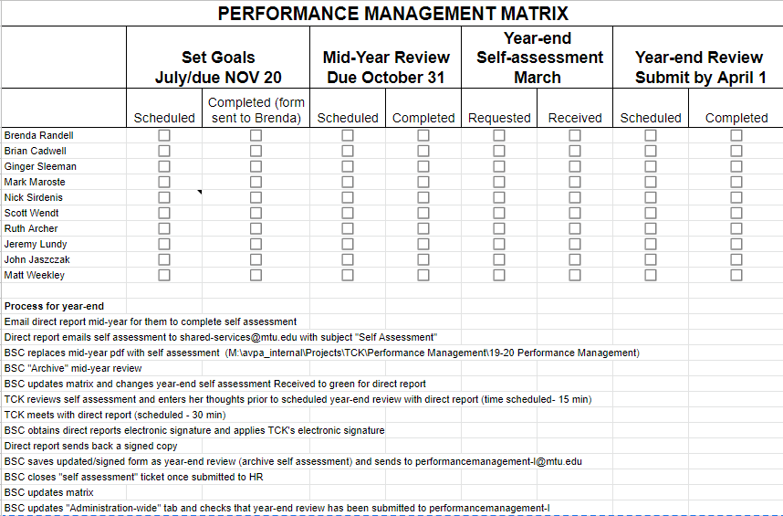
Notes:
Toolkit item for tracking progress toward completing the cycle

Slide 35
Pause for Q&A

Slide 36
Performance Management Cycle
Goal Setting/ Development Planning
Year-End Review
Continuous Coaching
Mentoring Leadership Supervision
Mid-Year Status Check-in
Self-Assessment prior to Year-End Review
Notes:
Performance management cycle provides the framework to promote employee engagement and development…
In the Cener - Coaching, mentoring, employee and supervisor interaction/discussion is a large component that supports this framework.

Slide 37
What is Coaching?
Providing timely feedback
Probing questions to promote development
Supervising
Mentoring
Advice
Leadership

Slide 38
Providing Feedback
Provide context
Describe the behavior - both good and needs correction
Provide a specific example
Explain the impact of the behavior on you, the team, the department, the University, and/or the customer
Have a conversation regarding alternative behaviors and desired results
Start, Stop, Continue technique
Notes:
We can role play start, stop, continue
Reid, I’d like to give you some feedback on how you can develop in your role and meet my expectations for your position.
I’d like you to start providing monthly year-end projections on the department’s budget position because this is my expectation and something your position is accountable for.
At this time, I need to ask you to stop processing purchase requisitions. This task is more in line with the responsibilities of the dispatch officers, and allowing them to perform this task will help them learn and practice new skills.
Please continue to coach the dispatch officers on this function. You’re a great trainer and mentor and I can see they’re really benefiting from your leadership.

Slide 39
General Workplace Standards and Expectations
Communicating general workplace standards and expectations

Slide 40
Code of Conduct
Ethical and Professional Conduct
Respect for Others
Conflict of Interest and Commitment
Compliance with Laws and Regulations
Compliance with University Policies and Procedures
Notes:
University-level expectations that apply to all employees

Slide 41
Code of Conduct, cont.
Appropriate use of University Resources
Health and Safety
Appropriate Treatment of Confidential and Private Information
Reporting Suspected Violations

Slide 42
Unit and Job Specific
Expectations
Examples
Notes:
Flip Chart - Make a list of general workplace standards
Name tag
Phone answering
Uniforms
Be on time
Service Standards
Safety expectations
PIC Work Policies
Work Ethic

Slide 43
Workplace Culture
Monitoring and managing expectations as part of the workplace culture
TACTICS:
Notes:
Flip Chart - Make a list of general workplace standards
Daily workplace huddles or stand-up meetings
Weekly-
Monthly-
Quarterly-
Annually-
Ad Hoc-

Slide 44
Workplace Culture
Standard agenda exercise
For a staff meeting, how can you weave expectation reinforcement into a standard agenda?
Notes:
State the Purpose. Always begging with the WHY
Teach-back on topic that you expect people to be knowledgeable about
Safety Topic - If you expect people to practice safety, talk about it regularly
Hot Topics/Immediate Concerns - (Clearing) Teach that you are willing to address these items so that people can then engage in the meeting topics
Action items from last meeting - Sets expectation of accountability
What else? Leave open for what else might be on people’s minds. Sets expectation that people should bring their lingering concerns forward.
Follow-up and action items - Sets expectations of accountability. Who, when, what.

Slide 45
Everyday Coaching
Coaching is a conversation that improves performance…
Coaching can be planned or spontaneous. It can take place anywhere, anytime. It can take an hour, or just a moment. It doesn’t have to be on anyone’s schedule. Yet, it’s one of the most important things we do.
Coaching is experiences shared honestly. It’s advice. It’s teaching. It’s feedback. It’s thoughtful listening. It’s seizing learning opportunities, no matter how small.
To coach is to care enough to help someone else succeed. To seek coaching is to act on our desire to be the best we can be. To do both is to reinforce our connection to the people around us.
Everyday Coaching – It’s your way of giving and getting what you need.
Notes:
No Surprises at Year-End…

Slide 46
Review Instructional
Objectives
Supervisor will be able to review job descriptions and develop employee expectations, onboarding and training based on current roles and responsibilities.
Supervisor will be able to complete the University’s performance management cycle with each employee they’re responsible for.
Supervisor will be able to create and communicate general and specific workplace expectations.
Supervisor will be able to integrate workplace expectations with daily and weekly employee interactions through coaching conversations and structured meetings.
Notes:
Why setting and managing workplace expectations is important. Systems thinking overview of setting and managing workplace expectations.
Operationalizing the job description through onboarding and training

Slide 47
Reflection on Agenda
Discussions of pre-work reflections
Why are expectations important
Lifecycle of expectation setting and management
Job descriptions
Onboarding and training
Industry best practices and critical success factors
Notes:
Why setting and managing workplace expectations is important. Systems thinking overview of setting and managing workplace expectations.
Group Engagement: Short discussion on their reflections of the value of expectations in their own work
Lecture - Why setting and managing workplace expectations is important. Review six steps from Pre-work video
Lecture - Introduction to the lifecycle elements of setting and managing employee workplace expectations
Think/Pair/Share Activity
Lecture: Job Descriptions
Table Activity: Review sample job description and practice how to use it to set expectations
Lecture: Onboarding and Training
Table Activity: Case study of simple job description and activity how to prepare an onboarding and training plan
Looking to industry best practices and critical success factors
Engage employees in bringing standards and expectations to the table, especially when you’re not the subject matter expert.

Slide 48
Wrap up
Canvas reflections and comment

Slide 49
Pause for Q&A

Slide 50
Thank you

