Slide 1
Supervisor Success Series
Safety Module
Photo Credit: Sarah Bird

Slide 2
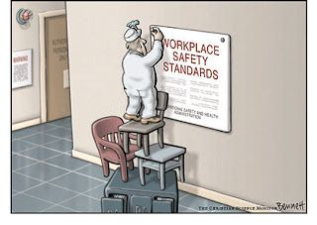
Welcome!
Fire exits
In case of fire, please walk to the nearest exit
Unsafe act or condition
If you see an unsafe act or condition, please notify the instructor

Slide 3
Safety Module Road Map
Introduction
Safety @ Michigan Tech
Occupational Safety
Job Hazard Analysis
Personal Protective Equipment (PPE) and Training
Incident Reporting
Supervisor Safety Responsibilities 4 Point Wrap-up

Slide 4
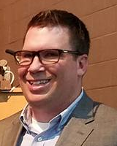
Presenters
Chris Maxson
Safety Specialist
Shane (Sully) Sullivan
Manager of Merchandising Operations
Scott Wendt
Manager of Health and Safety

Slide 5
What is the Goal of this Training?
To equip MTU supervisors with:
Safety responsibilities
Safety resources
Employee training
Evaluation of employee tasks
How to be effective Safety Leaders
as part of their supervisory responsibilities.

Slide 6
Break-Out Activity
What is the most Challenging to you about Safety?
2-3 min: Write down two or three Items.
Choose the Biggest Challenge.
5 min: Everyone Share Biggest Challenge.
Vote (2 Votes per person) to determine Biggest Challenge.
Brief Discussion as to why Biggest Challenge rose to #1 Position

Slide 7
Why Safety is Important?
Huskies commit to:
Shared Values:
A safe and secure campus environment
A workplace where employees can be productive
Preventing work-related injuries and illnesses
And there are rules too…

Slide 8
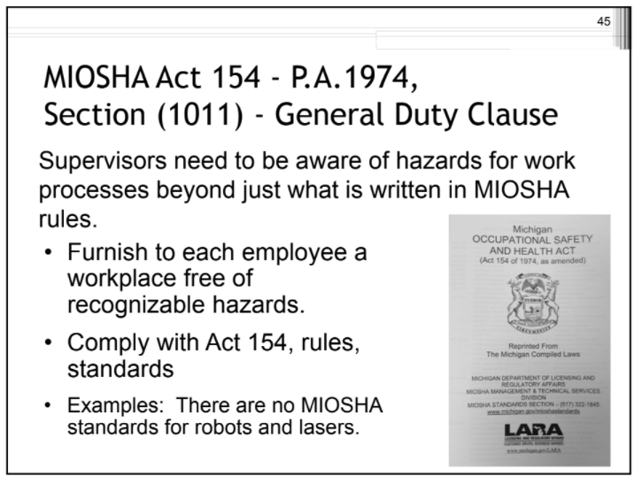
OSHA/MIOSHA

Slide 9
Safety Module Road Map
Introduction
Safety @ Michigan Tech
Occupational Safety
Job Hazard Analysis
Personal Protective Equipment (PPE) and Training
Incident Reporting
Supervisor Safety Responsibilities 4 Point Wrap-up

Slide 10
MTU Safety Culture
Safety culture is not exact, but a collection of attitudes and practices related to the commitment, type and effectiveness of health and safety matters.
“How we do things around here”.

Slide 11
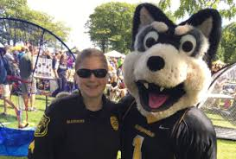
Departments
Safety @ Michigan Tech
Public Safety and Police Services
Environmental Health and Safety
Research Integrity
Risk Management
Michigan Tech EMS

Slide 12
Committees / Councils
Safety @ Michigan Tech
President’s Council on Health and Well-being
University Safety Advisory Council
MTU Flex Team
College of Engineering Safety Committee
Radiation Safety Committee
Bio-Safety Committee
Mine Safety and Health
Numerous Departmental Safety Committees

Slide 13
Safety Module Road Map
Introduction
Safety @ Michigan Tech
Occupational Safety
Job Hazard Analysis
Personal Protective Equipment (PPE) and Training
Incident Reporting
Supervisor Safety Responsibilities 4 Point Wrap-up

Slide 14
What are your Responsibilities as a Supervisor?
Supervisors are directly responsible and accountable for carrying out occupational health and safety regulations, and university safety procedures within their area of control
Notes:
TCK - You might want to use the term “occupational” somewhere in this slide to tie it back to your agenda item.

Slide 15
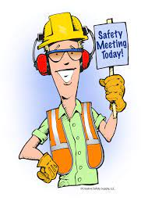
Supervisor Safety Responsibilities Include:
Making a reasonable effort to ensure the safety of employees and students in the area of your control
Evaluating physical capabilities of employees to perform tasks
Promoting safe attitudes and practices
Enforcing safe work practices
Responding appropriately to employee safety concerns
Completing all the same safety trainings required for your employees, so you know whether they are complying, and so you can answer their questions.

Slide 16
Supervisor Safety Responsibilities continued:
Providing job training on work area safety procedures for all employees, especially new hires and reassigned employees
Supervisors must ensure their employees or students receive all required safety training
Supervisors must provide on the job training specific to their location/activities
All training must be documented

Slide 17
Supervisors are the
Front-Line Safety Leaders
Supervisors represent MTU as the “employer” in Standards

Slide 18
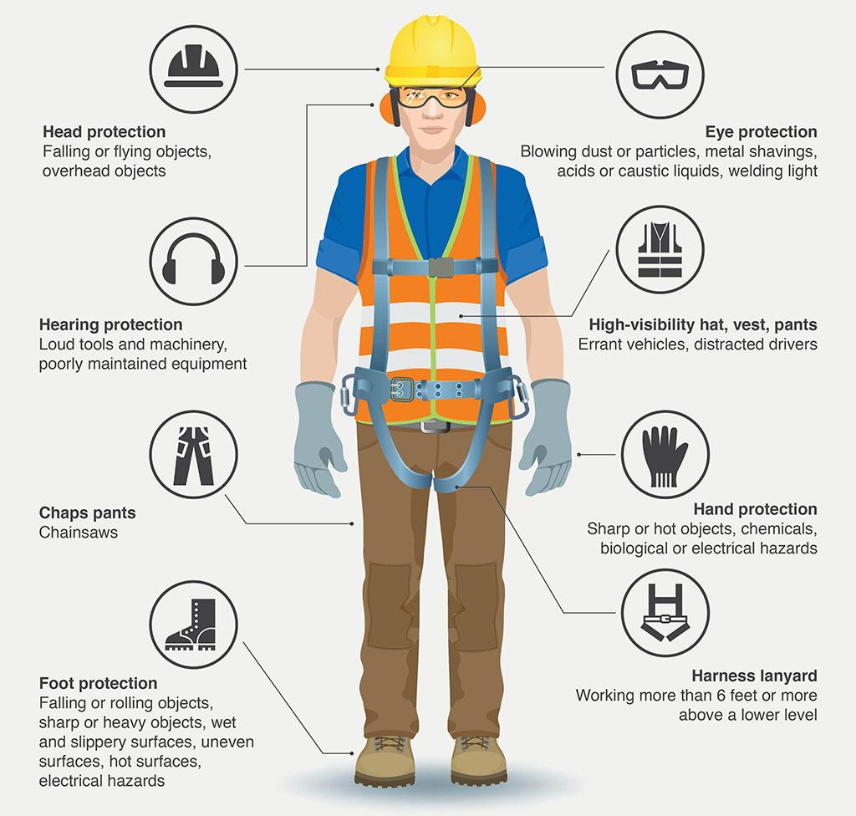
Supervisor Safety Responsibilities continued:
Conducting regular work area safety inspections with the guidance of EHS/RIO to identify and correct unsafe conditions and work practices
Providing proper equipment so employees can perform their jobs safely…including tools and personal protective equipment, as well as procedures and training for safe operation.
Notes:
….AND TRAINING ON HOW TO USE THE PPE AND TOOLS

Slide 19
Supervisor Safety Responsibilities continued:
Investigating injury accidents utilizing lean techniques (i.e. root cause analysis) to determine cause, correct safety deficiencies, and prevent reoccurrence.
Reporting accidents immediately
Notes:
ROOT CAUSE ANALYSIS

Slide 20
An Employee is anyone receiving monetary compensation to perform a duty at MTU
So who are you responsible for?
Faculty
Staff
Student Employees
Graduate Assistants
Temporary Workers
Keep in mind that you may supervise non-employees
(volunteers, visiting or adjunct professors, etc).
Their safety is equally important and safety rules and regulations apply to them as well, particularly safety training requirements.
Notes:
….AND THEY ALSO HELP US KEEP CAMPUS SAFE FOR STUDENTS IN GENERAL, THE GENERAL PUBLIC, VISITORS, PROSPECTIVE STUDENTS, ETC.

Slide 21
Break-Out Activity
Re-evaluate Challenges to you about Supervisory Safety?
5 min: Group Discussion on previous exercise results.
Any Changes?
Additions?
Reevaluate order?
Notes:
WHAT LEARNING ARE YOU EXPECTING THEM TO APPLY DURING THIS REDUX OF THE PREVIOUS EXERCISE? The first captures what they think is their safety challenges…the second is after listing the supervisor responsibilities, opening their eyes to job safety expectation.

Slide 22
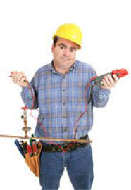
It can feel overwhelming
…beyond confusing
…and pretty much impossible….
But…Don’t Worry…
MTU ENVIRONMENTAL HEALTH & SAFETY
is always here to help!

Slide 23
MTU Environmental Health & Safety
Deals with all aspects of health and safety in the workplace with a strong focus on primary prevention of hazards on campus
Our goal is to prevent accidents and harm to employees from work-related activities

Slide 24
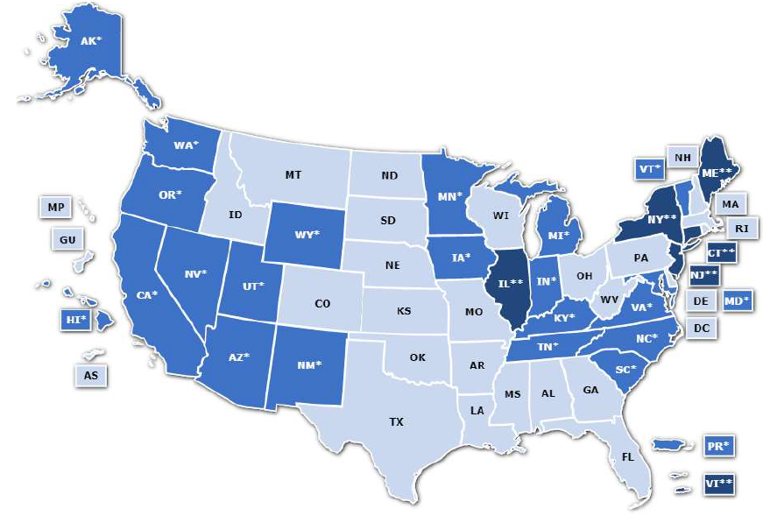
Most Standards start with OSHA
Occupational Safety and Health Administration
But…
some states have their Jurisdictions

Slide 25
Michigan is one of them…
Michigan Occupational Safety and Health Administration (MIOSHA)
MIOSHA Standards
are as stringent or more stringent than federal requirements

Slide 26
MTU EHS assists with:
Training
Inspections
Hazard Assessment
Accident Review
Environmental Monitoring
Safety Program Development

Slide 27
MTU EHS assists with:
EHS is responsible for promoting and ensuring MTU compliance with environmental and occupational safety and health requirements
EHS helps groups and departments identify rules, regulations, policies, and procedures that affect operations

Slide 28
OSHA/MIOSHA Required Programs
Right to Know / Hazard Communication
Lockout-Tagout
PPE Assessment
Respiratory Protection
Permit-Required Confined Space
Emergency Evacuation Plan
Bloodborne Infectious Diseases
Hearing Conservation Program
Construction- Accident Prevention Program

Slide 29
Safety Module Road Map
Introduction
Safety @ Michigan Tech
Occupational Safety
Job Hazard Analysis
Personal Protective Equipment (PPE) and Training
Incident Reporting
Supervisor Safety Responsibilities 4 Point Wrap-up

Slide 30
Break-Out Activity
How to Plant a Tree Scenario….
5 min: Break into groups.
Scenario: You have been instructed to plant this tree.
You have been provided all the tools necessary.
List the steps to safely complete this task.
Share and discuss steps. Are there any Hazards you can identify?
Notes:
THIS SENTENCE NEEDS SOME WORK….
List the steps to plant a safely do this task. OMG I must have been asleep when I typed that!!

Slide 31
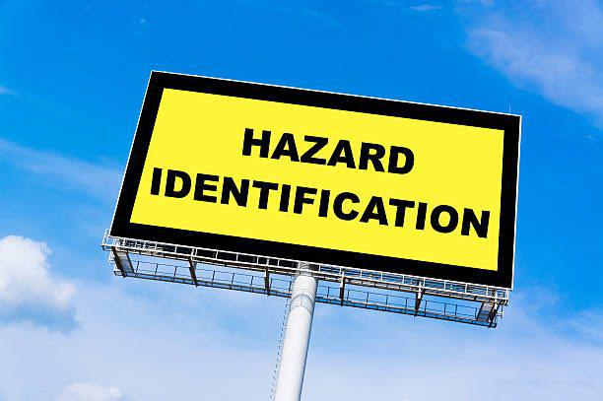
Hazard Identification
Hazard Identification is the
foundation of a safe workplace.
At its most basic level, hazard identification is simply looking at a job, task or a situation and asking,
“Is there anything here that could hurt someone or damage something?”
Notes:
Plant a tree activity, focus on Standard work and Job Safety Analysis.
One sheet of paper per person.
Ask people to write down the steps to plant a tree with minimal prompts. Discuss results.
Ask people to write down steps and include resources tools, labor, etc… needed. Discuss results.
Ask people to write down steps and include safety considerations. Discuss results.
In small groups or as one large group combine best practices.
This living documents should be used for training and reviewed with and by with each new employee before completing the task.
-New employees have fresh eyes, they may be able to add fresh observations to the document.

Slide 32
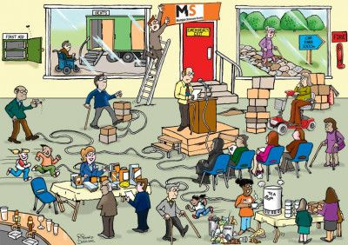
Hazard Identification
What is a workplace hazard?
A workplace hazard is ANY
practice, behavior or physical condition
that has the potential to cause:
Injury
Illness
Damage to property
Damage to the environment
Loss to a process
.
Notes:
Plant a tree activity, focus on Standard work and Job Safety Analysis.
One sheet of paper per person.
Ask people to write down the steps to plant a tree with minimal prompts. Discuss results.
Ask people to write down steps and include resources tools, labor, etc… needed. Discuss results.
Ask people to write down steps and include safety considerations. Discuss results.
In small groups or as one large group combine best practices.
This living documents should be used for training and reviewed with and by with each new employee before completing the task.
-New employees have fresh eyes, they may be able to add fresh observations to the document.

Slide 33
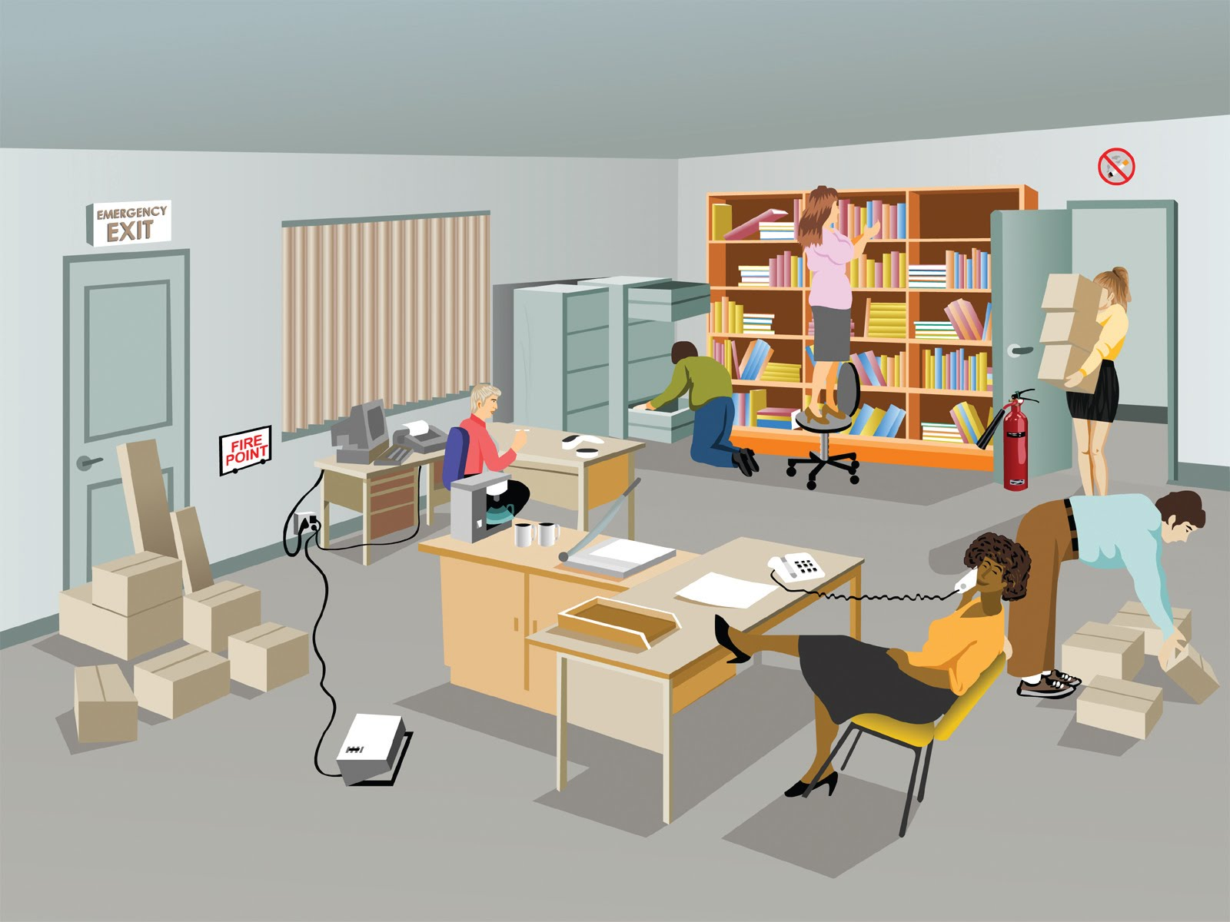
Hazard Identification
There are hazards in EVERY type of job and EVERY type of workplace!
Everyone at MTU:
Workers, Supervisors and EHS, share in the responsibility to identify and control hazards
A Hazard cannot be controlled
(i.e. eliminated, reduced, or otherwise managed)
until it has been identified !
Notes:
Plant a tree activity, focus on Standard work and Job Safety Analysis.
One sheet of paper per person.
Ask people to write down the steps to plant a tree with minimal prompts. Discuss results.
Ask people to write down steps and include resources tools, labor, etc… needed. Discuss results.
Ask people to write down steps and include safety considerations. Discuss results.
In small groups or as one large group combine best practices.
This living documents should be used for training and reviewed with and by with each new employee before completing the task.
-New employees have fresh eyes, they may be able to add fresh observations to the document.

Slide 34
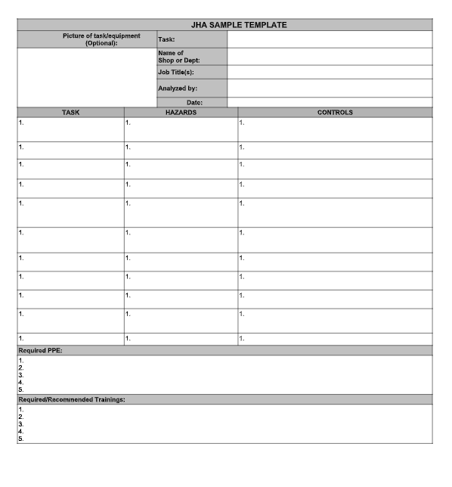
Hazard Identification Tool
There are many standard hazard identification tools that can help to document the
hazard identification and control processes
Job Hazard Analysis, often referred to as a Job Safety Analysis (JSA), is an important accident prevention tool that works by identifying existing and/or potential hazards associated with a particular job
Notes:
Plant a tree activity, focus on Standard work and Job Safety Analysis.
One sheet of paper per person.
Ask people to write down the steps to plant a tree with minimal prompts. Discuss results.
Ask people to write down steps and include resources tools, labor, etc… needed. Discuss results.
Ask people to write down steps and include safety considerations. Discuss results.
In small groups or as one large group combine best practices.
This living documents should be used for training and reviewed with and by with each new employee before completing the task.
-New employees have fresh eyes, they may be able to add fresh observations to the document.

Slide 35
Hazard Identification Tool
Job Hazard Assessment (JHA)
A JHA works by finding hazards and eliminating or minimizing them before the job is performed and before the employee has a chance to become injured.
JHA are used for :
Job clarification
Hazard awareness
To guide in new employee training
Retraining of employees,
Refresher for infrequent tasks,
Accident investigation tool
Informing employees of specific job hazards
Appropriate protective measures

Slide 36
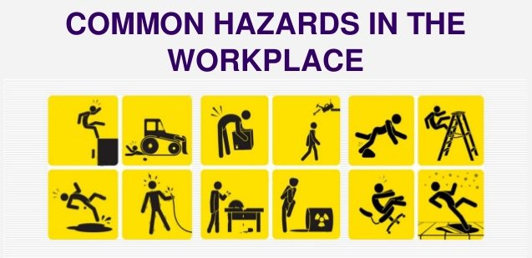
Hazard Identification Tool
Job Hazard Assessment (JHA)
Completing a JHA using the MTU JHA Worksheet involves the following three basic steps:
Determine the various Tasks that the employee will perform.
Identify the Potential Hazards associated with each task
Determine which Controls are necessary to minimize or eliminate the potential hazards.

Slide 37
Break-Out Activity
What are major occupational hazards in your workplace….
5 min: Group Participation..
What are the top 10 Occupational Hazards in your work area?
Discuss results…lead into Hazards slide for comparison.
Notes:
THIS SENTENCE NEEDS SOME WORK….
List the steps to plant a safely do this task. OMG I must have been asleep when I typed that!!

Slide 38
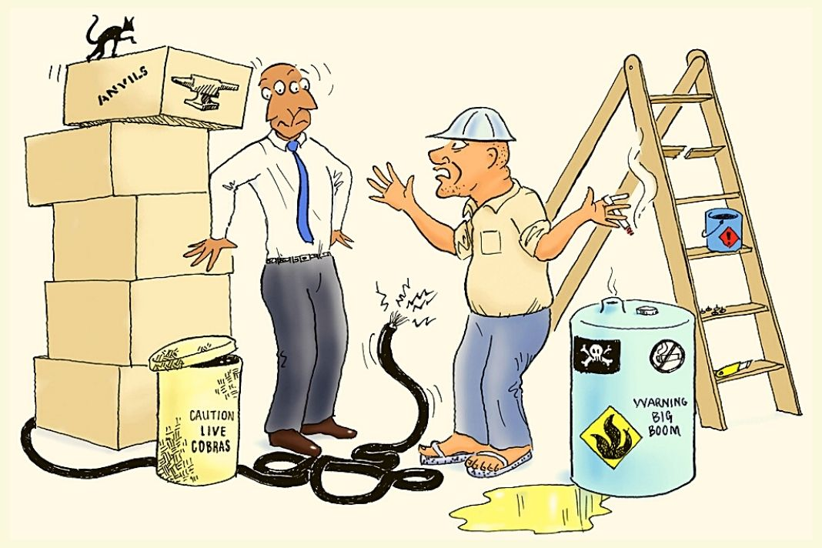
Types of Hazards in the Workplace
The Top 10 hazards that occur in workplaces
Slips, Trips, and Falls
2. Impacts – either Struck by or Struck against
3. Mechanical – these hazards result in caught-in, caught-on and crush incidents with a mechanism of injury as either:
Motions: rotating, reciprocating and transverse.
Actions: cutting, shearing, bending and punching
4. Vibration and Noise – both high and low frequency vibration
5. Toxics – There are four routes of entry:
a. Ingestion: eating or drinking
b. Absorption: through the skin
c. Injection: needles and other sharp objects
d. Inhalation
Notes:
SUGGESTION…..ASK THE GROUP FOR EXAMPLES OF THESE TOP 10 FROM THEIR OWN WORKPLACES…Good pull in!! Added

Slide 39
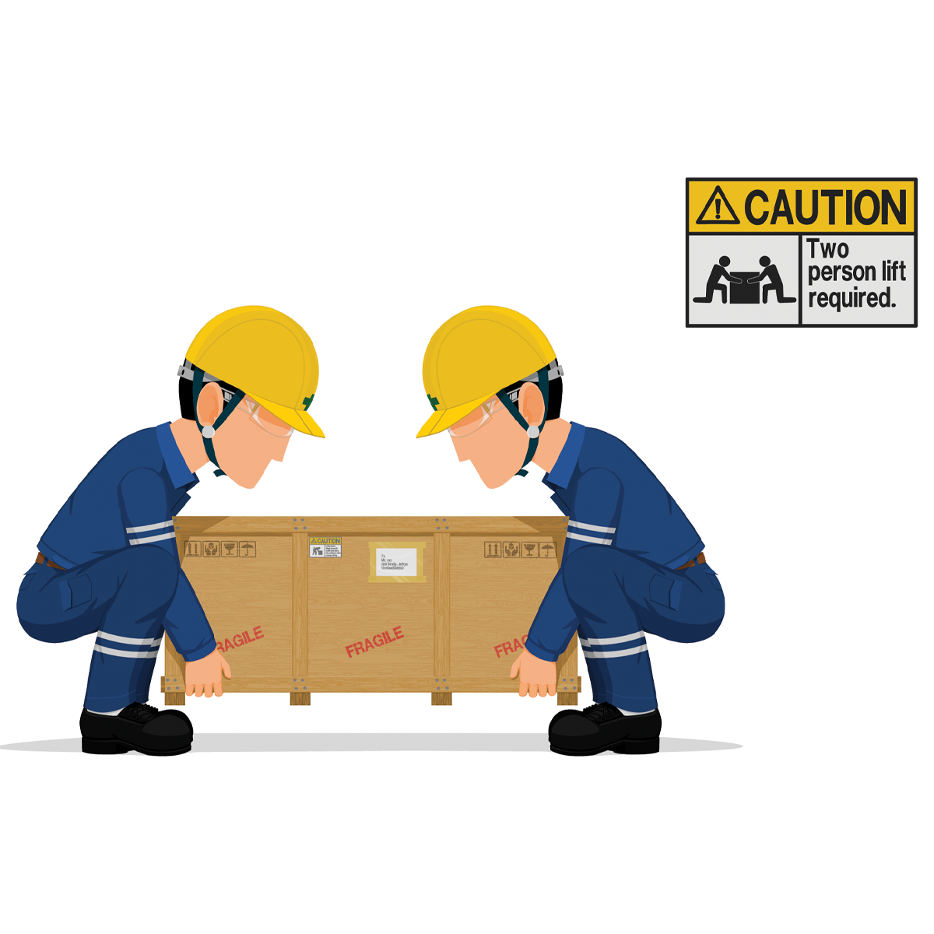
Types of Hazards in the Workplace
The Top 10 hazards that occur in workplaces
6. Heat and Temperature – may be due to examples such as:
a. the environment
b. chemical reactions
c. combustion
d. electrical current,
e. mechanical motion
7. Flammability / Fire
8. Explosives – including chemicals, dusts, solids, vapors, gases and equipment.
9. Ergonomics
10. Electrical Contact – including shock, ignition of combustibles, overheating of equipment, arc flash and inadvertent activation of equipment

Slide 40
Break-Out Activity
Back to our Plant a Tree Scenario….
Hazard Identification
5 min: Break into groups.
Brainstorm potential hazards for each step.
5 min Share and discuss steps.

Slide 41
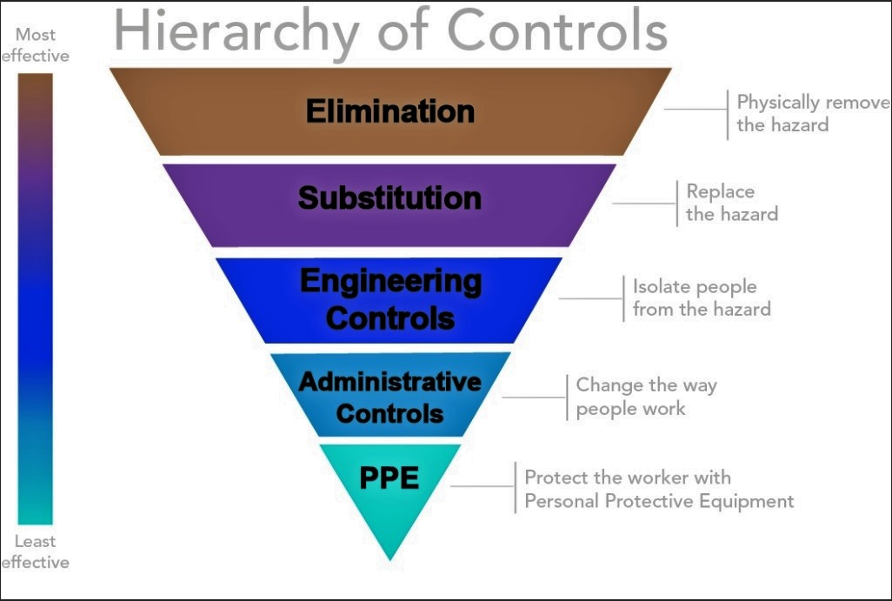
Controlling Hazards
These two strategies are commonly addressed through the Hierarchy of Controls
Two Primary Control Strategies
Control the Hazard
2. Control Exposure to the Hazard

Slide 42
Controlling Hazards
Controlling the hazard is more effective than controlling the exposure in most cases
Let’s look at an operation that uses a razor blade to cut a material

Slide 43
Controlling Hazards
Hazard Control: Elimination – Physically removing the hazard from the workplace is the most effective hazard control.
No Hazard = No Risk!!!

Slide 44
Controlling Hazards
Hazard Control: Substitution – Similar to elimination, substitution involves replacing a hazard with something less hazardous.
Change the Blade = Reduced Risk!!!

Slide 45
Controlling Hazards
Hazard Control: Engineering – The workplace is designed to physically isolate people from the hazards.
Examples include: enclosures, barriers, guarding, baffles, and relocation

Slide 46
Controlling Hazards
Hazard Control: Administrative – Also referred to as Management or Work Practice Controls, these are changes to the way people work.
Examples include: procedure changes, employee training, and installation of signs and warning labels.

Slide 47
Controlling Hazards
Hazard Control: Personal Protective Equipment (PPE) – This is the least effective means of controlling hazards because there are many factors that can render the PPE ineffective.
PPE should always be considered the last line of defense and not the main or primary strategy for control.

Slide 48
Break-Out Activity
Back to our Plant a Tree Scenario….
Hazard Controls
5 min: Break into groups.
Brainstorm hazard control for each step.
5 min Share and discuss steps.

Slide 49
Safety Module Road Map
Introduction
Safety @ Michigan Tech
Occupational Safety
Job Hazard Analysis
Personal Protective Equipment (PPE) and Training
Incident Reporting
Supervisor Safety Responsibilities 4 Point Wrap-up

Slide 50
Personal Protective Equipment (PPE)
OSHA standards require employers to provide workers with appropriate PPE and require them to use and maintain it in a sanitary and reliable condition.
Personal Protective Equipment PPE is designed to protect employees from serious workplace injury or illness resulting from contact with chemical, radiological, physical, electrical, mechanical, or other workplace hazards that cannot be eliminated.

Slide 51
Personal Protective Equipment (PPE)
PPE is a supplementary form of protection when hazards have not been controlled through engineering or administrative controls.
PPE includes a variety of garments and equipment such as goggles, coveralls, gloves, vests, earplugs, and respirators. PPE, when used properly, protects against hazards but does not eliminate them.

Slide 52
Personal Protective Equipment (PPE)
Personal protective equipment for common workplace hazards
Select appropriate equipment Provide appropriate PPE to employees who need protection from the hazards.
Require that employees use the equipment and use it correctly.

Slide 53
Break-Out Activity
Back to our Plant a Tree Scenario….
PPE
5 min: Break into groups.
Brainstorm hazard control for each step.
Is any Personal Protective Equipment needed?
5 min Share and discuss steps.

Slide 54
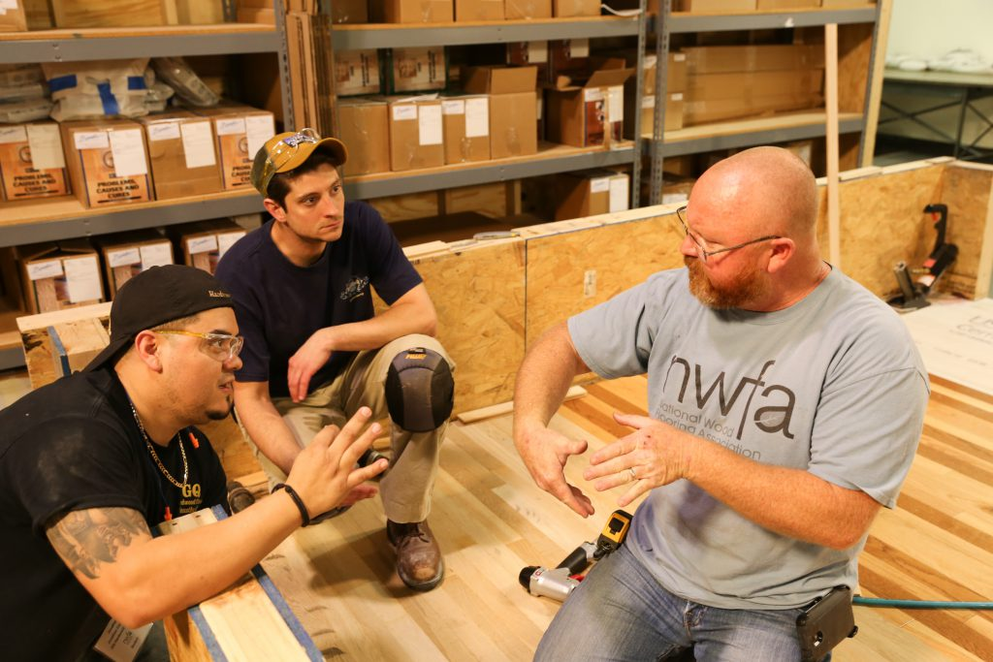
Safety Starts with Training!!
OSHA requires employers to provide training to workers who face hazards on the job.
Supervisors are responsible for completing site-specific training with their employees.
EHS conducts training to ensure MTU employees follow safe work practices and to ensure compliance with local, state and federal requirements.
Notes:
CAN YOU DISCUSS THE TRAINING THAT EVERYONE HAS TO TAKE VS. SITE SPECIFIC AND USE SOME EXAMPLES? Decided to incorporate this as a breakout.

Slide 55
Break-Out Activity
What training in your workplace is “hands-on” or site specific….
5 min: Group Participation..
Brainstorm Site specific training.
What training is university wide?
Discuss results.
Notes:
THIS SENTENCE NEEDS SOME WORK….
List the steps to plant a safely do this task. OMG I must have been asleep when I typed that!!

Slide 56
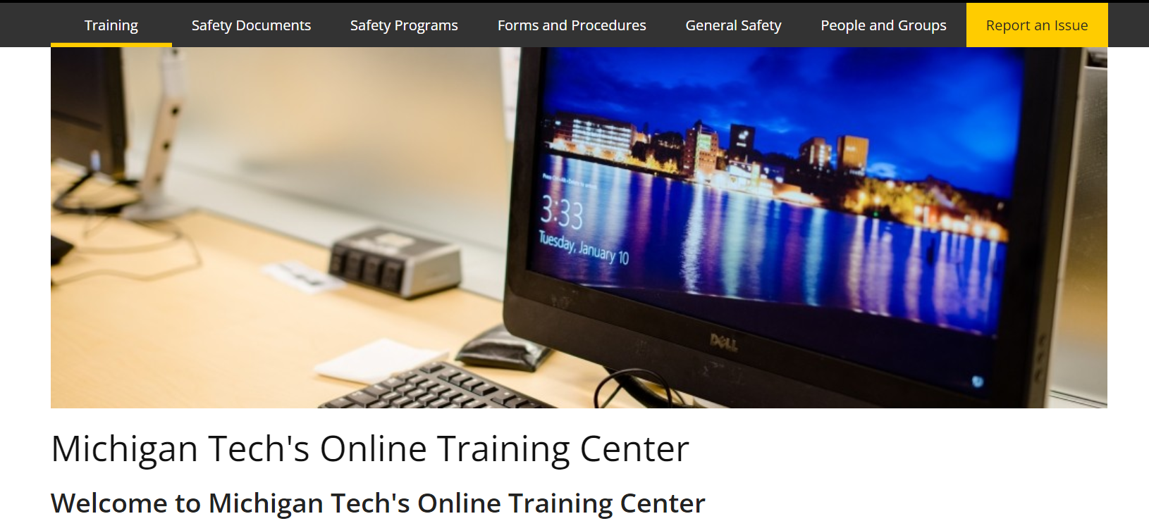
Safety Starts with Training!!
MTU EHS conducts training to ensure compliance with local, state and federal requirements using the Safety Skills online Learning Management System.
Over 750 titles, each created by industry experts
Adaptive learning is utilized to encourage active participation
Courses are regularly reviewed to meet changing regulations
Accessed through:
https://www.mtu.edu/ehs/training/

Slide 57
Break-Out Activity
Back to our Plant a Tree Scenario….
Training
5 min: Break into groups.
Brainstorm hazard control for each step.
Is any Training needed?
5 min Share and discuss steps.

Slide 58
You have Completed your First Job Hazard Assessment!!
MTU EHS is always available for questions or additional help when completing JHA in your areas!!
Email: EHS-HELP@MTU.edu

Slide 59
Safety Module Road Map
Introduction
Safety @ Michigan Tech
Occupational Safety
Job Hazard Analysis
Personal Protective Equipment (PPE) and Training
Incident Reporting
Supervisor Safety Responsibilities 4 Point Wrap-up

Slide 60
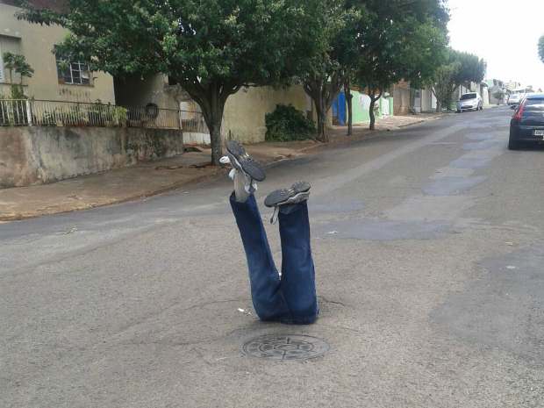
Oh-No!…
Even though we did all the right steps to safely plant a tree…
Accidents Happen!!!
The safety of our students and employees is a priority for MTU.
It is important to report injuries and property damage incidents so that appropriate corrective actions can be taken to prevent future incidents and improve our safety program.

Slide 61
Reporting an Incident
If urgent medical care is needed for a workplace injury or illness – immediately dial 911 for emergency medical assistance.
Always take care of the victim first!!!
MTU personnel are required to immediately report all workplace accidents (or near misses), injuries, illnesses, chemical exposure, or property damage to their supervisors/managers.

Slide 62
Major Accidents must be
Reported to EH&S Immediately
EHS must report all fatalities to MIOSHA within 8 hours.
EHS has 24 hours to report inpatient hospitalizations
(not just ER visit), loss of limb, or loss of an eye.
Supervisors are to report any other injury and occupational illness within 24 hours of occurrence using the on-line “Incident Report” form. (https://www.mtu.edu/ehs/report/ )
SIGNIFICANT NEAR MISSES MUST
ALSO BE REPORTED

Slide 63
Reporting an Incident
As a supervisor you are required to investigate the circumstances surrounding the incident and summarize their findings on the incident and injury report form.
Incident Form can be found at: https://www.mtu.edu/ehs/report/ or through Banner

Slide 64
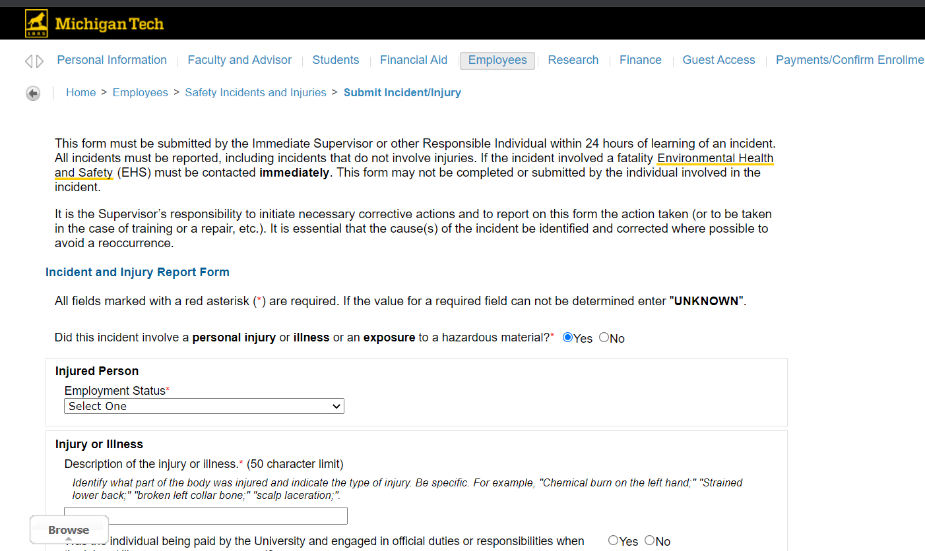
Reporting an Incident
Incident and Injury Report Form
To access the Incident and Injury Reporting Form, log in to Banner Self Service and select the Safety Incidents and Injuries link found under the Employees tab.
All fields with an asterisk are required for the form to be submitted.
Please contact ehs@mtu.edu with any corrections or additional information related to an incident/injury arising after submission of the form.
A Return to Work Form shall also be submitted for injured full- and part-time employees that require medical care.
Screenshot of Incident form
Notes:
IF ITS POSSIBLE, I WOULD WALK THEM THROUGH THE FORM SINCE ITS SO WONKY AND ACTS UP. The last one I did pulled my information from my Chem Sci job and over rode my entries for the injured party.

Slide 65
Safety Module Road Map
Introduction
Safety @ Michigan Tech
Occupational Safety
Job Hazard Analysis
Personal Protective Equipment (PPE) and Training
Incident Reporting
Supervisor Safety Responsibilities 4 Point Wrap-up

Slide 66
Supervisor Safety Responsibilities Wrap Up
We are almost to the end…but there are FOUR major points to remember….
Number One:
You must ensure that employees have the appropriate training, skills , resources, and supervision to safely perform their job.

Slide 67
Supervisor Safety Responsibilities Wrap Up
There are FOUR major points you need to remember….
Number Two:
You must work and act in a safe and healthful manner, and in compliance with all applicable safety and health rules and regulations.
You must require your employees to do the same.

Slide 68
Supervisor Safety Responsibilities Wrap Up
There are FOUR major points you need to remember….
Number Three:
Compliance with safety rules can be enforced through a system of effective accountability.
Supervisors must be involved in addressing safety performance issues and taking disciplinary action when safety policy is not followed.

Slide 69
Effective Accountability
To assure accountability for employees within your unit, follow some simple procedures:
Include safety procedures/compliance in the employee’s job description.
Require workers to comply with all safety rules and regulations.
Encourage a safety culture.
Discuss safety at regular staff meetings.
Model the behavior you want your employees to demonstrate.
In the annual performance review, note the employee’s safety record
a. For Example: Performed work safely and followed all rules and regulations
b. Reported accidents in a timely manner.
c. Reduced injuries
d. Identified Safety Issues
e. Completed safety training in a timely manner
f. Wore prescribed personal protective equipment.
Notes:
IT SEEMS LIKE THIS SHOULD BE ADDRESSED EARLIER……SO THAT YOUR FOUR FINAL POINTS FLOW AND ARE REVIEW OF MATERIAL ALREADY PRESENTED….Let me figure out how to work this in without looking like its shoe horned in….

Slide 70
Supervisor Safety Responsibilities Wrap Up
There are FOUR major points you need to remember….
Number Four:
You are not alone!!
There are a number of MTU departments available to assist and guide you with safety compliance
But always start with EHS!!
EHS-Help@mtu.edu

Slide 71
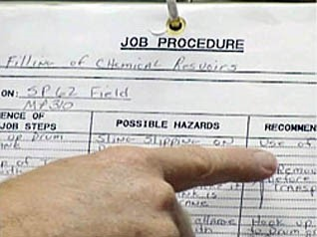
Post-Assignment (Duration one week)
Let’s See What We’ve Have Learned….
Supervisors are to turn in a completed JHA (JSA) for one Job within their areas of control for review by EHS.
Questions and concerns to be coached by EHS at the request of the supervisors.
Ask Questions and Submit to: To EHS-help.com

