Slide 1
Performance Management
Supervisor Success Series:
Catherine Burns, Manager of Staff Employment - Human Resources
Renee Hiller, Director of Human Resources

Slide 2
Series Objectives
Ensure comprehensive development and training for supervisors
Ensure supervisors have the core competencies to support their employees

Slide 3
SUPERVISOR SUCCESS SERIES
Schedule of Events
SEGMENT 1(completed Fall 2021)
Leading Diverse Teams Access and Disability (Canvas Course)
Engagement, Communication, and Relationship Building Preventing Harassment/Discrimination (Canvas Course)
How to Have Those Difficult Conversations
Workplace Expectations
SEGMENT 2 (current)
Performance Management Code of Conduct (Canvas Course)
Budget & Finance HIPAA/FERPA (Canvas Course)
Organizational Skills and Business Processes in the Workplace
Safety Module
SEGMENT 3 (scheduled May 11, May 17, and May 19)
Modules - to be determined

Slide 4
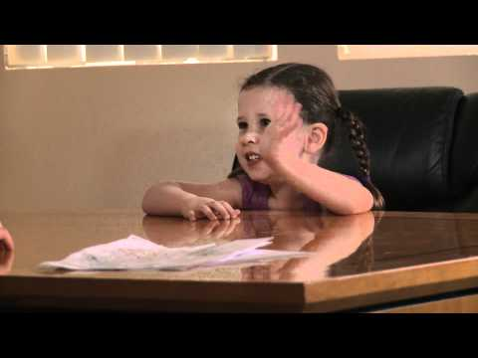

Slide 5
Why Performance Management?
The Performance Management Process provides a formal assessment of employee job performance on an annual basis for all staff (non-faculty, non-union). The process is intended to help employees understand their roles and expectations, continue to grow, learn, and develop, and support the continuous improvement of Michigan Tech.
The Performance Management Process consists of four phases annually: performance planning, mid-year status check-in, year-end employee self-assessment, and year-end supervisor review.

Slide 6
What is my role as a supervisor?
Initiate the process, ensure timely completion of each phase, and submit all required documents.
Facilitate the development of performance goals and set expectations.
Encourage employee input and be an active contributor to support employee development.
Monitor employee performance and provide coaching and feedback.

Slide 7
What is the role of the employee?
Be an active contributor in setting your performance goals and the review process.
Complete a self-assessment, utilizing it as an opportunity to showcase your accomplishments.
Be proactive – ask for coaching and feedback to clarify your supervisor’s expectations.
Utilize feedback provided.

Slide 8
Job Description
Use the Performance Management Cycle as an opportunity to update the employees’ job description
Blank job description templates can be found on the HR website or by contacting an Employment Services Representative

Slide 9
Performance Planning
Together set performance goals (SMART goals), employee development opportunities and/or development goals, and any resource or support needs to successfully achieve goals. Record this on the Performance Management Process Form.

Slide 10
SMART Goals
Specific: What will the goal accomplish? How and why will it be accomplished?
Measurable: How will you measure whether the goal has been accomplished? What will indicate progress towards the goal is being made?
Achievable: Is this goal achievable? Is the time frame adequate for completion? Is there a need to develop employee knowledge, skills, or abilities to successfully accomplish this goal? Are there any resource needs?
Results Focused: What is the result of the goal? What is the reason, purpose, or benefit of accomplishing the goal?
Time Bound: What time frame is connected to this goal? Is there a completion date for the goal?

Slide 11
Mid Year Status Check In
Formal check-in between the employee and supervisor to review status of performance goals and development plan, noting any modifications or status notes on the Performance Management Process Form.

Slide 12
Year-End Employee Self-Assessment
Employee provide details and examples of how performance goals were achieved as well as details and examples of accomplishments outside of set performance goals on the Performance Management Process Form.

Slide 13
Year-End Supervisor Review
Supervisor reviews performance goals, development plan, mid-year status remarks, and employee’s self assessment.
Supervisor assesses each performance goal and the employee’s overall employee performance, rates overall performance, and provides comments on the Performance Management Process Form.
Completed form is shared/discussed with employee.
Supervisor submits completed form to Human Resources via campus mail or via email to performancemanagement-l@mtu.edu.
Notes:
Remind attendees that the form is NOT due until year end.

Slide 14
2021 - 2022 Performance Management Cycle
By May 2021—Performance Planning complete
By October 2021—Mid-Year Review Complete
By March 2022 —Year-End Employee Self-Assessment complete
By April 14, 2022—Year-End Supervisor Review complete
By April 14, 2022—Supervisors must submit the completed Performance Management Process Forms to performancemanagement-l@mtu.edu.

Slide 15
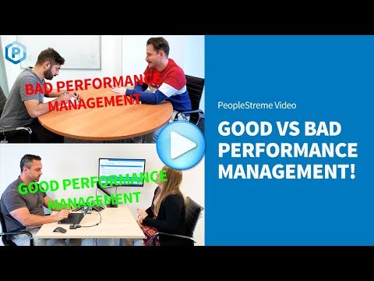
http://www.youtube.com/watch?v=oy-UZYDPvSs

Slide 16
Performance Management Form
Performance Goal Setting – Set anywhere from one (1) to five (5) goals
Document goals and expectations related to primary job activities, major responsibilities, and projects the employee is responsible for in their job. Goals and evaluation criteria may be modified throughout the year based upon changing organizational needs. Use SMART goal criteria: Specific, Measurable, Achievable, Results-Focused, and Time-bound when setting goals and expectations.
Mid-Year Goal Progress Review (to be completed by supervisor in October)
Year-End Employee Self-Assessment on Performance Goals (to be completed in March)
Year-End Supervisor Review on Performance Goals (to be completed by April 14)
Competency Assessments (completed by supervisor at year-end)
Supervisor will assess the employee based on at least four (4) of the following seven competencies most relevant to the employee’s position.
Overall Performance Evaluation Comments Supervisor will complete this section based on the employee’s overall performance for the year. Assess the employee’s performance on the essential duties and job responsibilities of the position and overall reflection on completion of performance goals set.

Slide 17
Competency Assessments (completed by supervisor at year-end)
Supervisor will assess the employee based on at least four (4) of the following seven competencies most relevant to the employee’s position.
Leadership: Ability to create a positive working environment, which influences, encourages, and supports others to deliver results. Knowledge Demonstrate job-related and professional knowledge and apply it to execute essential job functions successfully.
Accountability: Commit to deliver on job responsibilities, responsible for self and contributions to the organization, and present oneself as a credible representative of the University.
Communication: Understand and communicate effectively with others within a variety of contexts and using a variety of formats, which include writing, speaking, reading, listening and interpersonal skills.
Safety and Risk Management: Focus on the operational, financial, reputational, strategic, and compliance risk of the University. Specifically relate to workplace laws, regulations, standards, and best practices relating to physical safety and security, security of data and sensitive information, and compliance.
Diversity, Cultural Competence, and Sense of Belonging: Support and promote an environment that holds opportunities for all and values, encourages, and supports differences.
Service Excellence: Understand and work to meet the needs of the university and greater community, and strive to build and maintain satisfaction without compromising institutional values.
Overall how did the employee perform related to the competencies selected above.

Slide 18
University Competency Model

Slide 19
Who is required to complete Performance Management?
All non-faculty, non-union, staff who has already completed probation.
Employees on probation will complete Performance Management in the cycle following the completion of their probation.
Current MTU staff who transfer into a new department, should still be reviewed for Performance Management if the transfer is before the mid-year check in date.

