Slide 1
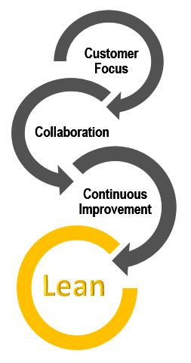
Organizational Skills and Business Processes in the Workplace
2/17/22
Ruth Archer, PhD
Director of Continuous Improvement
Michigan Technological University

Slide 2
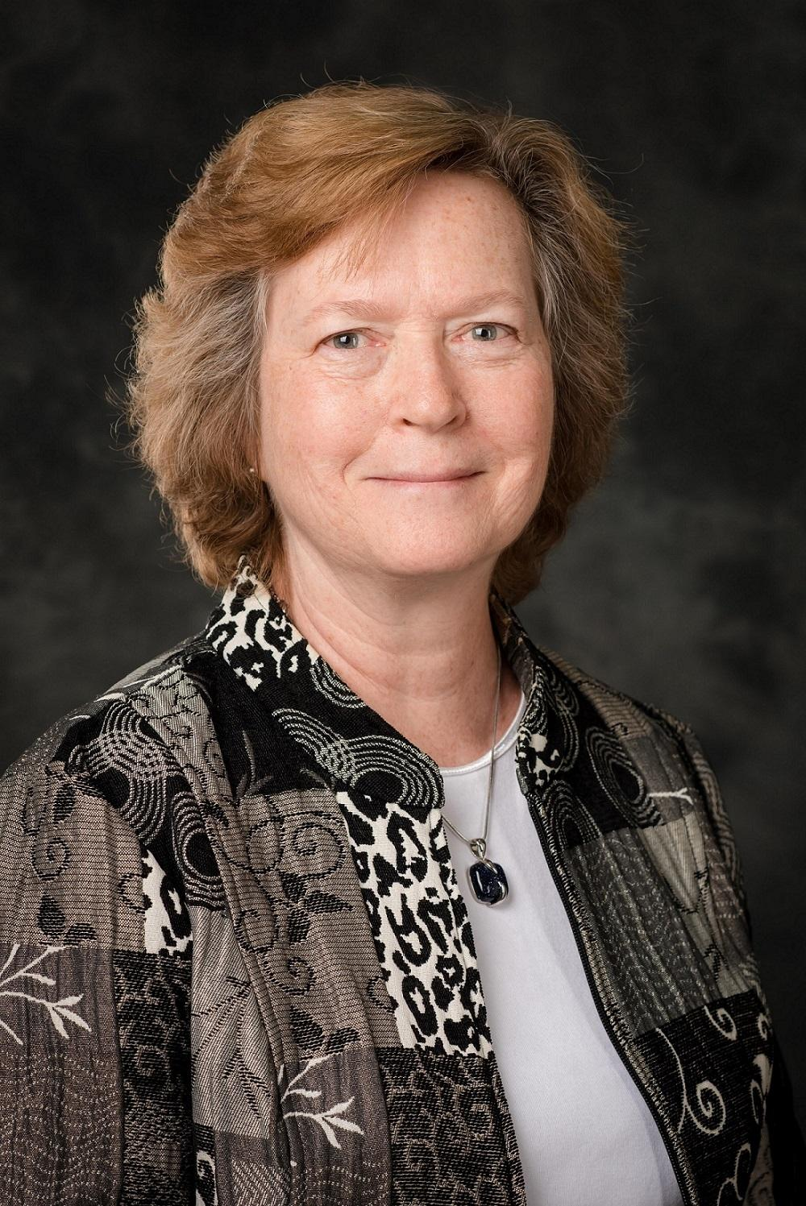
Presenters
Ruth Archer
Director of Continuous Improvement
Matt Bryan
IT Help Desk Manager
Brian Hutzler
IT Assistant Project Manager

Slide 3
Today’s Agenda
Effective Time Management
Prioritizing Work with Personal Kanbans
Improving Processes – Flow and Waste

Slide 4
Effective Time Management

Slide 5
Managing Time
Start by understanding what’s important
Be effective, then be efficient
Use the time management matrix
Learn to say no
Create a bias for action

Slide 6
Time Management Matrix
 | Urgent – Demands Immediate Attention | Not Urgent
Important – Produces the Desired Result | 1. Necessity – Reduce Crises Emergencies Customer Complaints Pressing Problems Deadline-Driven Projects Last Minute Preparations Do Now | 2. Quality – Increase Preparation, Planning, Prevention Values Clarification Capability Improvement Relationship Building Build Resiliency Schedule on Calendar
Not Important | 3. Deception – Manage Things that appear to be worth doing Interruptions Some Callers, Some Email Some Meetings Meeting Other People’s Priorities Delegate, Automate, or Decline | 4. Waste – Avoid Busy Work that Doesn’t Add Value Arguing Some Calls, Emails Escape Activities Time Wasters Trying to Make Everyone Happy Delegate, Automate, or Decline
Try to spend your time in Quadrants 1 and 2.

Slide 7
Share thoughts on your Time Management Matrix activity

Slide 8
Reflection and Report Out
In small groups, discuss:
What you think/how you feel about time management
Key learning points for you
What you’ll do differently based on what you’ve learned today
How you might create your own growth in these skills

Slide 9
Today’s Agenda
Effective Time Management
Prioritizing Work with Personal Kanbans
Improving Processes – Flow and Waste

Slide 10
Prioritizing Work

Slide 11
Kanban Defined
Literally translated to “signboard,” is a method used to signal for replenishment
Signals how much and what needs to be delivered to what location
Uses the philosophy of “take one, make one” as inventory is consumed…the kanban (signal) is sent upstream to call for replenishment
Could be paper or electronic cards, or the presence or absence of an item

Slide 12
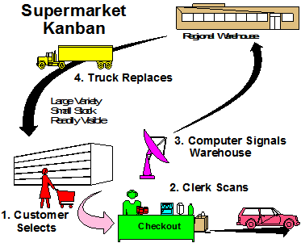
Kanban Example (Electronic)

Slide 13
Why is it called “personal” kanban?
Used to manage the tasks people do at work instead of things
Can be used for your individual responsibilities or for your team

Slide 14
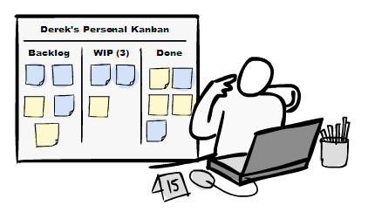
Personal Kanban
Two Simple Rules:
Visualize your work
Limit your work in progress
Benefits
Aids in task prioritization
Prioritizes your time
Increases likelihood of task completion
Foundation for improvement efforts in your work flow
Supports communication and coordination with your supervisor

Slide 15
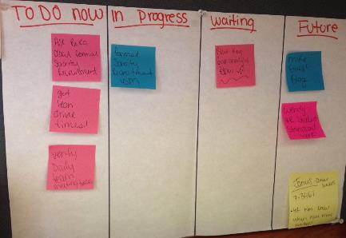
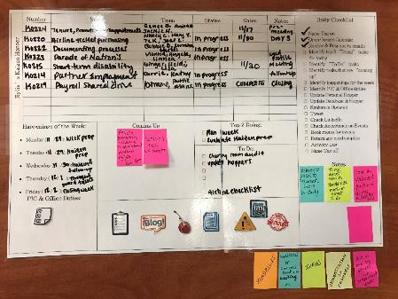
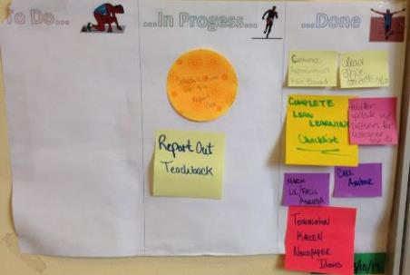
Student PIC Personal Kanban

Slide 16
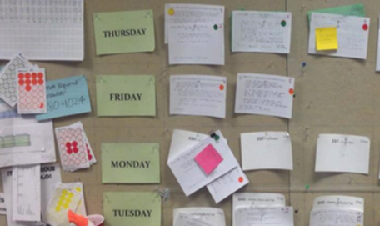
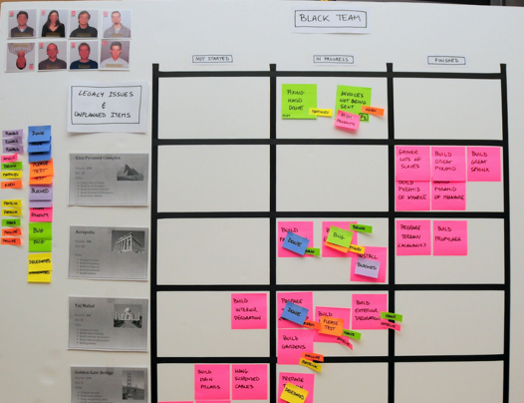
Flags, Tags, & Dots

Slide 17
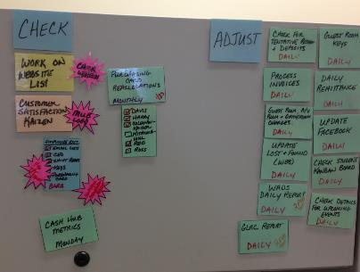
LH Personal Kanban
Laminated cards and dry erase markers allow for re-use
Kanban flow follows the PDCA cycle
Pink burst used to denote hot topics/actions

Slide 18
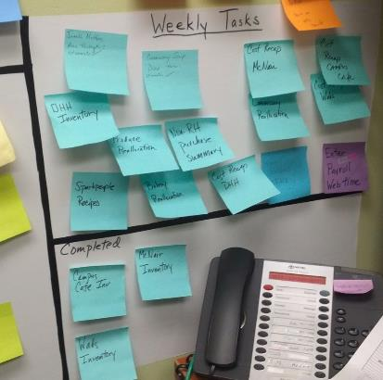
KW Personal Kanban
Color coded by month
Weekly repeated tasks separated

Slide 19
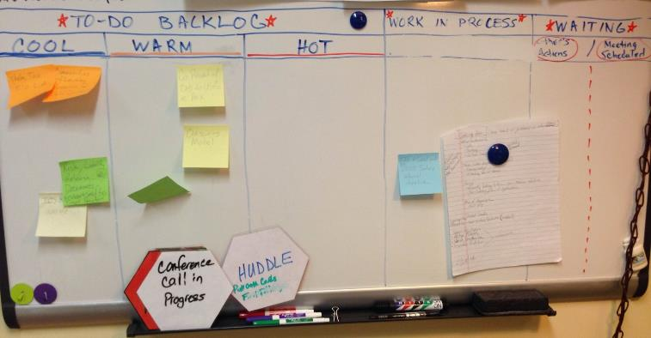
TCK Personal Kanban

Slide 20
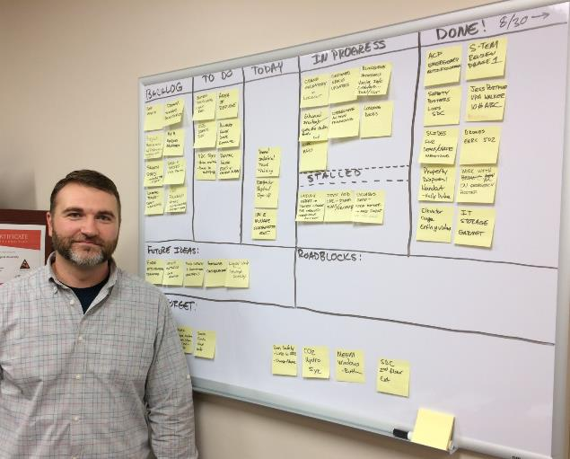
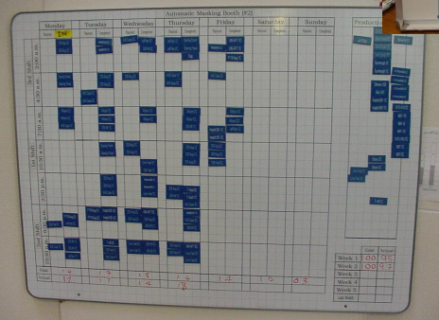
Use white boards or magnetic boards.

Slide 21
Team Kanban

Slide 22
Team Kanban

Slide 23
Electronic Kanban Example
Trello.com

Slide 24
Electronic Kanban Example
leankit.com

Slide 25
Tips for Success…
Make it a habit!
If what you’re doing isn’t working… try something different!

Slide 26
Make Your Own Personal Kanban Possible Categories
Opportunities / Future Options
Hopper / To Do
In Progress / Doing
Waiting
Done / Completed Since Last Meeting
I Felt Awesome / I Felt Okay / I Felt Awful
Planned/Unplanned
Today / This Week
High Priority / Low Priority
Cool / Warm / Hot
Quick Tasks / Projects
Plan / Do / Check / Adjust
Repeat Daily / Weekly / Monthly

Slide 27
Share personal kanban ideas

Slide 28
Reflection and Report Out
In small groups, discuss:
WHAT is something you noticed, learned, or something that stood out?
SO WHAT makes this important? So what can you conclude or hypothesize?
NOW WHAT are you going to do with this?

Slide 29
Today’s Agenda
Effective Time Management
Prioritizing Work with Personal Kanbans
Improving Processes – Flow and Waste

Slide 30
Improving Processes Flow and Waste

Slide 31
Value-Added =
Important to the customer (i.e. willing to pay for it)
Transformation of material or information
Done right the first time
Flow = The service or product moves from one Value-Added step to the next without stopping; there are no wasteful activities during or between process steps

Slide 32
Framework for Identifying Waste
Value Added typically around 5-15%
Impeded Flow
Unevenness
Motion
Overburden
Waiting
Untapped Knowledge
Movement
Inventory
Correction
Over- production
Over-
processing

Slide 33
General Steps When Improving a Process
Define the value of the process from the perspective of the beneficiaries of the process
Identify the flow of the process, from both the beneficiary and provider perspectives, to determine which steps and activities add value
Look for steps that add no value to the process (waste) and investigate possible root causes to eliminate them
Make the process flow smoothly, with activities or services “pulled” as needed by the beneficiary rather than “pushed” by the provider
Pursue perfection through a combination of continuous improvement and radical transformation of the process

Slide 34
A Typical Process
PROCESS
Value Added Activity
Typically 80-95% of
a process is
Non-Value Added!
Waste

Slide 35
A Typical Process
NON VALUE ADDED
VALUE ADDED
Often, we mistakenly focus improvement efforts here.
We get a lot more improvement for the same effort by working on this part!

Slide 36
Summarize Case Study
What is the value of the process from the perspective of a donor?
What is currently happening?
What should be happening?

Slide 37
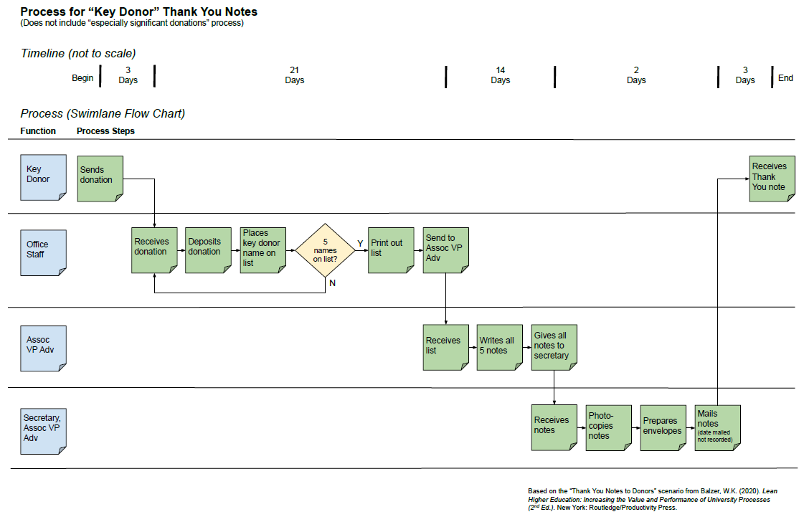
Current Conditions Process Map Handout

Slide 38
Reflection and Report Out
In small groups, discuss:
How would the VPUA know that this process was broken?
What data might you use to understand and evaluate the performance of the “Thank You Note to Donors” process?
Identify and discuss examples of waste in the Advancement Case Study. Use the Learning to See--Identifying Waste handout as a guide
What might be the root causes?
What changes would you make to the process to improve flow?
Describe what you might do to sustain the improvements over time to keep the changes from backsliding to how they used to be

Slide 39
Reflection and Report Out
In small groups, discuss:
WHAT is something you noticed, learned, or something that stood out?
SO WHAT makes this important? So what can you conclude or hypothesize?
NOW WHAT are you going to do with this?

Slide 40
Today’s Agenda
Effective Time Management
Prioritizing Work with Personal Kanbans
Improving Processes – Flow and Waste

Slide 41
What happens next?
Look for the wastes in your work
No blame! It’s the process, not the person
Ask yourself what the root cause of the waste might be
Work with your coworkers to see together. Experiment to see if you can reduce or get rid of the waste and improve the process. Ask for a consultation from the Office of Continuous Improvement

Slide 42
Post-Work Project
Create a flow chart for a process in your workplace
Identify some wastes in the process and describe what you think the root causes might be
Submit to Canvas
Contact the Office of Continuous Improvement for consultation or assistance with the project; email improvement@mtu.edu

Slide 43
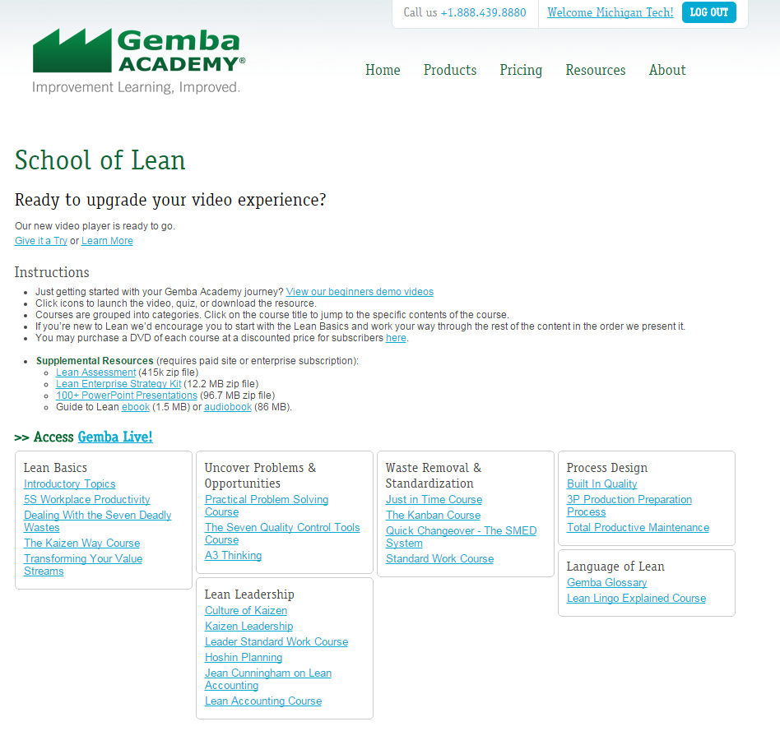
Gemba Academy! www.gembaacademy.com
Username: MichiganTech
Password: Lean

Slide 44
What questions do you have?

