Slide 1
Supervisor Success Series
Michigan Tech
February 16, 2022
Julie Seppala
Nicholas Stevens
Notes:
Nick & Julie

Slide 2
Budget & Planning Office
Overview of Key Functions & Responsibilities
Notes:
Nick

Slide 3
Budget & Planning Office Staff
Nick Stevens - Director of Budget and Financial Planning
Jen Laitala - Manager of Budget and Planning - Athletics (.5 FTE)
Tim Scullion – Sr. Manager of Budget and Planning – IT (.6 FTE)

Slide 4
Budget & Planning Office Key Functions & Responsibilities
Annual Budget Development/Load
Quarterly Financial Projections
Tuition/Enrollment Modeling
Financial Aid Projections
Ad Hoc Modeling and Planning
Budget Transfers (750-1000)
Committee Assignments
Biweekly S&W Projections
Assist Depts with Year End Finances
Perception Shift
Move towards a model of partnering with departments to help assist with finance-based solutions to solve short and long-term goals. Continue to develop financial tools to assist financial managers on campus.

Slide 5
Financial Services & Operations
Overview of Key Functions & Responsibilities
Notes:
Julie

Slide 6
Financial Services & Operations Office Units
Assoc VP for Finance & Controller’s Office 7-2642
Accounts Payable 7-2371
Accounts Receivable 7-2243
Financial Information Systems 7-2699
General/Auxiliary Accounting 7-2242
MTF Accounting 7-2310
Property, Plant Fund, & Tax Accounting 7-2449
Purchasing/Insurance 7-2510
Student Billing/Cashiers 7-2622
Notes:
Please do not hesitate to reach out via email or at the phone numbers listed on this slide if you have questions regarding any of the policies and procedures. We are happy to assist in any manner that we can.

Slide 7
Key FSO Functions & Responsibilities (https://www.mtu.edu/fso/)
External and internal financial accounting and reporting
Student billing and loan management
Procurement and P-card administration
Accounts Payable
Travel reimbursement
Property accounting and management
Tax compliance and reporting
Support users of the multiple Finance Systems
Create the financial reports & provide report support
Insurance and support of risk management functions
Gift processing and biographical updates
Provide customer service advice
Fringe & F&A rate proposal development
Coordinate external audits
Investment and treasury management
Bond issuance and compliance
Notes:
As you can see FSO by the list, there are varying responsibilities of the FSO Team. Ranging from accounting functions, such as AP and AR, property management & tax compliance. The weblink to the main FSO web page is a great resource to provide contact information, policies & procedures and an overview of the key functions. Some of you may already know the team and are familiar with the processes and some may not. The team strives to provide excellent customer service, while complying with the various internal and external policies and guidelines, by safeguarding the University’s as well as the Michigan Tech Fund assets.
Our units provide transaction processing support to the entire campus community including students, faculty and staff, by annually processing over 100,000 financial transactions.
Why is compliance so important? It can affect our ability to issue a bond, which is similar to loan, and received good interest rates, it could impact the University Wide Accreditation process which is a requirement if a University receives federal financial aid funding.

Slide 8
Finance & Budgeting Overview
Board Audit and Finance Committee
Financial Structure and Performance
Purchasing/Accounts Payable
Budget Management
Financial Reports & Systems
Enrollment Projections
Notes:
Julie

Slide 9
CFO/SVPA Strategic Visioning Areas
Enhance Financial Performance and Growth
We must ensure a sustainable trajectory for our business model.
Be a Best Place to Work
Attract and retain great faculty and staff to support our vision. Sustain healthy, inclusive and engaging work environment.
Improve Campus Life
Engage with campus partners to provide an environment where students, faculty and staff can obtain their full potential living, working, and learning.
Develop and Invest in Infrastructure
Our campus success depends on strong and dynamic facilities, infrastructure, and technology. Optimize our investments to strengthen our research and educational mission through thoughtful campus master planning, ongoing systems for space utilization and proactive maintenance planning.
Ensure Service Excellence and Forward Institutional Positioning
Provide highly effective services while minimizing impact on resources. Partner across campus to remove barriers and identify efficiencies.
Optimize Technology for the Future
Remaking Higher Education by harnessing technological capabilities and opportunities.

Slide 10
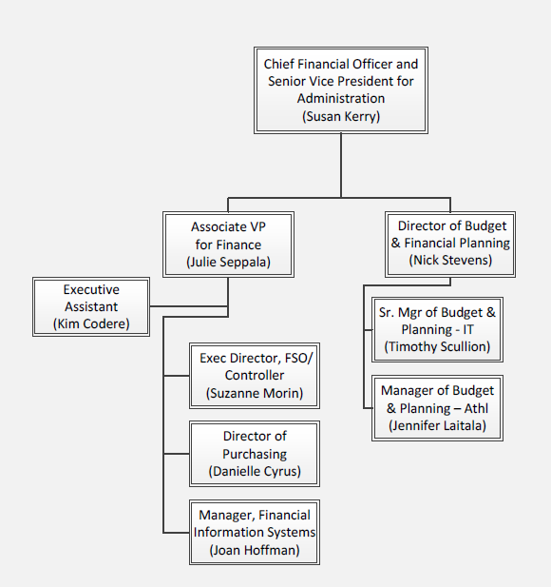
CFO- Budget & Planning Office & Financial
Services & Operations Organizational Chart
Notes:
Julie

Slide 11
Board Audit & Finance Committee
Board of Trustees Subcommittee Structure
Audit & Finance Committee Charter
Notes:
Julie

Slide 12
Board of Trustees Subcommittee Structure
Board of Trustees
Leadership Committee
Audit & Finance Committee
Academic Affairs Committee
Notes:
Julie

Slide 13
Board of Trustees Audit & Finance Committee Charter
Purpose:
The Audit and Finance Committee is appointed by the Board of Trustees to assist the Board in fulfilling its oversight responsibilities with respect to finances, facilities and internal controls.
Authority/Roles and Responsibilities:
Annual Budget
Tuition and fees
Interim financial reporting
Long-term financial picture
Legal matters
Financial statement and disclosure matters
Oversight of the University’s relationship to independent auditors
Membership:
Chair of the Board of Trustees
President of the University
Chief Financial Officer and Senior Vice President for Administration (Board of Trustees Treasurer)
Two members selected annually by the Chair of the Board
Notes:
Julie
The Board of Trustees meets 5 times a year to review the items listed on this slide. A good portion of Budget Office & AVPF/Controller’s office are to stay in compliance with the Audit & Finance Charter by developing various budget and financial reports to meet the needs of the Board. The AVPF/Controller’s office also manage the MTF Finance & Audit & Investments committees.

Slide 14
Financial Performance and Reporting Structure
Reporting Structure
Fund Accounting
FY21 Financial Performance
Revenue/Expense Breakdown
Financial Health
Composite Financial Index
Debt Ratio

Slide 15
Financial Reporting Structure
Reporting Entity
Michigan Technological University (“University”) is an institution of higher education and is considered to
be a component unit of the State of Michigan because its Board of Trustees is appointed by the Governor
of the State of Michigan.
The University has two component units which are described below.
The Michigan Tech Fund (“Fund”) is a legally separate tax-exempt component unit of the University. The
primary purpose of the Fund is to receive, invest, and disburse gifts received on behalf of the University.
The Michigan Tech Entrepreneurial Support Corporation (MTESC) is a legally separate tax-exempt
component unit of the University. The primary purpose of the MTESC is to support the entrepreneurial and
commercial development efforts of the University.
Source: MTU Financial Services Office, FY2020 Audited Financial Statements
Notes:
Julie

Slide 16
Michigan Tech Fund Board of Directors Subcommittee Structure
Board of Directors
Finance & Audit Committee
Investment Committee
Notes:
Julie
The board of directors meet 4 times a year along with the investment committee. The Finance & Audit committee meets 3 times a year.

Slide 17
Committees of the Board of Directors
The committees of the Board of Directors are to assist the Board in fulfilling its oversight responsibilities with respect to finances, investments and internal controls.
Finance & Audit:
Expenditure & financial controls
Financial statement and disclosure matters
Oversight of the University’s relationship to independent auditors
Internal controls & risk management
Investment:
Investment management
Asset allocation
Endowment management
Real estate gift acceptance
Oversight of the Fund’s relationship to professional investment firm
Notes:
The Board of Trustees meets 5 times a year to review the items listed on this slide. A good portion of Budget Office & AVPF/Controller’s office are to stay in compliance with the Audit & Finance Charter by developing various budget and financial reports to meet the needs of the Board. The AVPF/Controller’s office also manage the MTF Finance & Audit & Investments committees.

Slide 18
Higher Education Fund Accounting
Current Funds
Non-Current Funds
General Fund
Designated Fund
Expendable Restricted Fund
Auxiliary Activities Fund
Retirement & Insurance Fund
Loan Fund
Plant Fund
Agency Fund
Notes:
Nick
A method of segregating resources into categories, (known as funds) to identify both the source of funds and the use of funds. Nonprofit organizations and government agencies have traditionally used fund accounting to show, in financial statements and reports, how money is spent, rather than how much profit was earned. Unlike profit oriented businesses, which use a single set of self-balancing accounts (or categories), nonprofits can have more than one category (or fund), depending on their financial reporting requirements.

Slide 19
General Fund
Tuition and Fees
State Appropriation
Indirect Cost Recoveries
Administrative and Academic Departments
Lab indexes – student course fee revenue
Non-lab indexes – annual budgets
Notes:
Nick
This fund group accounts for activities related to academic and instructional programs and their administration. Student tuition and fee revenue, appropriations from the State of Michigan, and the recovery of indirect costs of sponsored programs (Facilities and Administrative Rate) are the primary sources of revenues in this fund group.

Slide 20
General Fund
General operations, administration labs – A11xxx & A12xxx
Research activity – A13xxx
Grad support clearing – A14xxx
GTA allocations – A140xx
Academic support – A16xxx
Notes:
Nick

Slide 21
Designated Fund
Unrestricted gifts – D9xxxx
Conferences & workshops – D93xxx
Summer Youth Programs & Summer Sports Camps – D92xxx
Start up – D97xxx
IRAD – E35xxx
MTF gifts – transfer $$ to university index to be spent according to the donor’s intent.
Notes:
Nick
This fund group accounts for activities designated for specific purposes by the University, such as faculty startup and Institutional Research and Development (IRAD). Gifts flowing through the Michigan Tech Fund and conference fees are examples of revenue sources.

Slide 22
Auxiliary Activities
Housing – residence halls and apartments
Retail operations – Campus Store, University Images, golf course, ski hill, dining
Others:
Athletics, Ford Center, Transportation, Husky Motors, Print Shop
F5xxxx and H4xxxx indexes
Notes:
This fund group accounts for revenue-producing, self-supporting activities that perform a service primarily for students, but are not themselves educational and general activities. Examples of such activities are student housing and residential dining, retail operations, Mont Ripley Ski Hill, Portage Lake Golf Course, etc.

Slide 23
Retirement & Insurance
Fringe benefit credits
Fringe benefit expenses
Insurance expenses
Investments
Notes:
Nick
This fund group is used to account for fringe benefits and insurance transactions. Fringe benefits are funded through interdepartmental charges based on approved fringe benefit rates. A portion of the University's operating investments are also accounted for in this fund group.

Slide 24
Expendable Restricted
Restricted gifts – E01xxx and E31xxx
Fellowships – E32xxx and E33xxx
Superior Ideas – E03xxx
Enterprise - E04xxx
Senior design – E06xxx
Sponsored projects – E2xxxx, E34xxx, E4xxxx, E5xxxx
Notes:
Julie
This fund group accounts for revenues restricted for specific purposes by supporting agencies, such as governmental and non-governmental grants and contracts, and by donors for sponsored scholarships.

Slide 25
Non-Current Funds
Agency – funds held by the university on behalf of other persons/organizations
Loan – student loans
Plant – construction, renovations, debt service
Notes:
Julie
This fund group is used to account for University and federal sponsored student loans (Perkins Loans) to students of the University.
This fund group is used to account for acquisition, construction and maintenance of the University's physical plant. Deprecation expense also runs through the Plant Fund.

Slide 26
FY2021 Current Fund Revenues
Notes:
Nick

Slide 27
FY2021 Current Fund Expenditures & Transfers
Notes:
Nick

Slide 28
Composite Financial Index (CFI)
The Higher Learning Commission considers amounts greater than or equal to 1.1 as
"Above the Zone" which means no further action is required. Amounts less than 1.1 but
greater than 0 are considered "In the Zone" and further review is required.
Notes:
Julie
You may have or will hear the CFO, Finance & Budget offices talk about the Composite Financial Index or CFI as a measure of financial health for Michigan Tech.

Slide 29
Enrollment Projections
Historic Undergraduate Student Enrollment/Projections
Cohort Projections
Historic Graduate Student Enrollment/Projections

Slide 30
MTU Undergraduate Student Enrollment
¹⁴²
¹²⁹
¹⁶

Slide 31
Cohort Undergraduate Enrollment Projections

Slide 32
MTU Graduate Student Enrollment
75
71
4

Slide 33
Purchasing/Travel/ Business Meals
Fiscal Responsibilities
Purchasing Methods
University Purchasing Card
Card Holder Responsibilities
Supervisor Card Holder Responsibilities
Concur Travel & Business Meals

Slide 34
Fiscal Responsibility
Ensure that university funds are used to advance the mission of the university and the academic needs of the students.
Ensure that all authorizations or expenditures comply with university expenditure policies as well as with any sponsoring agency or donor restrictions and applicable policies.
Consider the appropriateness of the expenditure. Should the expense be paid from public funds?
Fiscal controls must include a system of supervisor checks and balances at all levels of the organization for all expenditures.

Slide 35
Purchasing
Prior to Spending…
Is the expense within the start and end dates of the FY or Project?
Are there enough funds available?
Is the expense allowable?
Methods to Purchase:
University P-card
convenient for low cost supplies of $4,999 or less and travel expenses
Purchase order
Goods and/or services, capital equipment, any time you have an agreement or contract. Submit a Requisition to Purchasing.
Check Request
When a vendor won’t take a credit card, checks can be issued to pay for some items.
Blanket order
Repetitive small purchases or services an/or consumable supplies from a single vendor when multiple indexes and/or account codes are used

Slide 36
University Purchasing Card (P-card)
Used for Supplies and Travel (airfare, car rental, lodging, conference fees, etc.)
Monthly Credit Limit $5,000
Single Purchase Limit $4,999 (includes shipping)
No food, meals, entertainment
No personal items
No payments to Individuals (use Independent Contractor Procedure)
No prohibited items

Slide 37
Card Holder Responsibilities
The University Purchasing Card is used for appropriate university business purchases as per procedures.
Detailed receipts are required. Record retention requires all receipts kept for 3 years (or 3yr + 3mos from end of a sponsored project).
Reallocate charges to the appropriate index and account code, provide business purpose, and attach a detailed receipt.
P-card transactions must be allocated and submitted in Concur.
Notes:
Non-travel expenses must be submitted on a Purchasing Card Expense Report once every month.
Travel expenses must be submitted on a Travel &/or Business Meal Expense Report within 2 weeks of the end date.

Slide 38
Supervisor P-card Responsibilities
Supervisors will approve cardholders P-card reports in Concur
Review report for appropriate university purchases
Detailed receipts must be attached to correct expense
MI Sales tax is not allowable. Ensure cardholder has received or requested credit
Review Account Codes and Indexes
P-card transactions must be reported monthly
Notes:
30-day reminder: to Cardholder
45-day reminder: to Cardholder and Director
60-day reminder: to Cardholder, Director, and P-card Administrator
If cardholder is receiving 60-day reminders, consider terminating their card

Slide 39
Travel Expense Report
Complete a Concur Travel Expense Report within 2 weeks of return
Include all out-of-pocket expenses and p-card expenses associated with the travel
Approved by Financial Manager, Sponsored Programs Accounting and Dean/Chair/Director
International Travel
All University faculty/staff must submit a Concur Travel Request, and receive approval, at least 2 weeks prior to departure.
Approved by department chair/director, VP if using a General Fund, Sponsored Programs Accounting and Risk Management.
Notes:
Out of pocket i.e. such as meal per diem, lodging, airfare or car rental, parking fees, etc.

Slide 40
Business Meals
Complete a Concur Business Meal Expense Report within 2 weeks of the event to reimburse an employee.
Payment to vendor is completed on the Business Meal Report
Include a valid business purpose and attendees and affiliations
No alcohol
Unallowable functions/events
Holiday functions
Admin/Prof and Bosses Day
Service Recognition Events
Appreciation dinners/luncheons
Farewell parties
Off campus retirement parties
Notes:
Normally Intl Travel not allowable on Gen Funds
If using General Funds – require VP approval

Slide 41
Financial Reports & Systems
General Information
Where to find reports
Budget to Actual
Transaction Detail
How to run reports

Slide 42
Financial Reports
Where to find them – banweb.mtu.edu
Notes:
This slide and the next 3 slides will provide a broad overview of where to locate financial reports and how to run financial reports.
As you can see financial reports are available via banweb. You login into banweb and choose the Finance Box at the top of the menu & choose finance reports. Which will bring you to a screen you will see on the next slide.

Slide 43
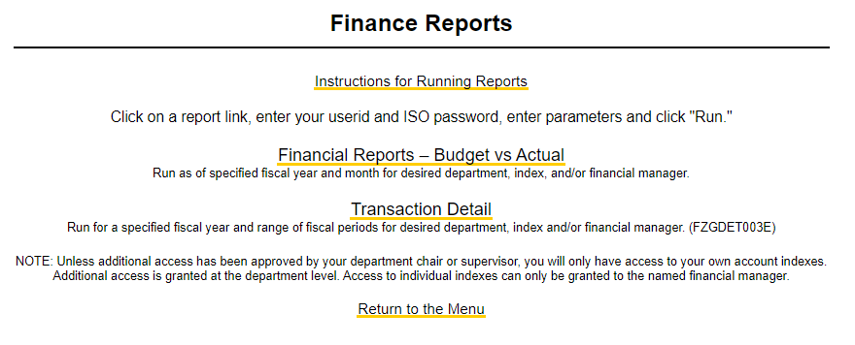
Financial Reports
Reports available in banweb.mtu.edu
Budget vs Actual
Summary information by account code
Includes balance information
Transaction Detail
Transactions by account code and document number
Notes:
Which includes instructions on how to run reports, and a link to run a Budget vs Actual report and/or the transaction detail report. Both reports provide relevant information for a financial manager or departmental budget coordinator to be fiscally responsible with student paid tuition dollars and taxpayers dollars, along with external terms and conditions that are associated with Grants, Contracts and gifts.
Each month is closed two business days following the end of the month and normally on the third business day of the month all financial managers and department budget managers and/or coordinators are emailed their respective financial reports.

Slide 44
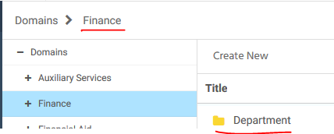
Financial Reports
Additional Reports (WebFOCUS)
https://www.banweb.mtu.edu/ibi_apps/
Choose Finance -> Department
Notes:
WebFOCUS is another report tool that is available to end users for not only financial information but other University data.

Slide 45
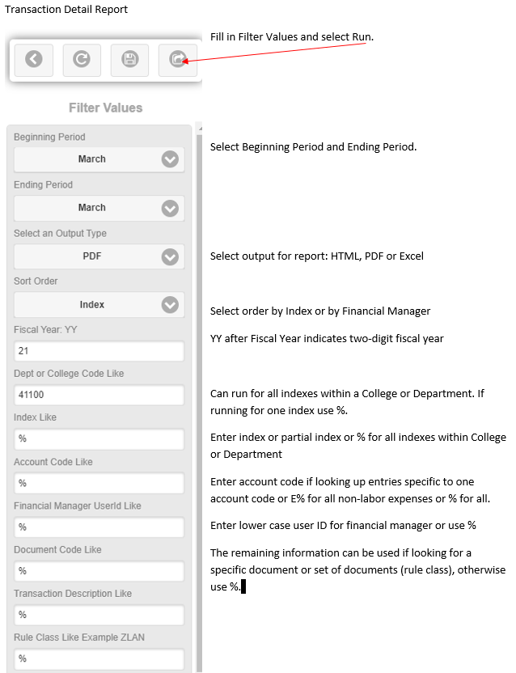
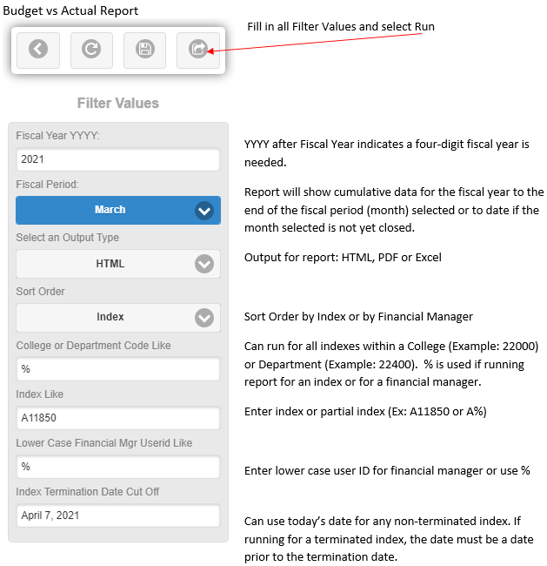
Financial Reports
How to run in WebFOCUS
Notes:
Fiscal Year – July 1st to June 30th -Ex: July 1, 2020 to June 30, 2021 is fiscal year 21 or 2021
Fiscal Year – July 1st to June 30th
YY- Two digit fiscal year
YYYY – Four digit fiscal year
Fiscal Period (Month) end – a month is closed two business days following the end of the month.
Department is the department code unless Department Name is stated
If Filter Values description uses “like” can use % as a wild card
Termination Date – use today’s date

Slide 46
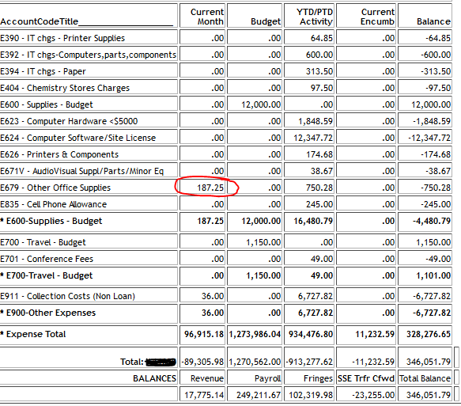
Financial Reports
Sample Data

Slide 47
Account Codes (Expense Categories)
E0xx- Equipment
E2xx- Services
E6xx – Supplies
E7xx- Travel & business meals
Notes:
E042 Computer equipment & E052 Technical/scientific equipment
E205 Miscellaneous services & E253 Printing costs
E671 Scientific supplies & E679 Office supplies
E701 Conference fees & E706 Business meal expenses

Slide 48
Budget Management
Budget Distribution – Control Total
Position Management Report
Budget Transfer Form

Slide 49
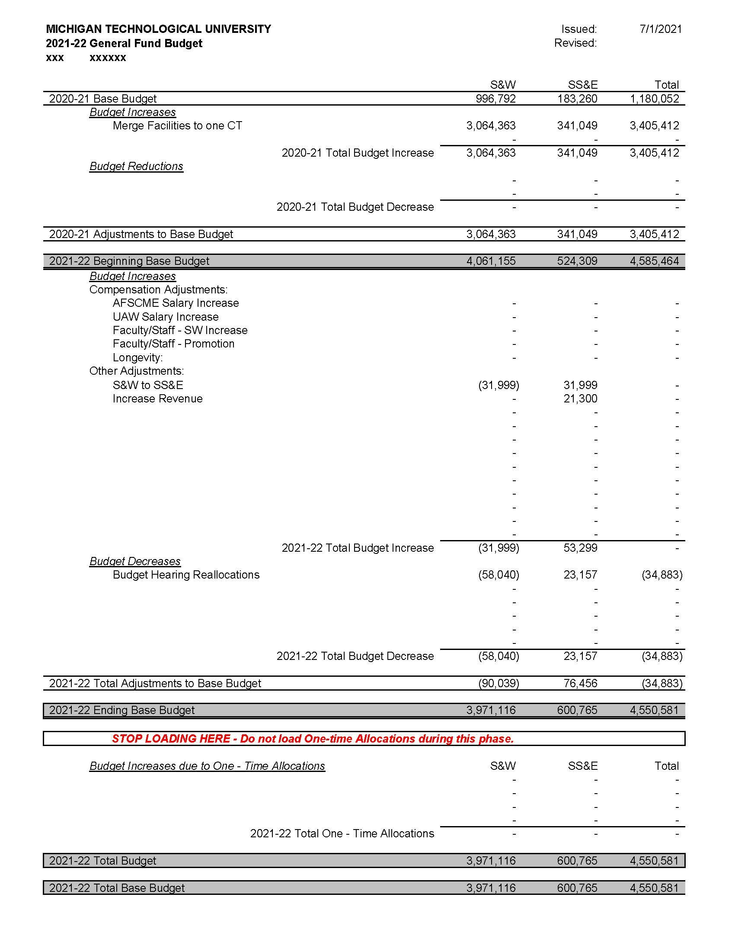
Budget Distribution - Control Total

Slide 50
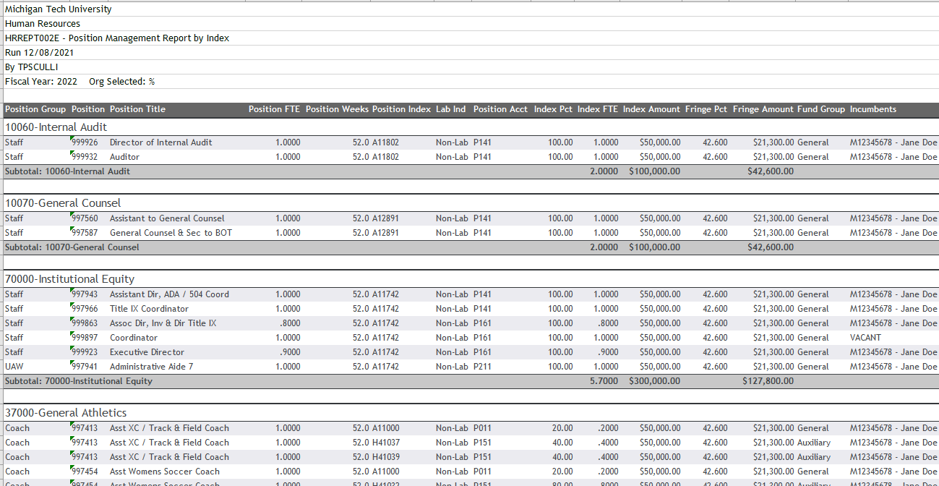
Position Management Report

Slide 51
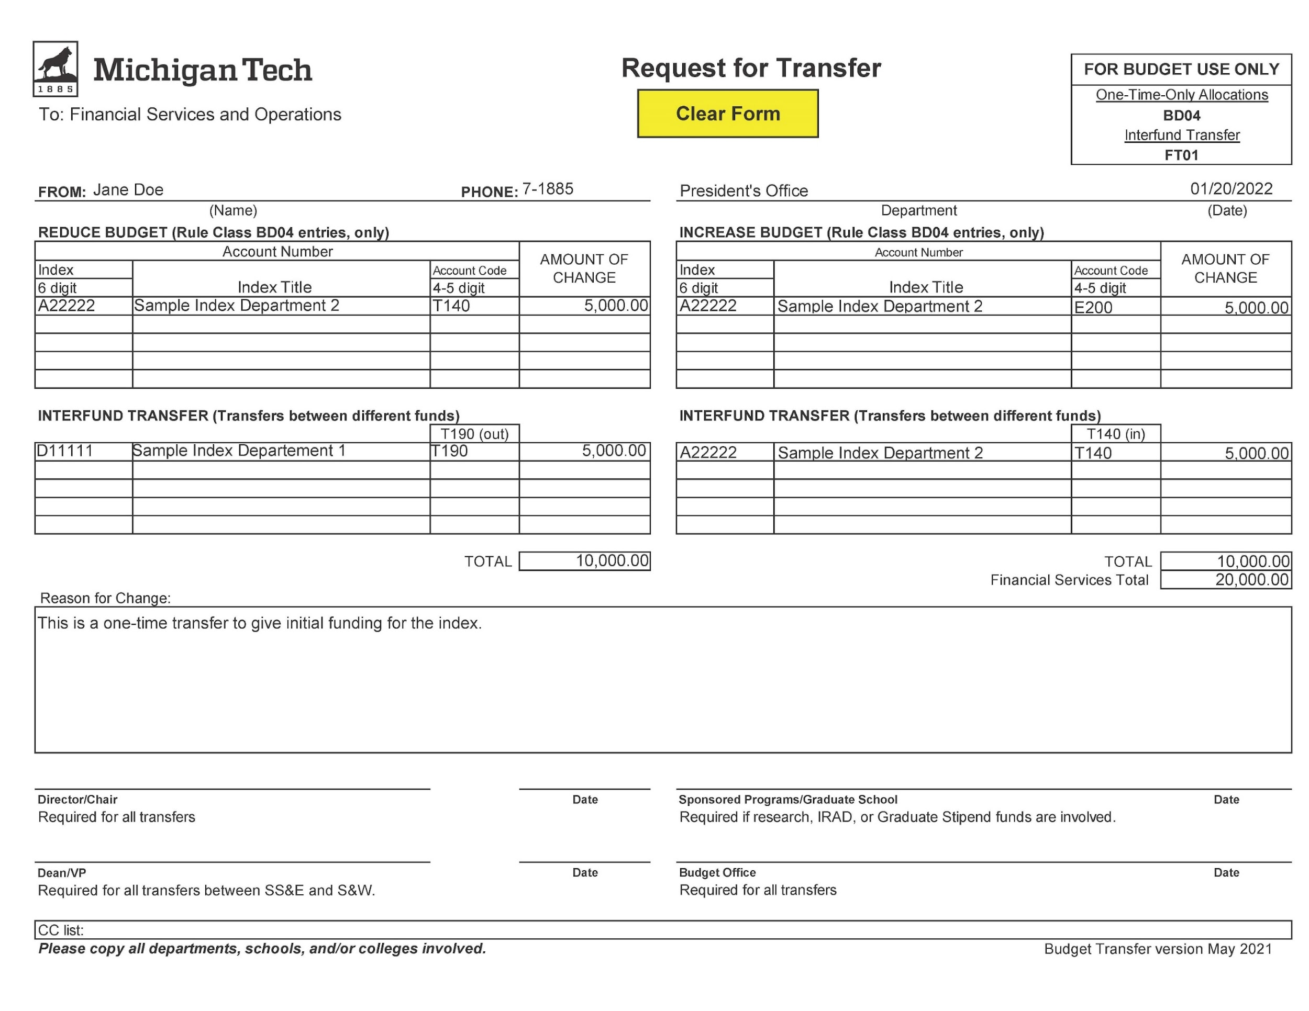
Budget Transfers

Slide 52
Questions

