Slide 1

Universum Student survey 2012
University Report • US Undergraduate Edition
Michigan Technological University
Business
WWW.UNIVERSUMGLOBAL.COM

Slide 2
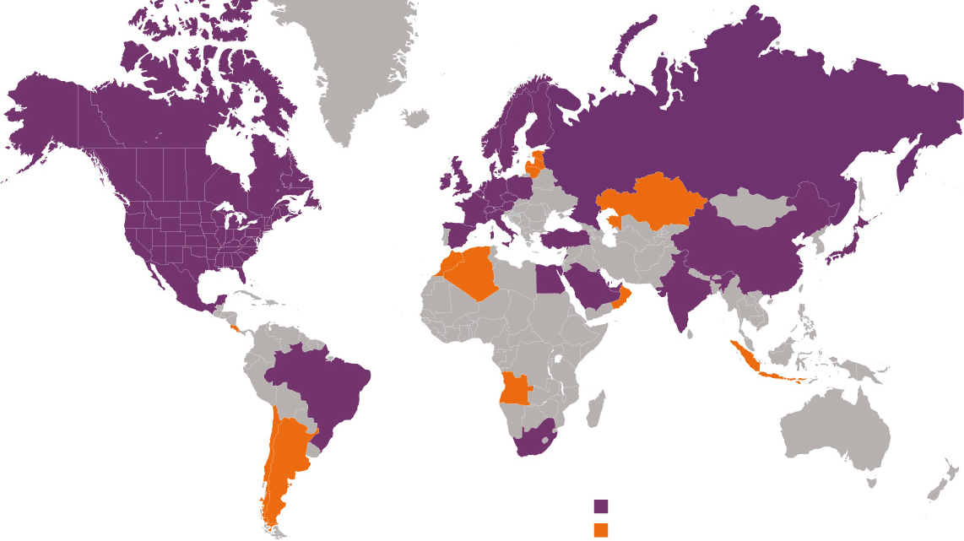
ANNUAL RESEARCH
CONSULTING PROJECTS
Universum in the world

Slide 3
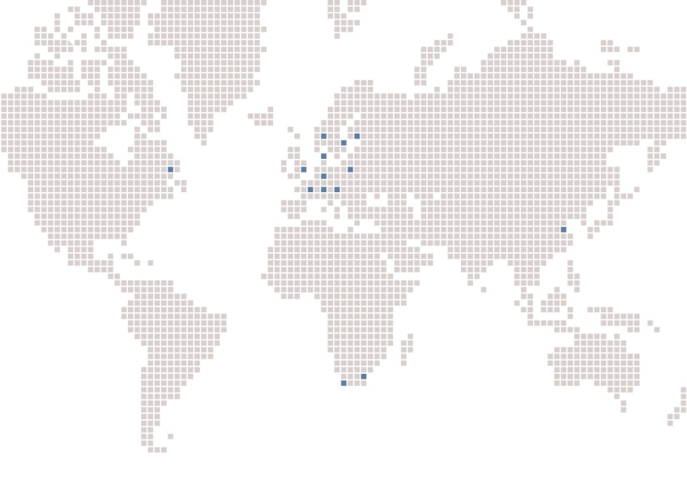
ABOUT US
Universum is an international organisation, with its headquarters in Stockholm, Sweden and operates in the field
of employer branding and talent research. Our purpose is
to improve the communications between students, career services and employers.
We believe that career choice is one of the most important decisions in a student’s life. We therefore want to provide students with information and support career services in
their role. We also believe that companies need to under-
stand student expectations, to adjust their offering and
working environment to attract potential candidates and
meet their resourcing needs.
Our role is threefold: 1) we provide students with information on companies, 2) support career services in their role and 3) help companies to develop their employer value.

Slide 4
1.
Methodology & KEY FINDINGS
2. UNIVERSITY EXPERIENCE
3. students’ career & communication preferences
4. Employer rankings
5. students’ employer preferences
6. appendix

Slide 5
Methodology & KEY FINDINGS
Universum Student Survey 2012
University Report
US Undergraduate Edition
Business
Michigan Technological University
Methodology & target groups
FIELD PERIOD: November 2011 to March 2012
NO. OF EDUCATIONAL INSTITUTIONS INCLUDED: 320
Base of the group
Number of respondents
The Questionnaire
Created with 24 years of experience, extensive research within HR, focus groups and communication with both our clients and students.
Global perspective - local insight.
Comprised of closed-ended questions with an extensive list of alternatives and an ‘Other’ option.
Data collection
Conducted via an on-line survey. The online link was distributed primarily via university contacts (career centers and the educational institutions).
Weighting:
In our data collection we set targets by main field of study and educational institution. In order to provide our clients with reliable data in each market and to get the questions distributions as close as possible to the actual population distribution, we use weighting based on population frequencies of the target groups.
Group 1
Michigan Technological University
34
Group 2
20,269
Total

Slide 6

Methodology & KEY FINDINGS
Universum Student Survey 2012
University Report
US Undergraduate Edition
Business
Michigan Technological University
Key findings • Michigan Technological University
56% women and 44% men
Average age:
21.4 years
Average perceived GPA:
3.2
Average expected annual salary:
41,902 USD
Top actual communication channels:
Social networks/communities
Employer websites
TV advertisements
Top career goals:
To be secure or stable in my job
To have work/life balance
To be a leader or manager of people
Most preferred industries:
Financial Services
Auditing and Accounting
Management consulting

Slide 7
Methodology & KEY FINDINGS
Universum Student Survey 2012
University Report
US Undergraduate Edition
Business
Michigan Technological University
Key findings • Total
64% women and 36% men
Average age:
21.6 years
Average perceived GPA:
3.5
Average expected annual salary:
51,052 USD
Top actual communication channels:
Employer websites
Social networks/communities
TV advertisements
Top career goals:
To have work/life balance
To be secure or stable in my job
To be a leader or manager of people
Most preferred industries:
Auditing and Accounting
Financial Services
Business services and operational consulting

Slide 8
Methodology & KEY FINDINGS
Universum Student Survey 2012
University Report
US Undergraduate Edition
Business
Michigan Technological University
Age & gender
Average Age
gender
Michigan Technological University
21.4 years
Total
21.6 years
What is your year of birth?
What is your gender

Slide 9
Methodology & KEY FINDINGS
Universum Student Survey 2012
University Report
US Undergraduate Edition
Business
Michigan Technological University
ethnicity
How would you classify your ethnic background?

Slide 10
Methodology & KEY FINDINGS
Universum Student Survey 2012
University Report
US Undergraduate Edition
Business
Michigan Technological University
Area of study
Business (1/3)
What is your major(s)/main area(s) of study?

Slide 11
Methodology & KEY FINDINGS
Universum Student Survey 2012
University Report
US Undergraduate Edition
Business
Michigan Technological University
Area of study
Business (2/3)
What is your major(s)/main area(s) of study?

Slide 12
Methodology & KEY FINDINGS
Universum Student Survey 2012
University Report
US Undergraduate Edition
Business
Michigan Technological University
Area of study
Business (3/3)
What is your major(s)/main area(s) of study?

Slide 13
Methodology & KEY FINDINGS
Universum Student Survey 2012
University Report
US Undergraduate Edition
Business
Michigan Technological University
Top educational institutions
Total
Which educational institution do you attend?
!
PLEASE NOTE: This is the distribution after the results have been weighted, reflecting the true population at these educational institutions

Slide 14
1. Methodology & KEY FINDINGS
2.
UNIVERSITY EXPERIENCE
3. students’ career & communication preferences
4. Employer rankings
5. students’ employer preferences
6. appendix

Slide 15
University experience
Universum Student Survey 2012
University Report
US Undergraduate Edition
Business
Michigan Technological University
Career services visits - Michigan Technological University
How often have you used your campus career services or attended event/work-shops hosed by them this year?

Slide 16
University experience
Universum Student Survey 2012
University Report
US Undergraduate Edition
Business
Michigan Technological University
Career services satisfaction by type of service
Career advising
Employment advisning
Please rate how satisfied you are with the following career services at your college. 1 = Not at all satisfied, 5 = Very satisfied

Slide 17
University experience
Universum Student Survey 2012
University Report
US Undergraduate Edition
Business
Michigan Technological University
Career services satisfaction by type of service
Internship postings
Career/Job fairs
Please rate how satisfied you are with the following career services at your college. 1 = Not at all satisfied, 5 = Very satisfied

Slide 18
University experience
Universum Student Survey 2012
University Report
US Undergraduate Edition
Business
Michigan Technological University
Career services satisfaction by type of service
Job postings
Resource materials (print, video, or online)
Please rate how satisfied you are with the following career services at your college. 1 = Not at all satisfied, 5 = Very satisfied

Slide 19
University experience
Universum Student Survey 2012
University Report
US Undergraduate Edition
Business
Michigan Technological University
Career services satisfaction by type of service
Career services website
Workshops (resume writing, interviewing, etc.)
Please rate how satisfied you are with the following career services at your college. 1 = Not at all satisfied, 5 = Very satisfied

Slide 20
University experience
Universum Student Survey 2012
University Report
US Undergraduate Edition
Business
Michigan Technological University
Career services satisfaction by type of service
Employer information sessions
Please rate how satisfied you are with the following career services at your college. 1 = Not at all satisfied, 5 = Very satisfied

Slide 21
University experience
Universum Student Survey 2012
University Report
US Undergraduate Edition
Business
Michigan Technological University
Overall satisfaction
How would you rate the career services offered at your school?

Slide 22
1. Methodology & KEY FINDINGS
2. University experience
3.
students’ career & communication preferences
4. Employer rankings
5. students’ employer preferences
6. appendix

Slide 23
students’ career & communication preferences
Universum Student Survey 2012
University Report
US Undergraduate Edition
Business
Michigan Technological University
Most Preferred industries
In which industry would you ideally want to work when choosing your first employment after graduation? Please select a maximum of three alternatives

Slide 24
students’ career & communication preferences
Universum Student Survey 2012
University Report
US Undergraduate Edition
Business
Michigan Technological University
Preferred size of employer
What size of employer would you prefer working for when choosing your first employment? Please select only one alternative

Slide 25
students’ career & communication preferences
Universum Student Survey 2012
University Report
US Undergraduate Edition
Business
Michigan Technological University
Career goals
Michigan Technological University vs. Total
Below is a list of nine possible career goals. Which are most important to you? Please select a maximum of three alternatives

Slide 26
students’ career & communication preferences
Universum Student Survey 2012
University Report
US Undergraduate Edition
Business
Michigan Technological University
Career goals • 2012 vs. 2011
Total
Below is a list of nine possible career goals. Which are most important to you? Please select a maximum of three alternatives

Slide 27
students’ career & communication preferences
Universum Student Survey 2012
University Report
US Undergraduate Edition
Business
Michigan Technological University
Expected annual salary
Michigan Technological University
41,902
USD
Total
51,052
USD
What is your expected salary before taxes (excluding commission and bonus) at your first employment after graduation?

Slide 28
students’ career & communication preferences
Universum Student Survey 2012
University Report
US Undergraduate Edition
Business
Michigan Technological University
Actual communication channels • top 10
Through which channels have you learnt about these employers?
Please select as many alternatives as applicable

Slide 29
1. Methodology & KEY FINDINGS
2. UNIVERSITY EXPERIENCE
3. students’ career & communication preferences
4.
Employer rankings
5. students’ employer preferences
6. appendix

Slide 30
Employer rankings
Universum Student Survey 2012
University Report
US Undergraduate Edition
Business
Michigan Technological University
Considered employer ranking
Michigan Technological University • top 30
Below is a list of employers. Which of these employers would you consider working for?

Slide 31
Employer rankings
Universum Student Survey 2012
University Report
US Undergraduate Edition
Business
Michigan Technological University
ideal employer ranking
Michigan Technological University • top 20
Please select five employers from the list below for which you would most like to work - your five Ideal Employers

Slide 32
Employer rankings
Universum Student Survey 2012
University Report
US Undergraduate Edition
Business
Michigan Technological University
Potential applicants’ ranking
Michigan Technological University • top 10
Please select five employers from the list below for which you would most like to work - your five Ideal Employers.
Have you or will you apply to these employers?

Slide 33
Employer rankings
Universum Student Survey 2012
University Report
US Undergraduate Edition
Business
Michigan Technological University
ideal employer ranking
Total • top 20
Please select five employers from the list below for which you would most like to work - your five Ideal Employers

Slide 34
Employer rankings
Universum Student Survey 2012
University Report
US Undergraduate Edition
Business
Michigan Technological University
Top findings • employer rankings
Total
Ideal Employer ranking
1. Google
2. Apple
3. Walt Disney Company
4. Ernst & Young
5. Deloitte
High achievers’ ranking
1. Google
2. Apple
3. Ernst & Young
4. Deloitte
5. Walt Disney Company
1
1
2
2
3
3
4
4
5
5
Considered
Employer ranking
1. Google
2. Apple
3. Walt Disney Company
4. Nike
5. The Coca-Cola Co.
Potential
applicants’ ranking
1. Ernst & Young
2. Deloitte
3. PwC
4. KPMG LLP
5. Walt Disney Company
1
1
2
2
3
3
4
4
5
5

Slide 35
1. Methodology & KEY FINDINGS
2. UNIVERSITY EXPERIENCE
3. students’ career & communication preferences
4. Employer rankings
5.
students’ employer preferences
6. appendix

Slide 36
students’ employer preferences
The Drivers of Employer Attractiveness
Employer Reputation & Image
The attributes of the employer as an organization
Attractive/exciting products and services
Corporate Social Responsibility
Environmental sustainability
Ethical standards
Fast-growing/entrepreneurial
Financial strength
Innovation
Inspiring management
Market success
Prestige
Job Characteristics
The contents and demands of the job, including the learning opportunities provided by the job
Challenging work
Client interaction
Control over my number of working hours
Flexible working conditions
High level of responsibility
Opportunities for international travel/relocation
Professional training and development
Secure employment
Team oriented work
Variety of assignments
People & Culture
The social environment and attributes of the work place
A creative and dynamic work environment
A friendly work environment
Acceptance towards minorities
Enabling me to integrate personal interests in my schedule
Interaction with international clients and colleagues
Leaders who will support my development
Recognizing performance (meritocracy)
Recruiting only the best talent
Respect for its people
Support for gender equality
Remuneration & Advancement Opportunities
The monetary compensation and other benefits, now and in the future
Clear path for advancement
Competitive base salary
Competitive benefits
Good reference for future career
High future earnings
Leadership opportunities
Overtime pay/compensation
Performance-related bonus
Rapid promotion
Sponsorship of future education
!
The framework is developed together with professor Paula Caligiuri, Director of the Center for HR Strategy at Rutgers University. Based on specific research within HR, as well as focus groups and general communication with both our clients and students.

Slide 37
students’ employer preferences
5
The Drivers of Employer Attractiveness
Employer Reputation
& Image
Job
Characteristics
People
& Culture
Remuneration & Advancement Opportunities

Slide 38
students’ employer preferences
5
Universum Student Survey 2012
University Report
US Undergraduate Edition
Business
Michigan Technological University
RELATIVE Importance of each driver
Michigan Technological University
Total
Employer Reputation & Image
People & Culture
Job Characteristics
Remuneration & Advancement Opportunities
How would you rate the relative importance of these aspects when choosing your Ideal Employer?
Please divide 100 points between the alternatives in accordance with importance

Slide 39
students’ employer preferences
5
Universum Student Survey 2012
University Report
US Undergraduate Edition
Business
Michigan Technological University
Employer Reputation & Image
Employer
Reputation
& Image
Which attributes do you perceive as the most attractive?
Please select a maximum of three alternatives

Slide 40
students’ employer preferences
Universum Student Survey 2012
University Report
US Undergraduate Edition
Business
Michigan Technological University
Job Characteristics
Job
Characteristics
Which attributes do you perceive as the most attractive?
Please select a maximum of three alternatives

Slide 41
students’ employer preferences
5
Universum Student Survey 2012
University Report
US Undergraduate Edition
Business
Michigan Technological University
People & Culture
People
& Culture
Which attributes do you perceive as the most attractive?
Please select a maximum of three alternatives

Slide 42
students’ employer preferences
Universum Student Survey 2012
University Report
US Undergraduate Edition
Business
Michigan Technological University
Remuneration & Advancement Opportunities
Remuneration & Advancement Opportunities
Which attributes do you perceive as the most attractive?
Please select a maximum of three alternatives

Slide 43
students’ employer preferences
Universum Student Survey 2012
University Report
US Undergraduate Edition
Business
Michigan Technological University
Top findings
Overall most attractive attributes • Top 5
Michigan Technological University
Total
A friendly work environment (People & Culture)
Competitive base salary (Remuneration & Advancement Opportunities)
Leaders who will support my development (People & Culture)
Respect for its people (People & Culture)
High future earnings (Remuneration & Advancement Opportunities)
Respect for its people (People & Culture)
Secure employment (Job Characteristics)
A friendly work environment (People & Culture)
A creative and dynamic work environment (People & Culture)
High future earnings (Remuneration & Advancement Opportunities)
!
Please Note: These tables show the attractiveness of each of the 40 attributes in relation to how important the students think its driver is. This analysis gives a summarized 360 degree view of what influences employer attractiveness.

Slide 44
1. Methodology & KEY FINDINGS
2. UNIVERSITY EXPERIENCE
3. students’ career & communication preferences
4. Employer rankings
5. students’ employer preferences
6.
appendix

Slide 45
appendix
Universum Student Survey 2012
University Report
US Undergraduate Edition
Business
Michigan Technological University
educational institutions
Total (1/9)
Which educational institution do you attend?
!
PLEASE NOTE: This is the distribution after the results have been weighted, reflecting the true population at these educational institutions

Slide 46
appendix
Universum Student Survey 2012
University Report
US Undergraduate Edition
Business
Michigan Technological University
educational institutions
Total (2/9)
Which educational institution do you attend?
!
PLEASE NOTE: This is the distribution after the results have been weighted, reflecting the true population at these educational institutions

Slide 47
appendix
Universum Student Survey 2012
University Report
US Undergraduate Edition
Business
Michigan Technological University
educational institutions
Total (3/9)
Which educational institution do you attend?
!
PLEASE NOTE: This is the distribution after the results have been weighted, reflecting the true population at these educational institutions

Slide 48
appendix
Universum Student Survey 2012
University Report
US Undergraduate Edition
Business
Michigan Technological University
educational institutions
Total (4/9)
Which educational institution do you attend?
!
PLEASE NOTE: This is the distribution after the results have been weighted, reflecting the true population at these educational institutions

Slide 49
appendix
Universum Student Survey 2012
University Report
US Undergraduate Edition
Business
Michigan Technological University
educational institutions
Total (5/9)
Which educational institution do you attend?
!
PLEASE NOTE: This is the distribution after the results have been weighted, reflecting the true population at these educational institutions

Slide 50
appendix
Universum Student Survey 2012
University Report
US Undergraduate Edition
Business
Michigan Technological University
educational institutions
Total (6/9)
Which educational institution do you attend?
!
PLEASE NOTE: This is the distribution after the results have been weighted, reflecting the true population at these educational institutions

Slide 51
appendix
Universum Student Survey 2012
University Report
US Undergraduate Edition
Business
Michigan Technological University
educational institutions
Total (7/9)
Which educational institution do you attend?
!
PLEASE NOTE: This is the distribution after the results have been weighted, reflecting the true population at these educational institutions

Slide 52
appendix
Universum Student Survey 2012
University Report
US Undergraduate Edition
Business
Michigan Technological University
educational institutions
Total (8/9)
Which educational institution do you attend?
!
PLEASE NOTE: This is the distribution after the results have been weighted, reflecting the true population at these educational institutions

Slide 53
appendix
Universum Student Survey 2012
University Report
US Undergraduate Edition
Business
Michigan Technological University
educational institutions
Total (9/9)
Which educational institution do you attend?
!
PLEASE NOTE: This is the distribution after the results have been weighted, reflecting the true population at these educational institutions

